Slide 1
Data wrangling and Feature Engineering
Lecture -9
Sumita Narang

Slide 2
Objectives
Data cleaning
Data Integration/ Aggregation
Data Sampling
Handling Numeric Data
Discretization, Binarization
Normalization
Data Smoothening
Dealing with textual Data
Managing Categorical Attributes
Transforming Categorical to Numerical Values
Encoding techniques
Feature Engineering
Feature Extraction (Dimensionality Reduction)
Feature Construction
Feature Subset selection
Filter methods
Wrapper methods
Embedded methods
Feature Learning
Case Study involving FE tasks

Slide 3
Data Cleaning, Data Integration
Source Courtesy: Some of the contents of this PPT are sourced from materials provided by publishers of prescribed books

Slide 4
Data Cleaning
Data in the Real World Is Dirty: Lots of potentially incorrect data, e.g., instrument faulty, human or computer error, transmission error
incomplete: lacking attribute values, lacking certain attributes of interest, or containing only aggregate data
e.g., Occupation = “ ” (missing data)
noisy: containing noise, errors, or outliers
e.g., Salary = “−10” (an error)
inconsistent: containing discrepancies in codes or names, e.g.,
Age = “42”, Birthday = “03/07/2010”
Was rating “1, 2, 3”, now rating “A, B, C”
discrepancy between duplicate records
Intentional (e.g., disguised missing data)
Jan. 1 as everyone’s birthday?

Slide 5
Incomplete (Missing) Data
Data is not always available
E.g., many tuples have no recorded value for several attributes, such as customer income in sales data
Missing data may be due to
equipment malfunction
inconsistent with other recorded data and thus deleted
data not entered due to misunderstanding
certain data may not be considered important at the time of entry
not register history or changes of the data
Missing data may need to be inferred

Slide 6
How to Handle Missing Data?
Ignore the tuple: usually done when class label is missing (when doing classification)—not effective when the % of missing values per attribute varies considerably
Fill in the missing value manually: tedious + infeasible?
Fill in it automatically with
a global constant : e.g., “unknown”, a new class?!
the attribute mean
the attribute mean for all samples belonging to the same class: smarter
the most probable value: inference-based such as Bayesian formula or decision tree

Slide 7
Noisy Data
Noise: random error or variance in a measured variable
Incorrect attribute values may be due to
faulty data collection instruments
data entry problems
data transmission problems
technology limitation
inconsistency in naming convention
7
Notes:
7

Slide 8
How to Handle Noisy Data?
Binning (also used for discretization)
first sort data and partition into (equal-frequency) bins
then one can smooth by bin means, smooth by bin median, smooth by bin boundaries, etc.
Binning methods smooth a sorted data value by consulting its "neighborhood," that is, the values around it, i.e. they perform local smoothing.
Regression
smooth by fitting the data into regression functions
Clustering
detect and remove outliers
Combined computer and human inspection
detect suspicious values and check by human (e.g., deal with possible outliers)
Notes:
Enrich using data integration research!!

Slide 9
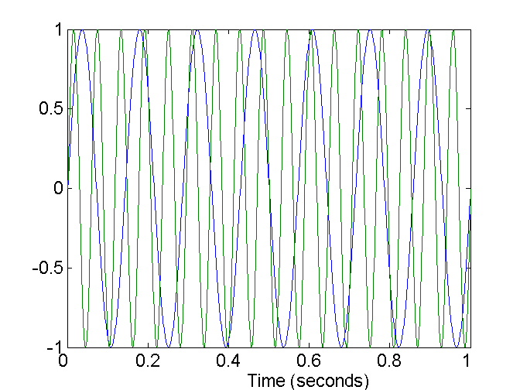
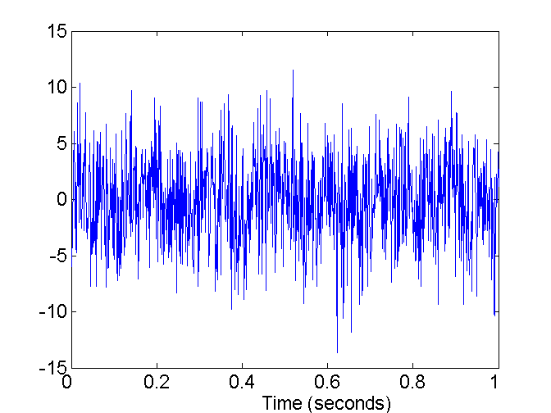
Noise
Noise refers to modification of original values
Examples: distortion of a person’s voice when talking on a poor phone and “snow” on television screen
Two Sine Waves
Two Sine Waves + Noise

Slide 10
Duplicate Data
Data set may include data objects that are duplicates, or almost duplicates of one another
Major issue when merging data from heterogonous sources
Examples:
Same person with multiple email addresses
Data cleaning
Process of dealing with duplicate data issues

Slide 11

Outliers
Outliers are data objects with characteristics that are considerably different than most of the other data objects in the data set

Slide 12
Data Cleaning as a Process
Data discrepancy detection
Use metadata (e.g., domain, range, dependency, distribution)
Check field overloading
Check uniqueness rule, consecutive rule and null rule
Use commercial tools
Data scrubbing: use simple domain knowledge (e.g., postal code, spell-check) to detect errors and make corrections
Data auditing: by analyzing data to discover rules and relationship to detect violators (e.g., correlation and clustering to find outliers)
Data migration and integration
Data migration tools: allow transformations to be specified
ETL (Extraction/Transformation/Loading) tools: allow users to specify transformations through a graphical user interface
Integration of the two processes
Iterative and interactive (e.g., Potter’s Wheels)

Slide 13
Data Integration/ Data Aggregation
Data integration:
Combines data from multiple sources into a coherent store
Schema integration: e.g., A.cust-id ≡ B.cust-#
Integrate metadata from different sources
Entity identification problem:
Identify real world entities from multiple data sources, e.g., Bill Clinton = William Clinton
Detecting and resolving data value conflicts
For the same real world entity, attribute values from different sources are different
Possible reasons: different representations, different scales, e.g., metric vs. British units
13
Notes:
Should ask students to do some survey on data integration. -JH

Slide 14
Handling Redundancy in Data Integration
Redundant data occur often when integration of multiple databases
Object identification: The same attribute or object may have different names in different databases
Derivable data: One attribute may be a “derived” attribute in another table, e.g., annual revenue
Redundant attributes may be able to be detected by correlation analysis and covariance analysis
Careful integration of the data from multiple sources may help reduce/avoid redundancies and inconsistencies and improve mining speed and quality
14

Slide 15
Data Sampling
Source Courtesy: Some of the contents of this PPT are sourced from materials provided by publishers of prescribed books

Slide 16
Central Limit Theorem
The Central Limit Theorem (CLT) is a statistical theory states that given a sufficiently large sample size from a population with a finite level of variance, the mean of all samples from the same population will be approximately equal to the mean of the population.
Larger the sample size, the more would be the normal distribution of means of samples

Slide 17
Important statistical terms
Population:
a set which includes all
measurements of interest
to the researcher
(The collection of all responses, measurements, or counts that
are of interest)
Sample:
A subset of the population

Slide 18
Why sampling?
Get information about large populations
Less costs
Less field time
More accuracy i.e. Can Do A Better Job of Data Collection
When it’s impossible to study the whole population

Slide 19
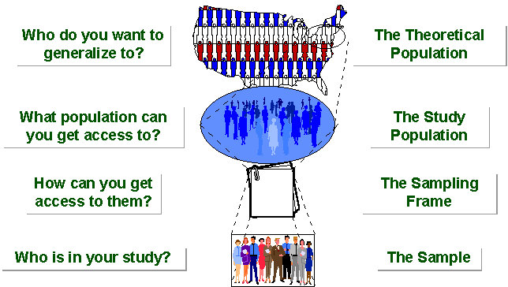
SAMPLING BREAKDOWN
Notes:
Picture of sampling breakdown

Slide 20
Definitions
Target Population:
The population to be studied/ to which the investigator wants to generalize his results
Sampling Unit:
smallest unit from which sample can be selected
Sampling frame
List of all the sampling units from which sample is drawn
Sampling scheme
Method of selecting sampling units from sampling frame

Slide 21
Types of Sampling

Slide 22
Non probability Sampling
Any sampling method where some elements of population have no chance of selection (these are sometimes referred to as 'out of coverage'/'undercovered'), or where the probability of selection can't be accurately determined. It involves the selection of elements based on assumptions regarding the population of interest, which forms the criteria for selection. Hence, because the selection of elements is nonrandom, nonprobability sampling not allows the estimation of sampling errors..
Example: We visit every household in a given street, and interview the first person to answer the door. In any household with more than one occupant, this is a nonprobability sample, because some people are more likely to answer the door (e.g. an unemployed person who spends most of their time at home is more likely to answer than an employed housemate who might be at work when the interviewer calls) and it's not practical to calculate these probabilities.

Slide 23
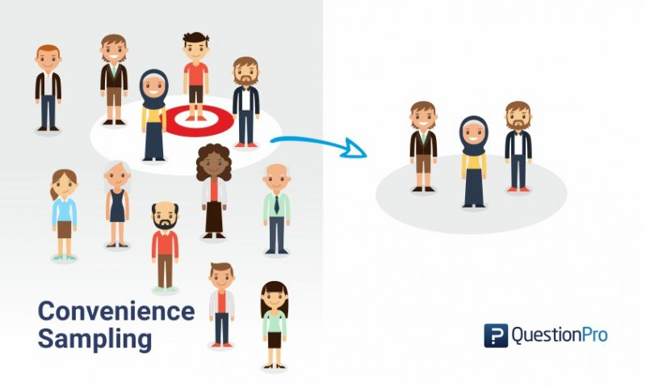
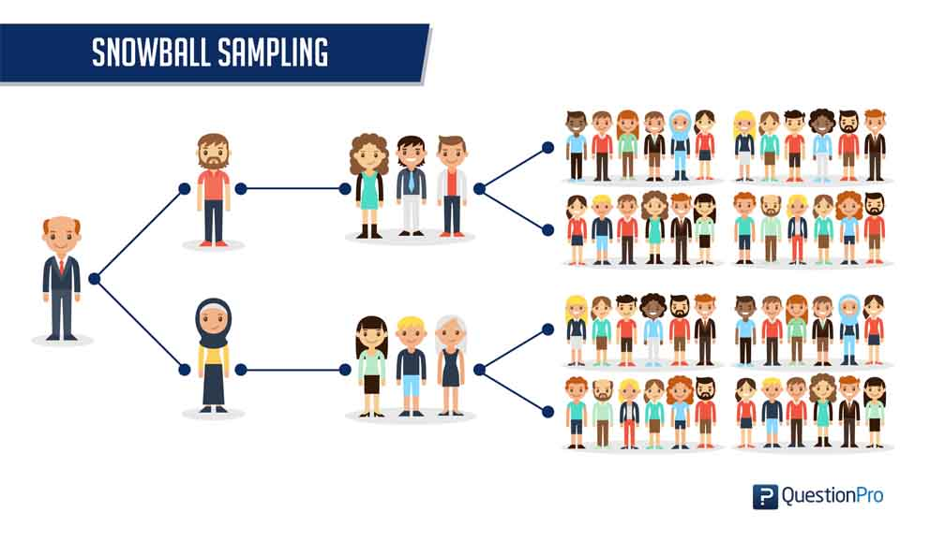
Non probability sampling 1/
Convenience samples (ease of access)
sample is selected from elements of a population that are easily accessible
https://www.questionpro.com/blog/convenience-sampling/
Snowball sampling (friend of friend….etc.)
Also referred as chain sampling, chain-referral sampling, referral samplinghttps://www.statisticshowto.datasciencecentral.com/snowball-sampling/

Slide 24
Non Probability Sampling 2/
Purposive /Judgemental Sampling
A purposive sample is a non-probability sample that is selected based on characteristics of a population and the objective of the study. Purposive sampling is also known as judgmental, selective, or subjective sampling.
The researcher chooses the sample based on who they think would be appropriate for the study. This is used primarily when there is a limited number of people that have expertise in the area being researched. https://www.thoughtco.com/purposive-sampling-3026727
Quota Sampling
The population is first segmented into mutually exclusive sub-groups, just as in stratified sampling.
Then judgment used to select subjects or units from each segment based on a specified proportion. For example, an interviewer may be told to sample 200 females and 300 males between the age of 45 and 60.
It is this second step which makes the technique one of non-probability sampling.
In quota sampling the selection of the sample is non-random. For example interviewers might be tempted to interview those who look most helpful. The problem is that these samples may be biased because not everyone gets a chance of selection. This random element is its greatest weakness and quota versus probability has been a matter of controversy for many years

Slide 25
Probability samples
Random sampling
Each subject has a known probability of being selected
Allows application of statistical sampling theory to results to:
Generalise
Test hypotheses
Ensure
Representativeness
Precision
Definition –
A probability sampling scheme is one in which every unit in the population has a chance (greater than zero) of being selected in the sample, and this probability can be accurately determined.
. When every element in the population does have the same probability of selection, this is known as an 'equal probability of selection' (EPS) design. Such designs are also referred to as 'self-weighting' because all sampled units are given the same weight.

Slide 26
Probability sampling…….
Probability sampling includes:
Simple Random Sampling,
Systematic Sampling,
Stratified Random Sampling,
Cluster Sampling
Multistage Sampling.
Multiphase sampling

Slide 27
Simple random sampling
Applicable when population is small, homogeneous & readily available
All subsets of the frame are given an equal probability. Each element of the frame thus has an equal probability of selection.
It provides for greatest number of possible samples. This is done by assigning a number to each unit in the sampling frame.
A table of random number or lottery system is used to determine which units are to be selected.
Pros –
Estimates are easy to calculate.
Simple random sampling is always an EPS design, but not all EPS designs are simple random sampling.
Cons -
If sampling frame large, this method impracticable.
Minority subgroups of interest in population may not be present in sample in sufficient numbers for study
When the population consists of different types of objects, with widely different numbers of objects, simple random sampling can fail to adequately represent those types of objects that are less frequent.

Slide 28
Variations of Simple Random Sampling
There are two variations on random sampling (and other sampling techniques as well):
(1) sampling without replacement-
as each item is selected, it is removed from the set of all objects that together constitute the population, and
(2) sampling with replacement-
objects are not removed from the population as they are selected for the sample
In sampling with replacement, the same object can be picked more than once.
Note- The samples produced by the two methods are not much different when samples are relatively small compared to the data set size, but sampling with replacement is simpler to analyze since the probability of selecting any object remains constant during the sampling process.

Slide 29
Weighted Random Sampling
https://utopia.duth.gr/~pefraimi/research/data/2007EncOfAlg.pdf
If all items have the same probability to be selected, the problem is known as uniform RS. Uniform random sampling in one pass.
In weighted random sampling (WRS) the items are weighted and the probability of each item to be selected is determined by its relative weight. WRS can be defined with the following algorithm D:

Slide 30
SYSTEMATIC SAMPLING
Systematic sampling relies on arranging the target population according to some ordering scheme and then selecting elements at regular intervals through that ordered list.
Systematic sampling involves a random start and then proceeds with the selection of every kth element from then onwards. In this case, k=(population size/sample size).
It is important that the starting point is not automatically the first in the list, but is instead randomly chosen from within the first to the kth element in the list.
A simple example would be to select every 10th name from the telephone directory (an 'every 10th' sample, also referred to as 'sampling with a skip of 10').

Slide 31
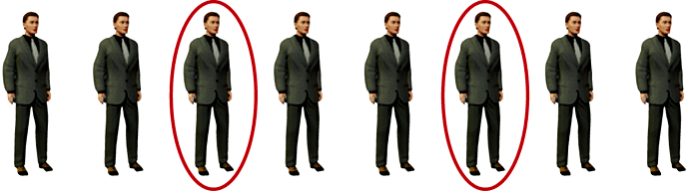
SYSTEMATIC SAMPLING……
As described above, systematic sampling is an EPS method, because all elements have the same probability of selection (in the example given, one in ten). It is not 'simple random sampling' because different subsets of the same size have different selection probabilities - e.g. the set {4,14,24,...,994} has a one-in-ten probability of selection, but the set {4,13,24,34,...} has zero probability of selection.

Slide 32
SYSTEMATIC SAMPLING……
ADVANTAGES:
Sample easy to select
Suitable sampling frame can be identified easily
Sample evenly spread over entire reference population
DISADVANTAGES:
Sample may be biased if hidden periodicity in population coincides with that of selection.
Difficult to assess precision of estimate from one survey.

Slide 33
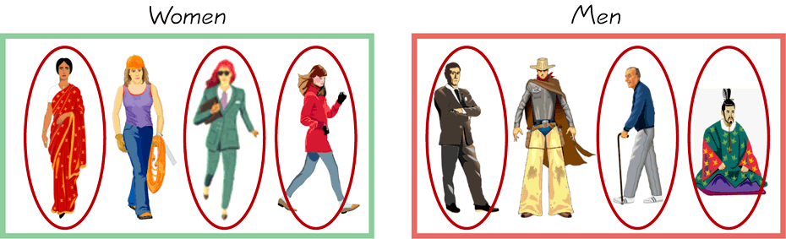
STRATIFIED SAMPLING
Draw a sample from each stratum

Slide 34
Stratified Sampling ….
When the population consists of different types of objects, with widely different numbers of objects, simple random sampling can fail to adequately represent those types of objects that are less frequent. This can cause problems when the analysis requires proper representation of all object types. For example, when building classification models for rare classes, it is critical that the rare classes be adequately represented in the sample. Hence, a sampling scheme that can accommodate differing frequencies for the items of interest is needed.
Stratified sampling, which starts with pre-specified groups of objects, is such an approach. In the simplest version, equal numbers of objects are drawn from each group even though the groups are of different sizes. In another variation, the number of objects drawn from each group is proportional to the size of that group.
Where population embraces a number of distinct categories, the frame can be organized into separate "strata." Each stratum is then sampled as an independent sub-population, out of which individual elements can be randomly selected.
Every unit in a stratum has same chance of being selected.
Using same sampling fraction for all strata ensures proportionate representation in the sample.
Adequate representation of minority subgroups of interest can be ensured by stratification & varying sampling fraction between strata as required.
Finally, since each stratum is treated as an independent population, different sampling approaches can be applied to different strata.

Slide 35
Stratified Sampling ….
Drawbacks to using stratified sampling.
First, sampling frame of entire population has to be prepared separately for each stratum
Second, when examining multiple criteria, stratifying variables may be related to some, but not to others, further complicating the design, and potentially reducing the utility of the strata.
Finally, in some cases (such as designs with a large number of strata, or those with a specified minimum sample size per group), stratified sampling can potentially require a larger sample than would other methods

Slide 36
CLUSTER SAMPLING
Cluster sampling is an example of 'two-stage sampling' .
First stage a sample of areas is chosen;
Second stage a sample of respondents within those areas is selected.
Population divided into clusters of homogeneous units, usually based on geographical contiguity.
Sampling units are groups rather than individuals.
A sample of such clusters is then selected.
All units from the selected clusters are studied.

Slide 37
CLUSTER SAMPLING ….
Advantages :
Cuts down on the cost of preparing a sampling frame.
This can reduce travel and other administrative costs.
Disadvantages:
sampling error is higher for a simple random sample of same size.
Often used to evaluate vaccination coverage in EPI
Identification of clusters
List all cities, towns, villages & wards of cities with their population falling in target area under study.
Calculate cumulative population & divide by 30, this gives sampling interval.
Select a random no. less than or equal to sampling interval having same no. of digits. This forms 1st cluster.
Random no.+ sampling interval = population of 2nd cluster.
Second cluster + sampling interval = 4th cluster.
Last or 30th cluster = 29th cluster + sampling interval

Slide 38
CLUSTER SAMPLING…….
Two types of cluster sampling methods.
One-stage sampling. All of the elements within selected clusters are included in the sample.
Two-stage sampling. A subset of elements within selected clusters are randomly selected for inclusion in the sample.

Slide 39
Cluster sampling
Section 1
Section 2
Section 3
Section 5
Section 4

Slide 40
CLUSTER SAMPLING…….
Freq c f cluster
I 2000 2000 1
II 3000 5000 2
III 1500 6500
IV 4000 10500 3
V 5000 15500 4, 5
VI 2500 18000 6
VII 2000 20000 7
VIII 3000 23000 8
IX 3500 26500 9
X 4500 31000 10
XI 4000 35000 11, 12
XII 4000 39000 13
XIII 3500 44000 14,15
XIV 2000 46000
XV 3000 49000 16
XVI 3500 52500 17
XVII 4000 56500 18,19
XVIII 4500 61000 20
XIX 4000 65000 21,22
XX 4000 69000 23
XXI 2000 71000 24
XXII 2000 73000
XXIII 3000 76000 25
XXIV 3000 79000 26
XXV 5000 84000 27,28
XXVI 2000 86000 29
XXVII 1000 87000
XXVIII 1000 88000
XXIX 1000 89000 30
XXX 1000 90000
90000/30 = 3000 sampling interval

Slide 41
Difference Between Strata and Clusters
Although strata and clusters are both non-overlapping subsets of the population, they differ in several ways.
All strata are represented in the sample; but only a subset of clusters are in the sample.
With stratified sampling, the best survey results occur when elements within strata are internally homogeneous. However, with cluster sampling, the best results occur when elements within clusters are internally heterogeneous

Slide 42
MULTISTAGE SAMPLING
Complex form of cluster sampling in which two or more levels of units are embedded one in the other.
First stage, random number of districts chosen in all states.
Followed by random number of talukas, villages.
Then third stage units will be houses.
All ultimate units (houses, for instance) selected at last step are surveyed.
This technique, is essentially the process of taking random samples of preceding random samples.
Not as effective as true random sampling, but probably solves more of the problems inherent to random sampling.
An effective strategy because it banks on multiple randomizations. As such, extremely useful.
Multistage sampling used frequently when a complete list of all members of the population not exists and is inappropriate.
Moreover, by avoiding the use of all sample units in all selected clusters, multistage sampling avoids the large, and perhaps unnecessary, costs associated with traditional cluster sampling.

Slide 43
MULTI PHASE SAMPLING
Part of the information collected from whole sample & part from subsample.
In Tb survey MT in all cases – Phase I
X –Ray chest in MT +ve cases – Phase II
Sputum examination in X – Ray +ve cases - Phase III
Survey by such procedure is less costly, less laborious & more purposeful

Slide 44
Errors in sample
Systematic error (or bias)
Inaccurate response (information bias)
Selection bias
Sampling error (random error)
Type of Errors
Type 1 Error
Type 2 Error
TYPE 1 Errors
The probability of finding a difference with our sample compared to population, and there really isn’t one….
Known as the α (or “type 1 error”)
Usually set at 5% (or 0.05)
TYPE 2 Errors
The probability of not finding a difference that actually exists between our sample compared to the population…
Known as the β (or “type 2 error”)
Power is (1- β) and is usually 80%

Slide 45
How to find Sample Size
https://www.statisticshowto.datasciencecentral.com/probability-and-statistics/find-sample-size/
https://www.statisticshowto.datasciencecentral.com/tables/z-table/

Slide 46
Sampling Techniques Comparison

Slide 47
Handling Numerical Data
Source Courtesy: Some of the contents of this PPT are sourced from materials provided by publishers of prescribed books

Slide 48
Learning Objectives
Articulate the need for feature scaling
List and define various data transformation methods
Make the calculations that are necessary to get meaningful transformations

Slide 49
Four Levels of data
Used for names or label a series of values.
Ex: Gender(dichotomous),Hair color, Country names
Ordinal values represent discrete and ordered units.
Ex: Shirt size, letter grades, food quality
Nominal
Categorical
(qualitative)
Ordinal
Data
Interval values represent ordered units that have the same difference.
Ex: temperature of a given place
Ratio values represent ordered units that have the same difference. There’s a value that means “nothing/none.”
Ex: Age, weight, test score
Interval
Numerical
(quantitative)
Ratio

Slide 50
Flavors for Quantitative Attributes
Quantitative Attributes
Discrete
Continuous
Has a finite or countably infinite set of values
Often integer values are used to denote the values
Ex: No of employees, set of words in a document collection
Has real numbers as attribute values
Often real numbers are used to denote the values
Ex: height, Weight, Blood sugar levels
Notes:
Discrete or whole numbers
Continuous or fractional numbers

Slide 51
Linear Models
Y = W₀+W₁ X
W indicates the change in Y per unit change of X
If X changes scale, W will change its value
Regression coefficients depend on the magnitude of the variable
Features with bigger magnitude dominate over the features with smaller magnitudes
Euclidian distances are sensitive to feature magnitude
Hence it is a good practice to have all variables within a similar scale.
Notes:
If X is a distance variable and in kilometers and we change it into miles
Gradient descent converges faster when all the variables are in the similar scale
Feature scaling helps decrease the time of finding support vectors
Euclidian distances are sensitive to feature magnitude
For distance-based methods, normalization helps prevent attributes with initially large ranges (e.g., income) from out-weighing attributes with initially smaller ranges (e.g., binary attributes).

Slide 52
Algorithms that are sensitive to feature magnitude
Linear and Logistic Regression
Neural Networks
Support Vector Machines
KNN
K-Means Clustering
Linear Discriminant Analysis (LDA)
Principal Component Analysis (PCA)

Slide 53
Data Transformation
Data transformation tasks:
Binarization
Normalization
Discretization
Aggregation
Attribute construction
Attribute Subset Selection

Slide 54
Issues with Continuous Predictors 1/
Predictors that are on a continuous scale are subject to a host of potential issues
For example, models that construct relationships between the predictors and the response; are based on the rank of the predictors’ values rather than the actual value, e.g. trees are immune to predictor distributions that are skewed or to individual samples that have unusual values (i.e., outliers).
Other models such as K-nearest neighbors and support vector machines are much more sensitive to predictors with skewed distributions or outliers.
Continuous predictors that are highly correlated with each other is another regularly occurring scenario that presents a problem for some models but not for others.
Partial least squares, for instance, is specifically built to directly handle highly correlated predictors.
But models like multiple linear regression or neural networks are adversely affected in this situation.

Slide 55
Issues with Continuous Predictors 2/
Illustrate how to handle continuous predictors with commonly occurring issues. The predictors may:
be on vastly different scales.
follow a skewed distribution where a small proportion of samples are orders of magnitude larger than the majority of the data (i.e., skewness).
contain a small number of extreme values.
be censored on the low and/or high end of the range. have a complex relationship with the response and is truly predictive but cannot be adequately represented with a simple function or extracted by sophisticated models.
contain relevant and overly redundant information. That is, the information collected could be more effectively and efficiently represented with a smaller, consolidated number of new predictors while still preserving or enhancing the new predictors’ relationship with the response.

Slide 56

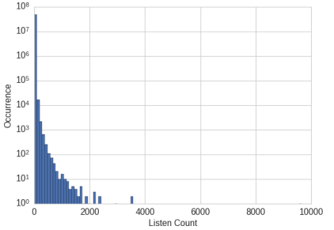
Motivation for Binarization
Echo Nest Taste Profile Dataset:
There are more than 48 million triplets of user ID, song ID, and listen count.
The full dataset contains 1,019,318 unique users and 384,546 unique songs.
Build a recommender system to recommend songs to users.
Larger count means the user really likes the song ?
99% of the listen counts are 24 or lower
Raw listen count is not a robust measure of user taste.
Notes:
One feature of the recommender might predict how much a user will enjoy a particular song. Since the data contains actual listen counts, should that be the target of the prediction?
This would be the right thing to do if a large listen count means the user really likes the song and a low listen count means they’re not interested in it. How‐ ever, the data shows that while 99% of the listen counts are 24 or lower, there are also some listen counts in the thousands, with the maximum being 9,667.
A more robust representation of user preference is to binarize the count and clip all counts greater than 1 to 1. In other words, if the user listened to a song at least once, then we count it as the user liking the song. This way, the model will not need to spend cycles on predicting the minute differences between the raw counts. The binary target is a simple and robust measure of user preference.

Slide 57
Binarization
Binarization maps a continuous or categorical attribute into one or more binary variables.
Must maintain ordinal relationship
Assume an ordinal attribute for representing service of a restaurant: ({Awful,Poor,OK,Good,Great})
Service quality | Integer Value | X1 | X2 | X3
Awful | 0 | 0 | 0 | 0
Poor | 1 | 0 | 0 | 1
Ok | 2 | 0 | 1 | 0
Good | 3 | 0 | 1 | 1
Great | 4 | 1 | 0 | 0
Unintended relationships: X2 and X3 are now correlated because “good” is encoded using both attributes

Slide 58
Binarization
Service quality | Integer Value | X1 | X2 | X3 | X4 | X5
Awful | 0 | 1 | 0 | 0 | 0 | 0
Poor | 1 | 0 | 1 | 0 | 0 | 0
Ok | 2 | 0 | 0 | 1 | 0 | 0
Good | 3 | 0 | 0 | 0 | 1 | 0
Great | 4 | 0 | 0 | 0 | 0 | 1
Binary attributes, where only the presence of 1 is important
One binary attribute for each categorical value
Be Careful: Number of resulting attributes may become too large

Slide 59
Normalization
Types of common scaling operations or Normalization methods
Min-max normalization
z-score normalization
Normalization by decimal scaling

Slide 60
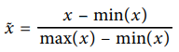
Min-Max Scaling
Min-max scaling squeezes (or stretches) all feature values to be within the range of [0, 1].
x
x - feature value
min(x) - minimum value of feature x
max(x) - maximum value of feature x
0
1

Slide 61
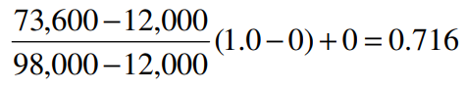
Example: Min-max Normalization
Let income range $12,000 to $98,000 be normalized to [0.0, 1.0].
Then $73,000 is mapped to ?

Slide 62
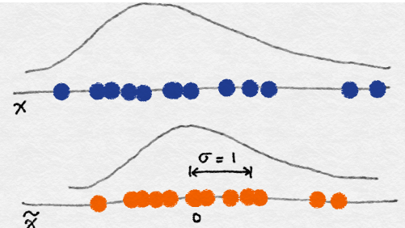
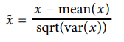
z-score Normalization -> Standardization
In z-score normalization (or zero-mean normalization)
The values for an attribute, x, are normalized based on the mean (x) and standard deviation (σ_{x} ) of x.
The resulting scaled feature has a mean of 0 and a variance of 1.

Slide 63
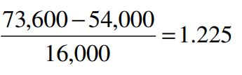
Example: z-score Normalization
Let μ_{x}= 54,000, σ_{x} = 16,000, for the attribute income
With z-score normalization, a value of $73,600 for income is transformed to:
Z=score normalization can change the original data quite a bit.

Slide 64
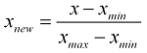
Normalization
https://www.statisticshowto.datasciencecentral.com/normalized/
The word “normalization” is used informally in statistics, and so the term normalized data can have multiple meanings. In most cases, when you normalize data you eliminate the units of measurement for data, enabling you to more easily compare data from different places. Some of the more common ways to normalize data include:
• Transforming data using a z-score or t-score. This is usually called standardization. In the vast majority of cases, if a statistics textbook is talking about normalizing data, then this is the definition of “normalization” they are probably using.
• Rescaling data to have values between 0 and 1. This is usually called feature scaling. One possible formula to achieve this is:
• Standardizing residuals: Ratios used in regression analysis can force residuals into the shape of a normal distribution.
• Normalizing Moments using the formula μ/σ.
• Normalizing vectors (in linear algebra) to a norm of one. Normalization in this sense means to transform a vector so that it has a length of one.

Slide 65
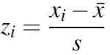
Standardization
The terms normalization and standardization are sometimes used interchangeably, but they usually refer to different things. Normalization usually means to scale a variable to have a values between 0 and 1, while standardization transforms data to have a mean of zero and a standard deviation of 1. This standardization is called a z-score, and data points can be standardized with the following formula:
A z-score standardizes variables.
Where:
• xi is a data point (x1, x2…xn).
• x̄ is the sample mean.
• s is the sample standard deviation.
Z-scores are very common in statistics. They allow you to compare different sets of data and to find probabilities for sets of data using standardized tables (called z-tables). For more about z-scores, see: Z-score: Definition, Formula, and Calculation.

Slide 66
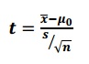
T-Score
https://www.statisticshowto.datasciencecentral.com/probability-and-statistics/t-distribution/t-score-formula/
A t-score is one form of a standardized test statistic (the other you’ll come across in elementary statistics is the z-score). The t score formula enables you to take an individual score and transform it into a standardized form > one which helps you to compare scores.
You’ll want to use the t score formula when you don’t know the population standard deviation and you have a small sample (under 30).
The t score formula is:
Where
x̄ = sample mean
μ0 = population mean
s = sample standard deviation
n = sample size

Slide 67
Decimal Scaling
Normalizes by moving the decimal point of values of attribute A.
The number of decimal points moved depends on the maximum absolute value of A.
A value, v, of A is normalized to v′ by computing
where j is the smallest integer such that Max(|v′|) < 1.
V’=$\frac{V}{10J}$

Slide 68
Examples of Decimal Scaling
Example-1
CGPA | Formula | Normalized CGPA
2 | 2/10 | 0.2
3 | 3/10 | 0.3
Example-2
Bonus | Formula | Normalized Bonus
400 | 4/1000 | 0.4
310 | 3/1000 | 0.31
Example-3
Salary | Formula | Normalized Salary
40000 | 4/100000 | 0.4
31000 | 3/100000 | 0.31

Slide 69
Aggregation
Combining two or more attributes (or objects) into a single attribute (or object)
Purpose
Data reduction
Change of scale
More stable data

Slide 70
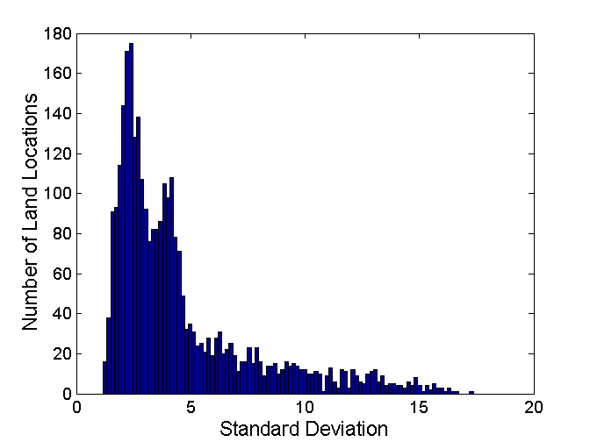
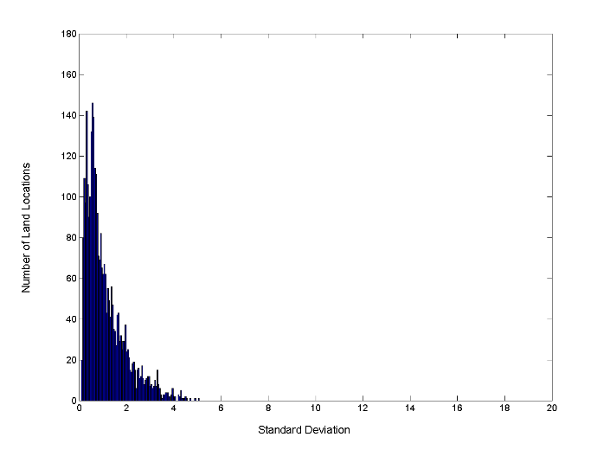
Aggregation – Change in Variability
Less variability at “higher-level” view
Standard Deviation of Average Monthly Precipitation
Standard Deviation of Average Yearly Precipitation

Slide 71
Correlation Analysis (Nominal Data)
Χ² (chi-square) test
The larger the Χ² value, the more likely the variables are related
The cells that contribute the most to the Χ² value are those whose actual count is very different from the expected count
Correlation does not imply causality
# of hospitals and # of car-theft in a city are correlated
Both are causally linked to the third variable: population
https://www.khanacademy.org/math/statistics-probability/inference-categorical-data-chi-square-tests/chi-square-goodness-of-fit-tests/v/pearson-s-chi-square-test-goodness-of-fit

Slide 72
Chi-Square Calculation: An Example
 | Play chess | Not play chess | Sum (row)
Like science fiction | 250(90) | 200(360) | 450
Not like science fiction | 50(210) | 1000(840) | 1050
Sum(col.) | 300 | 1200 | 1500
Χ² (chi-square) calculation (numbers in parenthesis are expected counts calculated based on the data distribution in the two categories)
It shows that like_science_fiction and play_chess are correlated in the group

Slide 73
Correlation Analysis (Numeric Data)
Correlation coefficient (also called Pearson’s product moment coefficient)
where n is the number of tuples, and are the respective means of A and B, σ_{A} and σ_{B} are the respective standard deviation of A and B, and Σ(a_{i}b_{i}) is the sum of the AB cross-product.
If r_{A,B} > 0, A and B are positively correlated (A’s values increase as B’s). The higher, the stronger correlation.
r_{A,B} = 0: independent; r_{AB} < 0: negatively correlated

Slide 74
Correlation (viewed as linear relationship)
Correlation measures the linear relationship between objects
To compute correlation, we standardize data objects, A and B, and then take their dot product

Slide 75
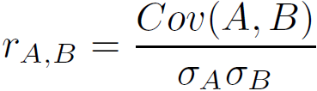
Covariance (Numeric Data)
Covariance is similar to correlation
where n is the number of tuples, and are the respective mean or expected values of A and B, σ_{A} and σ_{B} are the respective standard deviation of A and B
Positive covariance: If Cov_{A,B} > 0, then A and B both tend to be larger than their expected values
Negative covariance: If Cov_{A,B} < 0 then if A is larger than its expected value, B is likely to be smaller than its expected value
Independence: Cov_{A,B} = 0
Correlation coefficient:

Slide 76
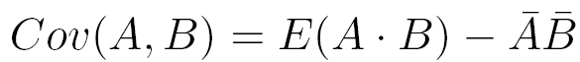
Co-Variance: An Example
It can be simplified in computation as
Suppose two stocks A and B have the following values in one week: (2, 5), (3, 8), (5, 10), (4, 11), (6, 14).
Question: If the stocks are affected by the same industry trends, will their prices rise or fall together?
E(A) = (2 + 3 + 5 + 4 + 6)/ 5 = 20/5 = 4
E(B) = (5 + 8 + 10 + 11 + 14) /5 = 48/5 = 9.6
Cov(A,B) = (2×5+3×8+5×10+4×11+6×14)/5 − 4 × 9.6 = 4
Thus, A and B rise together since Cov(A, B) > 0.

Slide 77
Discretization
Three types of attributes
Nominal—values from an unordered set, e.g., color, profession
Ordinal—values from an ordered set, e.g., military or academic rank
Numeric—real numbers, e.g., integer or real numbers
Discretization: Divide the range of a continuous attribute into intervals
Interval labels can then be used to replace actual data values
Reduce data size by discretization
Supervised vs. unsupervised
Split (top-down) vs. merge (bottom-up)
Discretization can be performed recursively on an attribute
Prepare for further analysis, e.g., classification
Notes:
08.09.12 MK: Slide moved here from Ch. 3. Added examples.

Slide 78
Data Discretization Methods
Typical methods: All the methods can be applied recursively
Binning
Top-down split, unsupervised
Histogram analysis
Top-down split, unsupervised
Clustering analysis (unsupervised, top-down split or bottom-up merge)
Decision-tree analysis (supervised, top-down split)
Correlation (e.g., χ²) analysis (unsupervised, bottom-up merge)
78
Notes:
78

Slide 79
Simple Discretization: Binning
Equal-width (distance) partitioning
Divides the range into N intervals of equal size: uniform grid
if A and B are the lowest and highest values of the attribute, the width of intervals will be: W = (B –A)/N.
The most straightforward, but outliers may dominate presentation
Skewed data is not handled well
Equal-depth (frequency) partitioning
Divides the range into N intervals, each containing approximately same number of samples
Good data scaling
Managing categorical attributes can be tricky

Slide 80
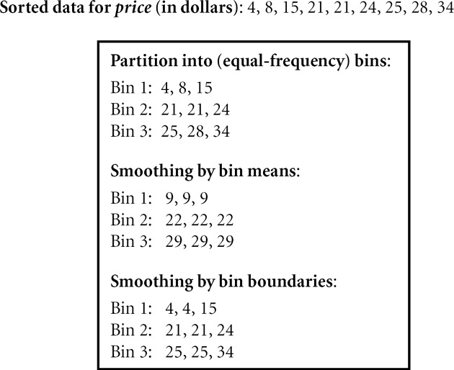
Binning Methods for Data Smoothing

Slide 81
Discretization by Classification & Correlation Analysis
Classification (e.g., decision tree analysis)
Supervised: Given class labels, e.g., cancerous vs. benign
Using entropy to determine split point (discretization point)
Top-down, recursive split
Details to be covered in Chapter “Classification”
Correlation analysis (e.g., Chi-merge: χ²-based discretization)
Supervised: use class information
Bottom-up merge: find the best neighboring intervals (those having similar distributions of classes, i.e., low χ² values) to merge
Merge performed recursively, until a predefined stopping condition
81
Notes:
81

Slide 82
Discretization
Convert continuous attribute into a discrete one
Age | Alzimer
60 | Yes
65 | Yes
45 | No
55 | Yes
50 | No
C1
C2
30
40
50
60
70
80
90
How to choose the number of intervals K ?
How to define the cut points ?
… which are relevant according to the studied problem….
Main issues
Notes:
Some statistical methods or machine learning algorithms like decision trees can handle discrete attributes only.

Slide 83
Discretization
Unsupervised discretization
Equal-interval binning
Equal-frequency binning
Supervised discretization
Entropy-based discretization
It tries to maximize the “purity” of the intervals (i.e. to contain as less as possible mixture of class labels)
• Class labels are ignored
• The best number of bins k is determined experimentally
Notes:
With or without taking class information (Supervised / Unsupervised)
Number of variables used (static variable / dynamic variable)

Slide 84
Unsupervised Discretization
User specifies the number of intervals and/or how many data points should be included in any given interval.
The following heuristic is often used to choose intervals:
The number of intervals for each attribute should not be smaller than the number of classes (if known).
The other popular heuristic is to choose the number of intervals, n_{Fi}, for each attribute, F_{i} (i=1,…,n,) where n is the number of attributes), as follows:
n_{Fi} = M/3∗ C where M is the number of training examples and C is the number of known classes.

Slide 85
Methods for Binning Numeric Predictor Variables
Equal width binning
Equal frequency binning
Binning by clustering
Original data: | 53 56 57 63 66 67 67 67 68 69 70 70 70 70 72 73 75 75 76 76 78 79 80 81
Method |  | Bin1 | Bin2 | Bin3
Equi Width | 81-53=28 28/3=9.33 | [53,62)= {53,56,57} | [62,72)= {63,66,67,67,67,68,69,70,70,70} | [72,81]={72,73,75,75,76,76,78,79,80,81}
Equi Frequency | 24/3=8 | {53,56,57,63,66,67, 67,67} | {68,69,70,70,70, 72,73,75} | {75,76,76,78,79,80,81}
Find natural gaps in the data | some variation | {53,56,57,63,66,67, 67,67,68,69} | {70,70,70, 72,73,75,75} | {76,76,78,79,80,81}
Notes:
Equal width binning : Can be greatly affected by outliers

Slide 86
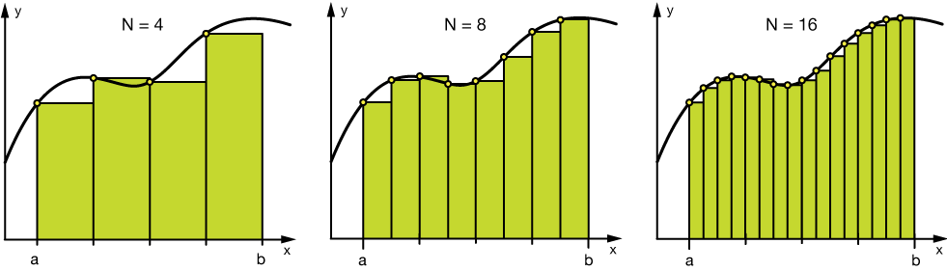
Binning
Binning can be applied on both categorical and numerical data:
#Numerical Binning Example
Value Bin 0-30 -> Low 31-70 -> Mid 71-100 -> High
#Categorical Binning Example
Value Bin Spain -> Europe Italy -> Europe Chile -> South America Brazil -> South America
The main motivation of binning is to make the model more robust and prevent overfitting, however, it has a cost to the performance. Every time you bin something, you sacrifice information and make your data more regularized.

Slide 87
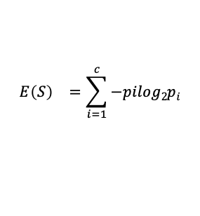
Supervised Discretization - Entropy
Entropy E(S) - measure of the impurity/un-certanity in a group of examples
S - training set with C₁,...,C_{C} classes
p_{i} - proportion of C_{c} in S
$${E\left(S\right)}^{}=\sum_{i=1}^{c}{−pilog2pi}$$
Very impure group
Less impure group
Pure group

Slide 88
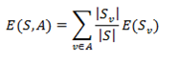
Supervised Discretization - Information Gain
Information gain (IG) measures how much “information” a feature gives us about the class.
Features that perfectly partition should give maximal information.
Unrelated features should give no information.
It measures the reduction in entropy.
Where S is the number of samples in the training set, with S_{v} instances belonging to class i, where i = 1, … , c.

Slide 89
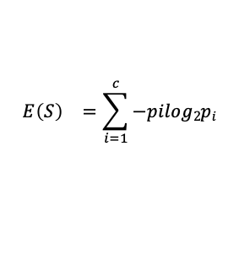
Supervised Discretization - Entropy Based
Entropy Based Discretization
Sort examples in increasing order
Each value forms an interval (m intervals)
Calculate the entropy measure of this discretization
Calculate "Entropy" for the target given a bin.
Calculate "Information Gain" given a bin. E(S) - E(S,A)
Apply the process recursively until some stopping criterion is met.
E(S) - E(S,A) > δ
$${E\left(S\right)}^{}=\sum_{i=1}^{c}{−pilog2pi}$$

Slide 90
Supervised Discretization Example
Runs | 53 | 56 | 57 | 63 | 66 | 67 | 67 | 67 | 68 | 69 | 70 | 70 | 70 | 70 | 72 | 73 | 75 | 75 | 76 | 76 | 78 | 79 | 80 | 81
Matches Won | Y | Y | Y | N | N | N | N | N | N | N | N | Y | Y | Y | N | N | N | Y | N | N | N | N | N | N
In this example we are discretizing the feature Runs using 2 bins <=60 and >60.
Step 3: Calculate "Entropy" for the target.
Step 4: Calculate "Entropy" for the target given a bin.
Runs
Y | N
7 | 17
 |  | Matches Won
 |  | Y | N
Runs | <= 60 | 3 | 0
 | > 60 | 4 | 17
E (Runs) = E(7, 17) = E(0.29, .71)
= -0.29 x log₂(0.29) - 0.71 x log₂(0.71)
= 0.871
E (Matches Won,Runs) = P(<=60) x E(3,0) + P(>60) x E(4,17)
= 3/24 x 0 + 21/24 x 0.7= 0.615
Step 5: Calculate "Information Gain" given a bin.
Information Gain (Matches Won,Runs) = 0.256

Slide 91
Supervised Discretization Example (Contd..)
Runs | 53 | 56 | 57 | 63 | 66 | 67 | 67 | 67 | 68 | 69 | 70 | 70 | 70 | 70 | 72 | 73 | 75 | 75 | 76 | 76 | 78 | 79 | 80 | 81
Matches Won | Y | Y | Y | N | N | N | N | N | N | N | N | Y | Y | Y | N | N | N | Y | N | N | N | N | N | N
 |  | Matches Won
 |  | Y | N
Runs | <= 60 | 3 | 0
 | > 60 | 4 | 17
 |  | Matches Won
 |  | Y | N
Runs | <= 70 | 6 | 8
 | > 70 | 1 | 9
 |  | Matches Won
 |  | Y | N
Runs | <= 75 | 7 | 11
 | > 75 | 0 | 6
Dealing with Categorical Data
Information Gain = 0.256
Information Gain = 0.101
Information Gain = 0.148

Slide 92
Data wrangling and Feature Engineering
Lecture -9
Sumita Narang

Slide 93
Objectives
Data cleaning
Data Integration/ Aggregation
Data Sampling
Handling Numeric Data
Discretization, Binarization
Normalization
Data Smoothening
Managing Categorical Attributes
Transforming Categorical to Numerical Values
Encoding techniques
Dealing with textual Data
Data Similarity
Feature Engineering
Feature Extraction (Dimensionality Reduction)
Feature Construction
Feature Subset selection
Filter methods
Wrapper methods
Embedded methods
Feature Learning
Case Study involving FE tasks

Slide 94
Handling Categorical Data
Source Courtesy: Some of the contents of this PPT are sourced from materials provided by publishers of prescribed books

Slide 95
Learning Objectives
Articulate the need for categorical encoding
List and define various data encoding methods
Make the calculations that are necessary to get meaningful encodings

Slide 96
Four Levels of data
Used for names or label a series of values.
Ex: Gender(dichotomous),Hair color, Country names
Ordinal values represent discrete and ordered units.
Ex: Shirt size, letter grades, food quality
Nominal
Categorical
(qualitative)
Ordinal
Data
Interval
Numerical
(quantitative)
Interval values represent ordered units that have the same difference.
Ex: temperature of a given place
Ratio values represent ordered units that have the same difference. There’s a value that means “nothing/none.”
Ex: Age, weight, test score
Ratio

Slide 97
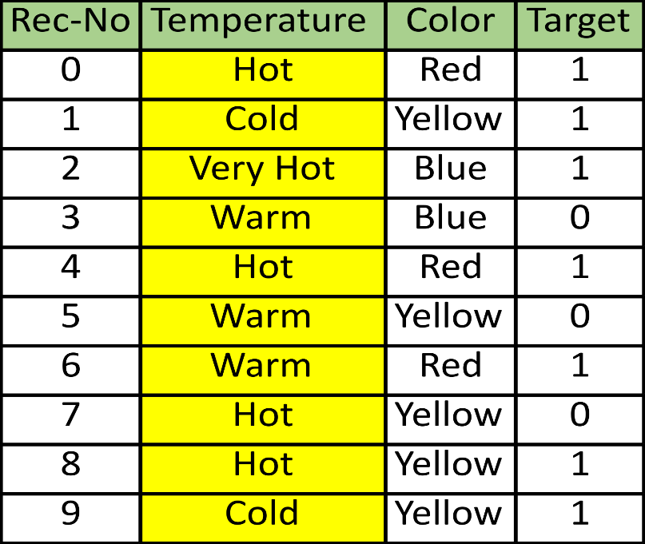
Categorical Encoding
Defined
Categorical encoding refers to replacing the category strings by a numerical representation
The goal of categorical encoding is:
To build predictive features from categories
To produce variables that can be used to train machine learning models
https://towardsdatascience.com/all-about-categorical-variable-encoding-305f3361fd02

Slide 98
Categorical Encoding Techniques
Traditional
One hot encoding
Count / frequency encoding
Monotonic relationship
Ordered label encoding
Mean encoding
Alternatives
Binary encoding
Feature hashing
Label Encoding
Ordinal Encoding
Helmert Encoding
Frequency Encoding
Weight of Evidence Encoding
Probability Ratio Encoding
Backward Difference Encoding
Leave One Out Encoding
James-Stein Encoding
M-estimator Encoding

Slide 99
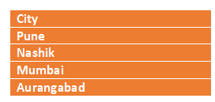
One hot encoding
One hot encoding, consists in encoding each categorical variable with a set of boolean variables which take values 0 or 1, indicating if a category is present for each observation.
Pune | Nashik | Mumbai | Aurangabad
1 | 0 | 0 | 0
0 | 1 | 0 | 0
0 | 0 | 1 | 0
0 | 0 | 0 | 1

Slide 100
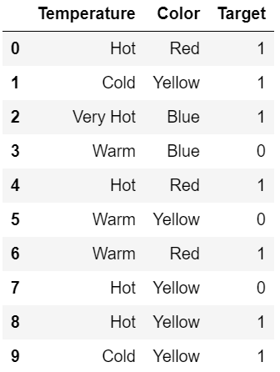
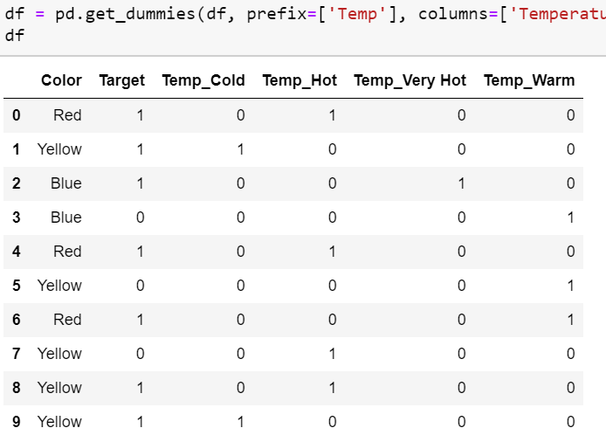
One hot Encoding (k Variables)

Slide 101
One hot encoding (k-1 variables)
Using “k-1” fields
More generally, a categorical variable should be encoded by creating k-1 binary variables, where k is the number of distinct categories.
In the case of binary variables, like gender where k=2 (male / female)we need to create only 1 (k - 1 = 1) binary variable.
One hot encoding into k-1 binary variables takes into account that we can use 1 less dimension and still represent the whole information:
if the observation is 0 in all the binary variables, then it must be 1 in the final (not present) binary variable.
Pune | Nashik | Mumbai
1 | 0 | 0
0 | 1 | 0
0 | 0 | 1
0 | 0 | 0

Slide 102
One hot encoding into k -1 variables
Most machine learning algorithms, consider the entire data set while being fit.
Therefore, encoding categorical variables into k - 1 binary variables, is better, as it avoids introducing redundant information.

Slide 103
One hot encoding into k variables
There are a few occasions when it is better to encode variables into k dummy variables:
when building tree based algorithms
when doing feature selection by recursive algorithms
when interested in determine the importance of each single category

Slide 104
One hot encoding: Advantages & Disadvantages
Advantages
Makes no assumption about the distribution or categories of the categorical variable
Keeps all the information of the categorical variable
Suitable for linear models
Disadvantages
Expands the feature space
Does not add extra information while encoding
Many dummy variables may be identical, introducing redundant information

Slide 105
Label / integers encoding
Defined
Integer encoding consist in replacing the categories by digits from 1 to n (or 0 to n-1, depending the implementation), where n is the number of distinct categories of the variable.
The numbers are assigned arbitrarily.
This encoding method allows for quick benchmarking of machine learning models.
City
Pune
Nashik
Mumbai
Aurangabad
City
1
2
3
4

Slide 106
Label / integers encoding (2)
Advantages and Limitations
Advantages
Straightforward to implement
Does not expand the feature space
Can work well enough with tree based algorithms
Limitations
Does not add extra information while encoding
Not suitable for linear models
Does not handle new categories in test set automatically

Slide 107
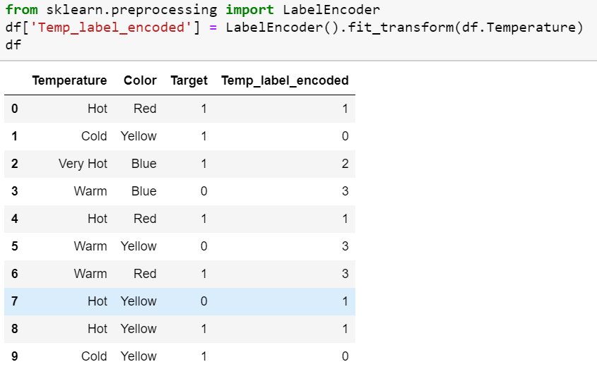
Example

Slide 108
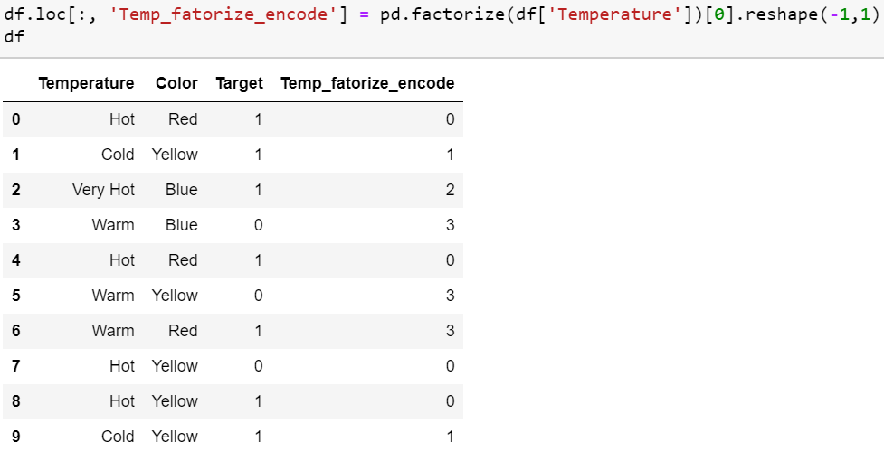
Example

Slide 109
Count / frequency encoding
Defined
Categories are replaced by the count or percentage of observations that show that category in the dataset.
Captures the representation of each label in a dataset
Very popular encoding method in Kaggle competitions.
Assumption: the number observations shown by each category is predictive of the target.
Count Encoding
Frequency Encoding
City
Pune
Nashik
Mumbai
Aurangabad
Pune
Mumbai
City
2
1
2
1
2
2
City
2 / 6 = 0.33
1 / 6 = 0.166
2 / 6 = 0.33
1 / 6 = 0.166
2 / 6 = 0.33
2 / 6 = 0.166

Slide 110
Count / frequency encoding (2)
Advantage / Limitations
Advantages
Straightforward to implement
Does not expand the feature space
Can work well enough with tree based algorithms
Limitations
Not suitable for linear models
Does not handle new categories in test set automatically
If 2 different categories appear the same amount of times in the dataset, that is, they appear in the same number of observations, they will be replaced by the same number:
may lose valuable information.

Slide 111
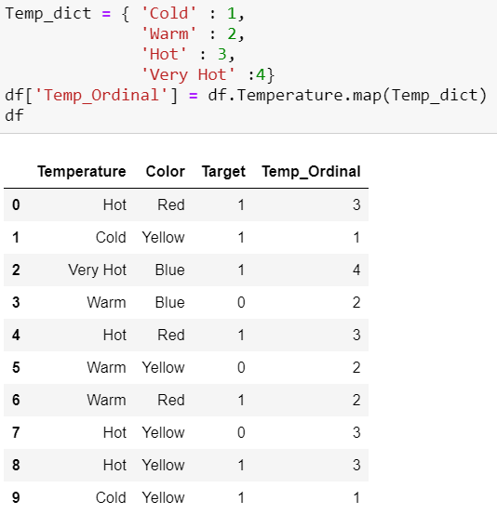
Ordinal Encoding
Ordinal encoding is done to ensure encoding of variable retains ordinal nature of the variable. This is reasonable only for ordinal variables as I mentioned in the beginning of this article. This encoding looks almost similar to Label Encoding but slightly different as Label coding would not consider whether variable is ordinal or not and it will assign sequence of integers
as per the order of data (Pandas assigned Hot (0), Cold (1) , “Very Hot” (2) and Warm (3)) or
as per alphabetical sorted order (scikit-learn assigned Cold(0), Hot(1) , “Very Hot” (2) and Warm (3)) .

Slide 112
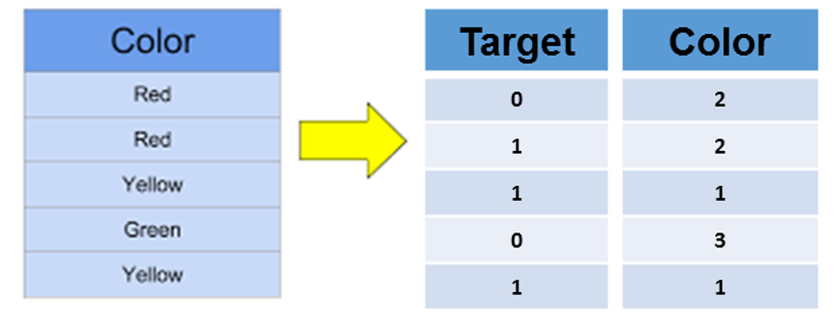
Ordered ordinal encoding
Defined
Categories are replaced by integers from 1 to k, where k is the number of distinct categories in the variable, but this numbering is informed by the SUM of the target for each category
Note- Feature Category with smallest sum of targets, gets highest order number; while the category with largest sum of targets, gets the lowest order number. Reason: Optimal in memory
0+1
0+1
1+1
0
1+1

Slide 113
Ordered ordinal encoding (2)
Advantages & Limitations
Advantages
Straightforward to implement
Does not expand the feature space
Creates monotonic relationship between categories and target
Limitations
May lead to over-fitting
Difficult to implement together with cross validation with current libraries

Slide 114
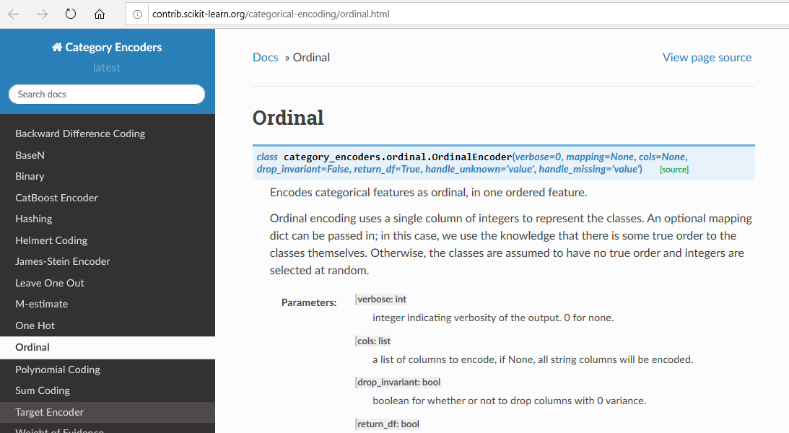
Ordered ordinal encoding (3)

Slide 115
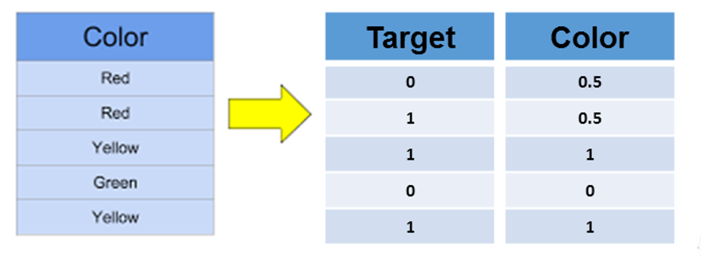
Mean or Target encoding
Defined
Mean encoding implies replacing the category by the average target value for that category
0+1
0+1
1+1
0
1+1

Slide 116
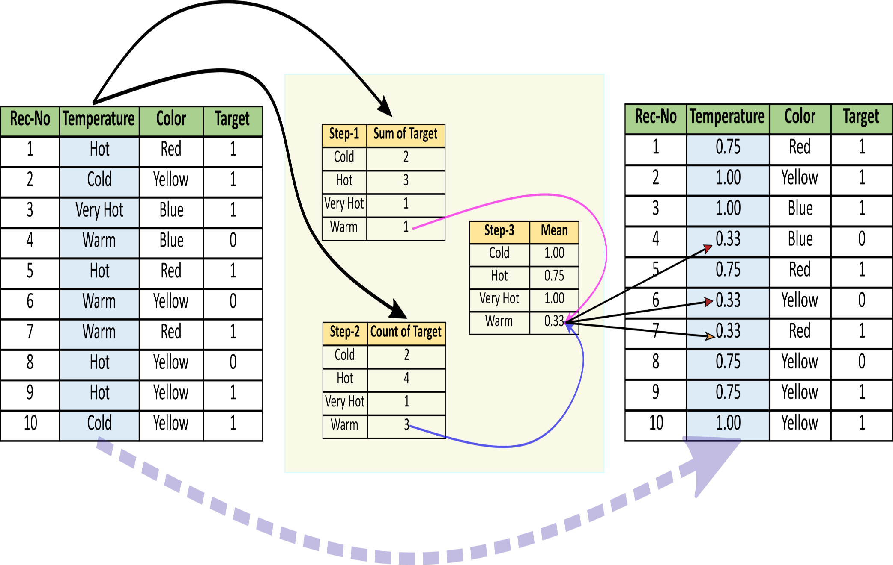
Example

Slide 117
Mean or target encoding (2)
Advantages and Limitations
Advantages
Straightforward to implement
Does not expand the feature space
Creates monotonic relationship between categories and target
Limitations
May lead to over-fitting
Difficult to implement together with cross-validation with current libraries
If 2 categories show the same mean of target, they will be replaced by the same number => potential loss of value

Slide 118
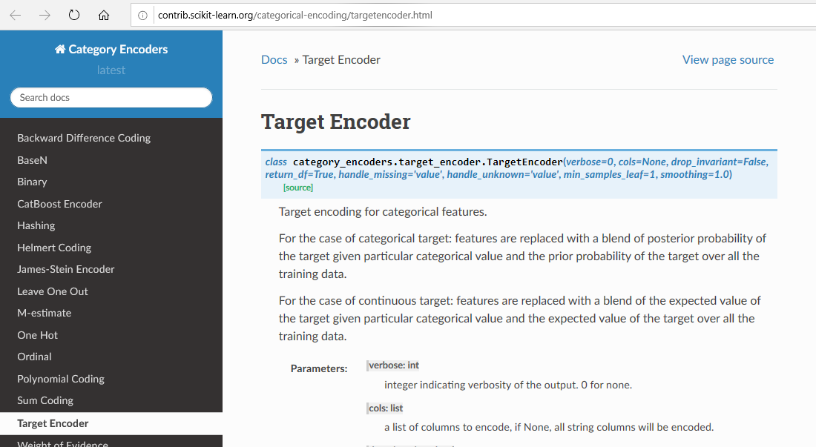
Mean or target encoding (3)

Slide 119
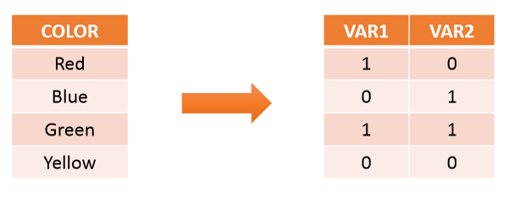
Binary encoding
Definition
Use binary code, a collection of 0s and 1s, to encode the meaning of the variable.
Individually derived variable lack human readable meaning.

Slide 120
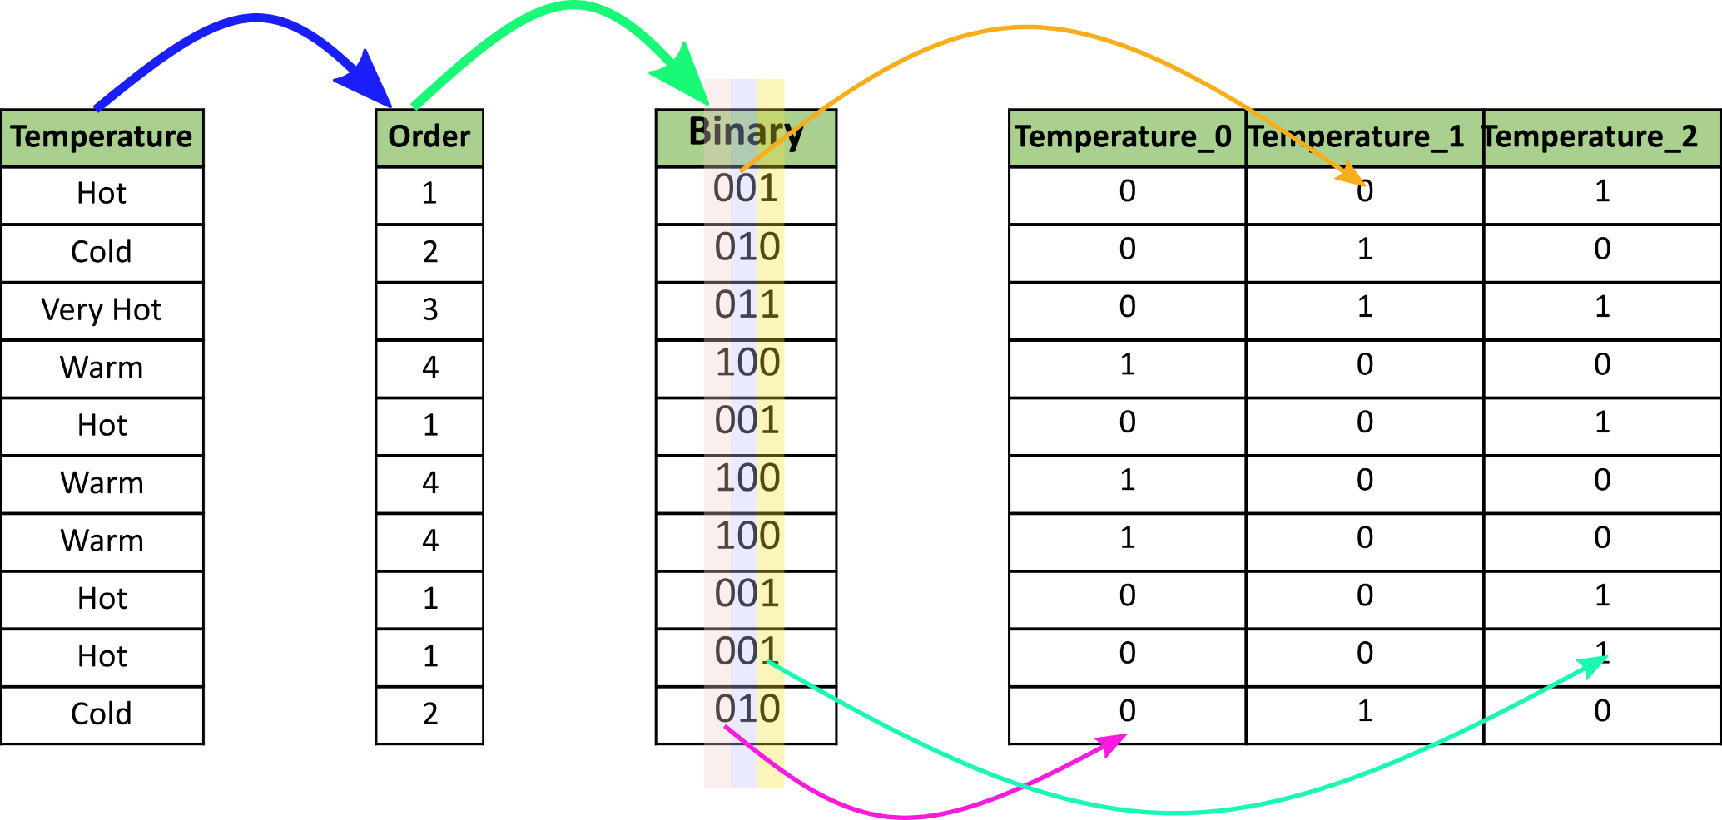
Example

Slide 121
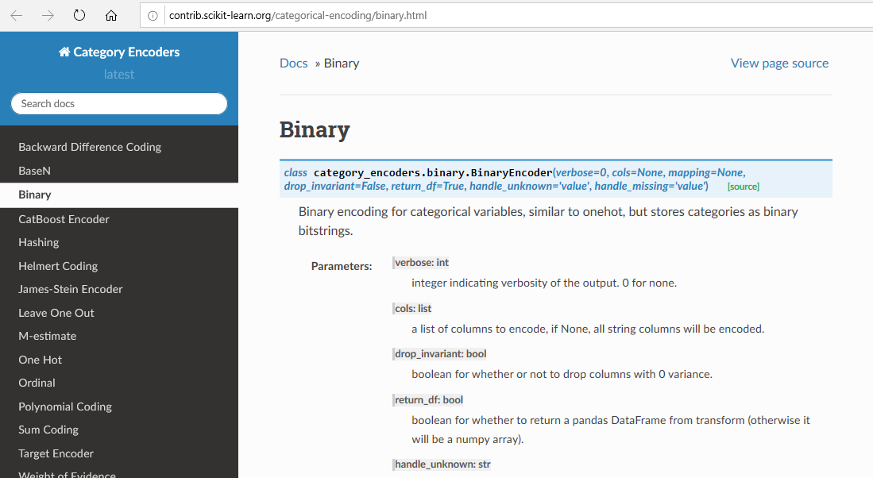
Binary encoding (2)

Slide 122
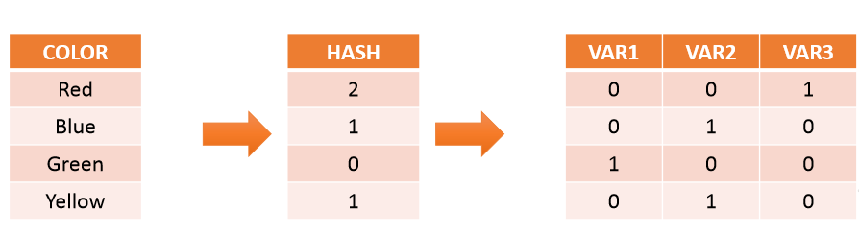
Feature Hashing
Defined
Use a hashing method, any of choice, to encode the variables
May lead to different labels taking the same value

Slide 123
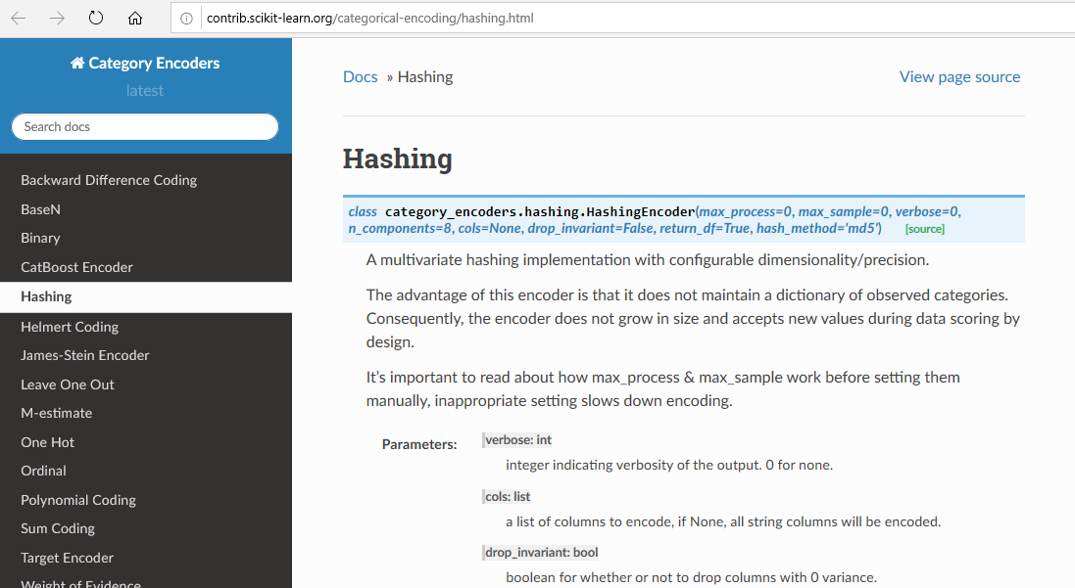
Feature Hashing (2)

Slide 124
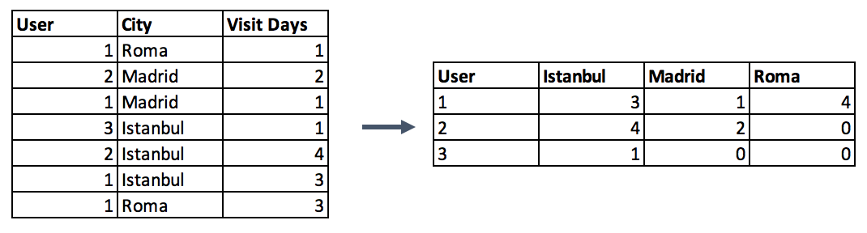
Categorical Column Grouping
3 different ways for aggregating categorical columns:
The first option is to select the label with the highest frequency. In other words, this is the max operation for categorical columns, but ordinary max functions generally do not return this value, you need to use a lambda function for this purpose.
data.groupby('id').agg(lambda x: x.value_counts().index[0])
Second option is to make a pivot table.
Last categorical grouping option is to apply a group by function after applying one-hot encoding. This method preserves all the data -in the first option you lose some-, and in addition, you transform the encoded column from categorical to numerical in the meantime.

Slide 125
Feature Split
Splitting features is a good way to make them useful in terms of machine learning. Most of the time the dataset contains string columns that violates tidy data principles. By extracting the utilizable parts of a column into new features:
We enable machine learning algorithms to comprehend them.
Make possible to bin and group them.
Improve model performance by uncovering potential information.
Split function is a good option
#String extraction example
data.title.head()
0 Toy Story (1995)
1 Jumanji (1995)
2 Grumpier Old Men (1995)
3 Waiting to Exhale (1995)
4 Father of the Bride Part II (1995)
data.title.str.split("(", n=1, expand=True)[1].str.split(")", n=1, expand=True)[0]
0 1995
1 1995
2 1995
3 1995
4 1995

Slide 126
Data Quality – Handling Missing Data

Slide 127
Learning objectives
Understanding reasons for missing values
Identify and impute missing values
List different type Imputation techniques
Choose appropriate techniques to impute missing values

Slide 128

Major issue with real word data sets
Real world data is often dirty

Slide 129
Missing data
Customer Name | Age | Income
Rahul | 35 | 12,00,000
Shravya | -- | 8,00,000
Mehul | 40 | 22,00,000
Vaishali | 25 | --
Shiva | 65 | --

Slide 130
Impact of Missing data
Incompatible in Scikitlearn
Missing data imputation may distort variable distribution
Affect the performance of Machine Learning Models

Slide 131

Missing Data : Mechanism
Understanding the mechanism of missing data will help us choose appropriate imputation method.
Missing completely at random (MCAR)
Missing at random (MAR)
Not missing at random (NMAR):

Slide 132
Missing completely at random (MCAR)
The probability of missing is same for all the observations.
There is no relationship between the missing values and any other values in the dataset.
Removing such missing values will not effect the inferences made.

Slide 133
Missing Data at Random(MAR)
Gender | Age
Male | 42
Male | NA
Male | 24
Male | NA
Male | 36
Male | 57
Female | 32
Female | NA
Female | NA
Female | 18
Female | NA
Female | 23
The probability of a missing values depends on available information i.e it depends on other variables in the dataset.
33% males
50% Females

Slide 134
Missing Data Not at Random(MNAR)
No of clinical visits | No of sports classes attended | Depression
1 | NA | Yes
NA | NA | Yes
NA | 0 | Yes
4 | 2 | Yes
NA | 1 | Yes
3 | NA | Yes
0 | 0 | No
NA | 5 | No
1 | 2 | No
1 | 1 | No
2 | 1 | No
NA | 2 | No
The missing values exist as an indication of a certain class.

Slide 135
Missing Values Handling
Techniques for Numerical and Categorical Data
Dropping missing values rows or columns; define a threshold e.g. 70% rows/columns with more than threshold missing values need to be dropped
Imputation – Missing data is imputed, preserves the data size
Numerical Imputation – Use mean or medians to impute values. However; if your data has classes then applying mean/median for every class. Mean is more impacted by outliers.
Categorical Imputation – Replacing missing value with maximum occurred values; define a new category as “others”

Slide 136
Imputation Techniques for numeric values
Mean / Median Imputation
Random Sampling Imputation
Adding a new variable to indicate missingness
Imputation of NA by values at the end of distribution
Imputation of NA by arbitrary values

Slide 137
Imputation Techniques for Numeric values
Gender | Age
Male | 42
Male | NA
Male | 24
Male | NA
Male | 36
Male | 57
Female | 32
Female | NA
Female | NA
Female | 18
Female | NA
Female | 23
Mean / Median Imputation
Used when MCAR / MAR
Assumes that the feature follows normal distribution
Mean age = 33.14
Median age = 32

Slide 138
Pros and cons of mean/median imputation
Advantages
Easy to implement
Faster way of obtaining complete dataset
Disadvantages
Mean imputation reduces the variance of the imputed variables.
Mean imputation does not preserve relationships between variables such as correlations.

Slide 139
Random Sampling Imputation
Gender | Age | Imputed Age
Male | 42 | 42
Male | NA | 36
Male | 24 | 24
Male | NA | 24
Male | 36 | 36
Male | 57 | 57
Female | 32 | 32
Female | NA | 18
Female | NA | 32
Female | 18 | 18
Female | NA | 23
Female | 23 | 23
Used when MCAR / MAR
Aim to preserve the statistical parameters of the feature
Number of random samples are at least as many as missing values
https://feature-engine.readthedocs.io/en/latest/imputers/RandomSampleImputer.html#:~:text=The%20RandomSampleImputer()%20replaces%20missing,both%20numerical%20and%20categorical%20variables.&text=In%20this%20case%2C%20the%20observations,the%20variables%20as%20a%20seed.

Slide 140
Adding a new variable to indicate missingness
Gender | Age | Age Missing?
Male | 42 | 0
Male | NA | 1
Male | 24 | 0
Male | NA | 1
Male | 36 | 0
Male | 57 | 0
Female | 32 | 0
Female | NA | 1
Female | NA | 1
Female | 18 | 1
Female | NA | 0
Female | 23 | 1
Used when MCAR / MAR

Slide 141
Imputation of NA by values at the end of distribution
Gender | Age
Male | 42
Male | NA
Male | 24
Male | NA
Male | 36
Male | 57
Female | 32
Female | NA
Female | NA
Female | 18
Female | NA
Female | 23
Used when NMAR
Imputed value can be 18 or 57 depending on other feature observation

Slide 142
Imputation of NA by arbitrary values
Gender | Age
Male | 42
Male | NA
Male | 24
Male | NA
Male | 36
Male | 57
Female | 32
Female | NA
Female | NA
Female | 18
Female | NA
Female | 23
Used when NMAR
Use any value except mean/median value

Slide 143
Imputation Techniques for categorical values
Imputation by most frequent category
In categorical variables treating NA as an additional category

Slide 144
Imputation by most frequent category for categorical values
Gender | Age
Male | 42
Male | 43
Male | 24
NA | 63
Male | 36
Male | 57
Female | 32
NA | 33
Female | 45
Female | 18
NA | 55
Female | 23
Used when NMAR
Mode = Male

Slide 145
In categorical variables treating NA as an additional category
Encode as unique category as unknown or missing
Use mode to fill missing value
Gender | Gender_new | Gender_new_value
Male | Male | Male
Male | Male | Male
Male | Male | Male
NA | Missing | Male
Male | Male | Male
Male | Male | Male
Female | Female | Female
NA | Missing | Male
Female | Female | Female
Female | Female | Female
NA | Missing | Male
Female | Female | Female

Slide 146
How to compensate for missing values ?
https://towardsdatascience.com/6-different-ways-to-compensate-for-missing-values-data-imputation-with-examples-6022d9ca0779
https://measuringu.com/handle-missing-data/

Slide 147
Handling Outliers
Outliers can be detected via visualization and statistical methodologies
Standard Deviation based outlier detection
If a value has a distance to the average higher than x * standard deviation, it can be assumed as an outlier.
There is no trivial solution for x, but usually, a value between 2 and 4 seems practical.
In addition, z-score can be used instead of the formula x * standard deviation. Z-score (or standard score) standardizes the distance between a value and the mean using the standard deviation.
Percentiles based outlier detection
Can assume a certain percent of the value from the top or the bottom as an outlier.
Another option for handling outliers is to cap them instead of dropping. So you can keep your data size and at the end of the day, it might be better for the final model performance.
On the other hand, capping can affect the distribution of the data, thus it better not to exaggerate it.

Slide 148
3.2 Data Similarity/Dissimilarity
Source Courtesy: Some of the contents of this PPT are sourced from materials provided by publishers of prescribed books

Slide 149
Similarity and Dissimilarity
Similarity
Numerical measure of how alike two data objects are
Value is higher when objects are more alike
Often falls in the range [0,1]
Dissimilarity (e.g., distance)
Numerical measure of how different two data objects are
Lower when objects are more alike
Minimum dissimilarity is often 0
Upper limit varies
Proximity refers to a similarity or dissimilarity
Notes:
Keep here because keeping it in clustering chapter seems far away. 08.11.02

Slide 150
Data Matrix and Dissimilarity Matrix
Data matrix
n data points with p dimensions
Two modes
Dissimilarity matrix
n data points, but registers only the distance
A triangular matrix
Single mode
Notes:
Distance is just once way of measuring dissimilarity (wiki). Changed “register only the distance” to “registers only the difference” or “dissimiarity”?

Slide 151
Type of data in Proximity Measure analysis
Nominal variables
Binary variables
Numerical: Ordinal , Interval-scaled and ratio variables
Variables of mixed types

Slide 152
Proximity Measure for Nominal Attributes
Can take 2 or more states, e.g., red, yellow, blue, green (generalization of a binary attribute)
Method 1: Simple matching
m: # of matches, p: total # of variables
Method 2: Use a large number of binary attributes : One hot-encoding
creating a new binary attribute for each of the M nominal states
Then apply Binary Attribute based Similarity Techniques e.g. Jaccard similarity

Slide 153
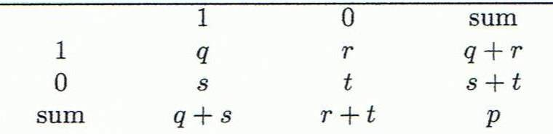
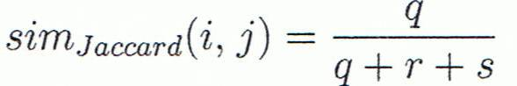
Proximity Measure for Binary Attributes
A contingency table for binary data
Distance measure for symmetric binary variables:
A binary symmetric variable is said to be symmetric if both of its states are of the same value and carry the same weight, and there is no preference as such as which outcome should be mapped to 0 or mapped to 1. e.g. attribute of gender.
Distance measure for asymmetric binary variables
Jaccard coefficient (similarity measure for asymmetric binary variables): Note: Jaccard coefficient is the same as “coherence”
Object j
Object i
A = {0,1,2,5,6}
B = {0,2,3,4,5,7,9}
Solution: J(A,B) = |A∩B| / |A∪B| = |{0,2,5}| / |{0,1,2,3,4,5,6,7,9}| = 3/9 = 0.33.
Jaccard Index = (the number in both sets) / (the number in either set) * 100
J(X,Y) = |X∩Y| / |X∪Y|
Note- Apply jaccard similarity where cardinality i.e. number of elements of each type matter.

Slide 154
Dissimilarity between Binary Variables
Example
Gender is a symmetric attribute
The remaining attributes are asymmetric binary
Let the values Y and P be 1, and the value N 0
 | Gender | fever | Cough | Test-1 | Test-2 | Test-3 | Test-4
Jack | M | 1 | 0 | 1 | 0 | 0 | 0
Mary | F | 1 | 0 | 1 | 0 | 1 | 0
Jim | M | 1 | 1 | 0 | 0 | 0 | 0
 | Mary
Jack | 1 | 0 |  | D(jack,Mary) |  | q/ q+r+s
1 | 2 | 0 |  |  |  | 0.66666
0 | 1 | 3
https://en.wikipedia.org/wiki/Jaccard_index
https://www.statisticshowto.datasciencecentral.com/jaccard-index/

Slide 155

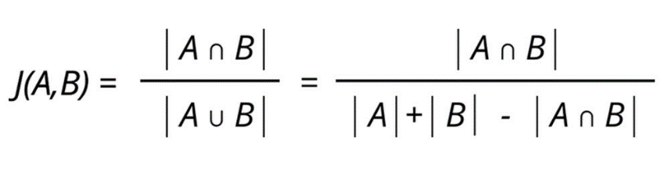
Jaccard Similarity Index (1/2)
• Jaccard Similarity Index compares members for two sets to see which
members are shared and which are distinct.
• It’s a measure of similarity for the two sets of data, with a range from 0% to
100%. The higher the percentage, the more similar the two populations.
• The formula to find the Jaccard Similarity Index is:
Jaccard Index = (the number in both sets) / (the number in either set)
Sources: https://www.statisticshowto.datasciencecentral.com/jaccard-index/
http://techinpink.com/2017/08/04/implementing-similarity-measures-cosine-similarity-versus-jaccard-similarity/
8
BAZG523(Introduction to Data Science)

Slide 156
Jaccard Similarity Index (2/2)
Example
• There are two strings A and B:
[How, Can, I, Be, A, Geologist, What, Should, Do, To]
A = "How can I be a geologist?"
B = "What should I do to be a geologist?"
A ∩ B = ['a', 'be', 'geologist?', 'i']
A U B = ['a', 'be', 'geologist?', 'to', 'do', 'i', 'what', 'should', 'how', 'can’]
|A ∩ B| = 4 (Cardinality of the elements in the intersection of A and B)
|A
B| = 10 (Cardinality of the elements in the union of A and B)
Jaccard Similarity = |A ∩ B| : |A U B|
= 4:10
= 0.40
Sources: https://www.statisticshowto.datasciencecentral.com/jaccard-index/
http://techinpink.com/2017/08/04/implementing-similarity-measures-cosine-similarity-versus-jaccard-similarity/
9
BAZG523(Introduction to Data Science)

Slide 157
Standardizing Numeric Data: Ordinal, Interval, Ratio
Z-score:
X: raw score to be standardized, μ: mean of the population, σ: standard deviation
the distance between the raw score and the population mean in units of the standard deviation
negative when the raw score is below the mean, “+” when above
An alternative way: Calculate the mean absolute deviation
where
standardized measure (z-score):
Using mean absolute deviation is more robust than using standard deviation
Notes:
MK: For lecture, this may be OK here, but I think discussion of standardization/normalization is better kept all together in Chapter 3

Slide 158
Ordinal Variables
An ordinal variable can be discrete or continuous
Order is important, e.g., rank
Can be treated like interval-scaled
replace x_{if} by their rank
map the range of each variable onto [0, 1] by replacing i-th object in the f-th variable by
compute the dissimilarity using methods for interval-scaled variables

Slide 159
Ratio-Scaled Variables
Ratio-scaled variable: a positive measurement on a nonlinear scale, approximately at exponential scale, such as Ae^{Bt} or Ae^{-Bt}
Methods:
treat them like interval-scaled variables — not a good choice! (why?)
apply logarithmic transformation
y_{if} = log(x_{if})
treat them as continuous ordinal data treat their rank as interval-scaled.

Slide 160
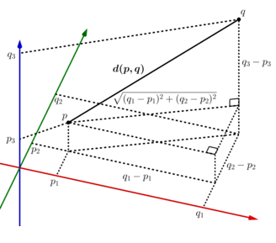
Proximity Measures on Numeric Data: Data Matrix and Dissimilarity Matrix
Data Matrix
Euclidean distance or Euclidean metric is the "ordinary" straight-line distance between two points in Euclidean space. With this distance, Euclidean space becomes a metric space. The associated norm is called the Euclidean norm. Older literature refers to the metric as the Pythagorean metric. A generalized term for the Euclidean norm is the L² norm or L² distance.
Dissimilarity Matrix
(with Euclidean Distance)
https://en.wikipedia.org/wiki/Euclidean_distance

Slide 161
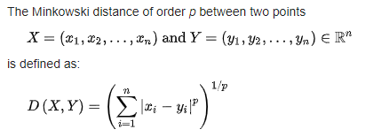
Distance on Numeric Data: Minkowski Distance
https://iq.opengenus.org/minkowski-distance/
Minkowski distance: A popular distance measure
Properties
d(i, j) > 0 if i ≠ j, and d(i, i) = 0 (Positive definiteness)
d(i, j) = d(j, i) (Symmetry)
d(i, j) ≤ d(i, k) + d(k, j) (Triangle Inequality)
A distance that satisfies these properties is a metric
Minkowski distance is a distance/ similarity measurement between two points in the normed vector space (n- dimensional real space) and is a generalization of the Euclidean distance and the Manhattan distance.
Here p = L_{p} –norm, where p = -∞ to + ∞

Slide 162
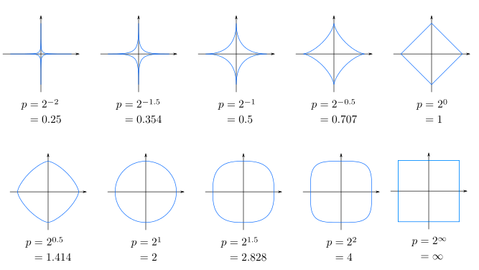
Minkowski Distance

Slide 163
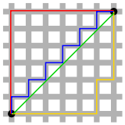


Special Cases of Minkowski Distance
p = 1: Manhattan (city block, L₁ norm) distance
Hamming distance : The distance between two points measured along axes at right angles. In a plane with p1 at (x1, y1) and p2 at (x2, y2), it is |x1 - x2| + |y1 - y2|.
In n-dim data points,
d(i, j) = |x_{i1} – x_{j1}|+ |x_{i2} – x_{j2}|+ |x_{i3} – x_{j3}|+… |x_{in} – x_{jn}|
p = 2: (L₂ norm) Euclidean distance
p → ∞. “supremum” (L_{max} norm, L∞ norm) distance.
This is the maximum difference between any component (attribute) of the vectors
Red: Manhattan distance.
Green: Euclidean distance
Red, blue, yellow: equivalent Manhattan distances.

Slide 164
Example: Minkowski Distance
(Dissimilarity Matrices)
Manhattan (L₁)
Euclidean (L₂)
Supremum

Slide 165
Attributes of Mixed Type
A database may contain all attribute types
Nominal, symmetric binary, asymmetric binary, numeric, ordinal
One may use a weighted formula to combine their effects
f is binary or nominal:
d_{ij}^{(f)} = 0 if x_{if} = x_{jf} , or d_{ij}^{(f)} = 1 otherwise
f is numeric: use the normalized distance
f is ordinal
Compute ranks r_{if} and
Treat z_{if} as interval-scaled

Slide 166

Cosine Similarity (1/6)
A document can be represented by thousands of attributes, each recording the frequency of a particular word (such as keywords) or phrase in the document.
Other vector objects: gene features in micro-arrays, …
Applications: information retrieval, biologic taxonomy, gene feature mapping, ...
Cosine measure: If d₁ and d₂ are two vectors (e.g., term-frequency vectors), then
cos(d₁, d₂) = (d₁ • d₂) /||d₁|| ||d₂|| ,
where • indicates vector dot product, ||d||: the length of vector d
Notes:
MK: Machine learning used the term “feature VECTORS” > I made some changes to the wording of this slide because it implied that our previous data were not vectors, but they were all feature vectors. I also changed the example since the one used was from Tan’s book (see next slide).
Chapter 3: Statistics Methods
Co-variance distance
K-L divergence

Slide 167
Example: Cosine Similarity
cos(d₁, d₂) = (d₁ • d₂) /||d₁|| ||d₂|| ,
where • indicates vector dot product, ||d|: the length of vector d
Ex: Find the similarity between documents 1 and 2.
d₁ = (5, 0, 3, 0, 2, 0, 0, 2, 0, 0)
d₂ = (3, 0, 2, 0, 1, 1, 0, 1, 0, 1)
d₁•d₂ = 5*3+0*0+3*2+0*0+2*1+0*1+0*1+2*1+0*0+0*1 = 25
||d₁||= (5*5+0*0+3*3+0*0+2*2+0*0+0*0+2*2+0*0+0*0)^{0.5}=(42)^{0.5} = 6.481
||d₂||= (3*3+0*0+2*2+0*0+1*1+1*1+0*0+1*1+0*0+1*1)^{0.5}=(17)^{0.5} = 4.12
cos(d₁, d₂ ) = 0.94
Notes:
09/09/25MK: New example (previous one was from Tan’s book).
Chapter 3: Statistics Methods
Co-variance distance
K-L divergence

Slide 168


Cosine Similarity (2/6)
• Cosine Similarity between two vectors is a measure that calculates the
Cosine of the angle between them.
• This metric is a measurement of orientation and not magnitude, for which
we calculate the Euclidean Distance.
• Euclidian Distance is the linear distance between two points in multi-
dimensional hyper-space. Euclidian distance for point i and point j in n-
dimensional space can be computed as:
Sources: http://blog.christianperone.com/2013/09/machine-learning-cosine-similarity-for-vector-space-models-part-iii/
https://www.machinelearningplus.com/nlp/cosine-similarity/
https://www.edupristine.com/blog/curse-dimensionality
3
BAZG523(Introduction to Data Science)

Slide 169




Cosine Similarity (3/8)
Dot Product
• There are two vectors as follows, each with n dimensions:
• The dot product is a simple multiplication of each component from the both
vectors added together.
• Dot product may be understood geometrically as the projection of one vector
onto another, multiplied by the length of the vector that it is projected onto.
Sources: http://blog.christianperone.com/2013/09/machine-learning-cosine-similarity-for-vector-space-models-part-iii/
https://www.machinelearningplus.com/nlp/cosine-similarity/
https://www.edupristine.com/blog/curse-dimensionality
4
BAZG523(Introduction to Data Science)

Slide 170



Cosine Similarity (4/6)
• Cosine Similarity between two vectors is a measure that calculates the
Cosine of the angle between them.
Sources: http://blog.christianperone.com/2013/09/machine-learning-cosine-similarity-for-vector-space-models-part-iii/
https://www.machinelearningplus.com/nlp/cosine-similarity/
https://www.edupristine.com/blog/curse-dimensionality
5
BAZG523(Introduction to Data Science)

Slide 171

Cosine Similarity (5/6)
Example
• There are two strings text1 and text2:
text1 = 'How can I be a geologist?'
text2 = 'What should I do to be a
geologist?’
• Vector Space, which is a set (unique
values) after combining all the words in
both strings:
[How, Can, I, Be, A, Geologist, What,
Should, Do, To]
• From the table on the right, we create the
document matrices as below:
text1 = [1, 1, 1, 1, 1, 1, 0, 0, 0, 0]
text2 = [0, 0, 1, 1, 1, 1, 1, 1, 1, 1]
Sources: http://techinpink.com/2017/08/04/implementing-similarity-measures-cosine-similarity-versus-jaccard-similarity/
6
BAZG523(Introduction to Data Science)

Slide 172

Cosine Similarity (6/6)
Example (continued)
• Following is the calculation of Cosine similarity:
Sources: http://techinpink.com/2017/08/04/implementing-similarity-measures-cosine-similarity-versus-jaccard-similarity/
7
BAZG523(Introduction to Data Science)

Slide 173
Prescribed Text Books
 | Author(s), Title, Edition, Publishing House
T1 | Tan P. N., Steinbach M & Kumar V. “Introduction to Data Mining” Pearson Education
T2 | Data Mining: Concepts and Techniques, Third Edition by Jiawei Han, Micheline Kamber and Jian Pei Morgan Kaufmann Publishers

Slide 175
Data wrangling and Feature Engineering
Lecture -9
Sumita Narang

Slide 176
Objectives
Data cleaning
Data Integration/ Aggregation
Data Sampling
Handling Numeric Data
Discretization, Binarization
Normalization
Data Smoothening
Managing Categorical Attributes
Transforming Categorical to Numerical Values
Encoding techniques
Feature Engineering
Feature Construction
Feature Extraction (Dimensionality Reduction)
Feature Subset selection
Filter methods
Wrapper methods
Embedded methods
Feature Learning
Case Study involving FE tasks
Dealing with textual Data

Slide 177
Feature Engineering
Source Courtesy: Some of the contents of this PPT are sourced from materials provided by publishers of prescribed books

Slide 178
Feature Engineering
Motivation for feature engineering
Define Feature and Feature engineering
Machine learning workflow

Slide 179
Motivation for Feature Engineering - Case study - 1
Real Estate price prediction
Problem Definition: Given the characteristics in terms of landmark, facilities, complaints etc. of property predict the sale price.
Data Set Description: The dataset has 108 Features and 6664 instances. The dependent variable is the sale price.
Name of the person
Address
Pincode
Area_code
Building_Area
Common_Area
Type_of_Flooring
School_Nearby

Slide 180
Motivation for Feature Engineering – Case Study - 2
Problem Definition: Given a data set of customer purchasing data gathered over a year, predict which customers will return to make a purchase.
Data set: The set contains around 350 million rows and 11 features has the following features:
Customer ID
Store ID
Department ID
Product Category
Manufacturer
Brand of the product
Date of Purchase
Product Size
Product Measure
Purchase quantity
Product price
Has bought from manufacturer X

Slide 181
Motivation for Feature Engineering – Case Study - 3
Problem Definition: Given a data set of cancer patients and the tests they have undergone to predict whether a patient will have cancer or not.
Data set: The set contains around 100 million rows and 35 features has the following features:
Patient id
Name
Age
Gender
Profession
Martial status
Biopsy
Endoscopy
Diagnostic Imaging
Blood Tests
Patient id
Age
Gender
Biopsy
Blood Tests
Endoscopy
Feature Selection

Slide 182
Feature
Feature is a property of an object under study.
Features are the basic building blocks of datasets.
Building Area | Common Area | Type of Flooring | DistanceFrom BusDepot | Sale Price per square feet
11345 | 350 | Marble | 16503.22 | 6,715
2000 | 1334 | Vitrified Tiles | 16321.19 | 3,230
2544 | 924 | Wood Vitrified Tiles | 15619.92 | 6,588

Slide 183
Feature Engineering
Feature Engineering is the process of selecting and extracting useful, predictive signals from data.
The goal is to create a set of features that best represent the information contained in the data, producing a simpler model that generalizes well to future observations.
Steps to do feature engineering are as follows:
Brainstorm features.
Create features.
Check how the features work with the model.
Start again from first until the features work perfectly.
Feature engineering is the process of transforming raw data into features that better represent the underlying problem to the predictive models, resulting in improved model accuracy on unseen data.
Feature engineering turn your inputs into things the algorithm can understand.

Slide 184

Machine Learning Workflow
Feature Engineering - process
Target/Class Label
Data Integration
Tree Based Model
Data quality &
Transformation
Model Building
Regression Model
Features/Attributes
Multiple data sources
Feature Engineering
Feature Creation
Feature Reduction
Feature Selection
Mapping Data to new space
Feature extraction (splitting etc.)
New Feature Construction

Slide 185
Feature Creation/ Construction
Define Feature creation.
List the commonly used methodologies for Feature Creation.
Identify appropriate techniques to be used given a data set.

Slide 186
Feature Construction
Create new attributes that can capture important information in a data set much more efficiently than the original attributes.
Three general methodologies:
Mapping Data to New Space
Feature Construction
Feature Extraction
Feature Engineering
Feature Creation/ Construction
Feature Selection
Mapping Data to new space
New Feature Construction
Feature Extraction
Dimensionality Reduction
E.g. Categorical to numerical
Create Derived Features

Slide 187


Mapping Data to a New Space
Fourier transform
Wavelet transform
Scale-Invariant Feature Transform (SIFT)
Two Sine Waves
Two Sine Waves + Noise
Frequency

Slide 188
Mapping Data to a New Space
Fourier transform
Wavelet transform
Two Sine Waves
Two Sine Waves + Noise
Frequency
Notes:
188

Slide 189
Wavelet Transformation
Discrete wavelet transform (DWT) for linear signal processing, multi-resolution analysis
Compressed approximation: store only a small fraction of the strongest of the wavelet coefficients
Similar to discrete Fourier transform (DFT), but better lossy compression, localized in space
Method:
Length, L, must be an integer power of 2 (padding with 0’s, when necessary)
Each transform has 2 functions: smoothing, difference
Applies to pairs of data, resulting in two set of data of length L/2
Applies two functions recursively, until reaches the desired length
Notes:
189

Slide 190

Wavelet Decomposition
Wavelets: A math tool for space-efficient hierarchical decomposition of functions
S = [2, 2, 0, 2, 3, 5, 4, 4] can be transformed to S^ = [2³/₄, -1¹/₄, ¹/₂, 0, 0, -1, -1, 0]
Compression: many small detail coefficients can be replaced by 0’s, and only the significant coefficients are retained
Notes:
190

Slide 191
Feature construction
Create dummy features: Often used to convert categorical variable into numerical variables.
Customer_ID | Gender | Paymet_Method | Online Banking | Credit Card | Debit Card
C001 | FEMALE | Online Banking | 1 | 0 | 0
C002 | MALE | Online Banking | 1 | 0 | 0
C003 | FEMALE | Credit Card | 0 | 1 | 0
C004 | MALE | Debit Card | 0 | 0 | 1
Notes:
Used when the modeling algorithm that does not accept categorical features. for example Neural network

Slide 192
Feature construction
Create derived features
Customer_ID | Gender | Session_Begin | Session_End | Session_Duration
C001 | FEMALE | 15-06-2019 10.30 | 15-06-2019 11.15 | 45
C002 | MALE | 13-06-2019 8.00 | 13-06-2019 8.03 | 3
C003 | FEMALE | 2-06-2019 16.25 | 2-06-2019 18.35 | 126
C004 | MALE | 1-06-2019 11.20 | 1-06-2019 1.00 | 100

Slide 193
Derived features examples
Commonly used tricks
Handling date, time and addresses
Handling sales and Marketing data
Handling large range of values using standard transformations
Encoding special objects as influencing person
Notes:
https://www.analyticsvidhya.com/blog/2013/11/simple-manipulations-extract-data/

Slide 194
Feature/Attribute Creation
(Feature Generation)
Create new attributes (features) that can capture the important information in a data set more effectively than the original ones
Three general methodologies
Mapping data to new space (see: data reduction)
E.g., Fourier transformation, wavelet transformation
Attribute construction
Combining features
Data discretization
Attribute extraction
Domain-specific
Feature Engineering
Feature Creation/ Construction
Feature Selection
Mapping Data to new space
New Feature Construction
Feature Extraction
Dimensionality Reduction
E.g. Categorical to numerical
Create Derived Features
194
Notes:
194

Slide 195
Data Reduction – Feature Extraction
Data reduction: Obtain a reduced representation of the data set that is much smaller in volume but yet produces the same (or almost the same) analytical results
Why data reduction? — A database/data warehouse may store terabytes of data. Complex data analysis may take a very long time to run on the complete data set.
Data reduction strategies
Dimensionality reduction, e.g., remove unimportant attributes
Wavelet transforms
Principal Components Analysis (PCA)
Feature subset selection, feature creation
Numerosity reduction (some simply call it: Data Reduction)
Regression and Log-Linear Models
Histograms, clustering, sampling
Data cube aggregation
Data compression
Notes:
MK 09/09/05: Wiki has dimensionality reduction as feature extraction (PCA) and feature subset selection. It states both wavelet transforms and PCA as forms of data compression. It does not have any pages for "numerosity reduction". We claim there are many different ways to organize data reduction strategies, which is true, so this presentation below should be OK. Let’s discuss.

Slide 196
Data Reduction: Numerosity Reduction
Reduce data volume by choosing alternative, smaller forms of data representation
Parametric methods (e.g., regression)
Assume the data fits some model, estimate model parameters, store only the parameters, and discard the data (except possible outliers)
Ex.: Log-linear models—obtain value at a point in m-D space as the product on appropriate marginal subspaces
Non-parametric methods
Do not assume models
Major families: histograms, clustering, sampling, …

Slide 197
Data Reduction : Dimensionality Reduction
Curse of dimensionality
When dimensionality increases, data becomes increasingly sparse
Density and distance between points, which is critical to clustering, outlier analysis, becomes less meaningful
The possible combinations of subspaces will grow exponentially
Dimensionality reduction
Avoid the curse of dimensionality
Help eliminate irrelevant features and reduce noise
Reduce time and space required in data mining
Allow easier visualization
Dimensionality reduction techniques
Wavelet transforms
Principal Component Analysis
Supervised and nonlinear techniques (e.g., feature selection)
Notes:
197
JH: put SVD at clustering high-D reduction.

Slide 198
Dimension Reduction Approaches
Feature Reduction via Domain Knowledge
Speech waveform -> FCC data samples
Vision -> pixels to high level features in image
Mathematical approaches
Feature Reduction via Feature Selection (5 columns; remove 3 columns select only 2 columns – based on mathematical approaches lets say Info Gain
Feature Reduction via Feature Extraction (5 columns; try to extract information and depict that information in some way as 2 columns -> project on a 2D plane)

Slide 199
Dimensionality Reduction – Spectral Dimension Reduction (Eigen Vector and Eigen Values)
https://www.youtube.com/watch?v=ue3yoeZvt8E
A . V = λ . V
If a matrix satisfies the above equation; here
V = Eigen Vector
Λ = Eigen Value
This implies that there are certain points (& their connecting vector) in the spacial domain, which when applied any kind of transformation; only stretch but do not change direction.
Dimensionality Reduction Algorithms
Large number of algorithms; all have these steps –
Find a similarity matrix for your R matrix (how you compute this, varies for different algorithms)
Find the Eigen Vectors of the Similarity Matrix
Note- Eigen Vectors would be the Reduced dimensional vector for your original Matrix on which you can apply your Data Modelling algorithms

Slide 200
PCA (Principal Component Analysis) – Dimensionality Reduction
https://www.youtube.com/watch?v=g-Hb26agBFg
PCA -> projecting the points in a multi dimensional space on two linear vectors; so that the points are distinctly spaced. (Taking picture of points from two angles such that we get maximum coverage).
- In other words; you try to find the co-relation between various features(columns) and then try to project them on a 2D Plane (https://www.youtube.com/watch?v=HMOI_lkzW08)
Discuss in class -
Mean, Variance, Covariance
Steps in PCA -
- Find the Covariance Matrix
Find Eigen Vectors and Eigen Values of Covariance Matrix
Select top two Eigen Vectors (PC1 and PC2)’ which project these points on a 2D plane

Slide 201
Principal Component Analysis (PCA)
Find a projection that captures the largest amount of variation in data
The original data are projected onto a much smaller space, resulting in dimensionality reduction.
x₂
e
x₁

Slide 202
Principal Component Analysis (Steps)
Given N data vectors from n-dimensions, find k ≤ n orthogonal vectors (principal components) that can be best used to represent data
Normalize input data: Each attribute falls within the same range
Compute k orthonormal (unit) vectors, i.e., principal components
Each input data (vector) is a linear combination of the k principal component vectors
The principal components are sorted in order of decreasing “significance” or strength
Since the components are sorted, the size of the data can be reduced by eliminating the weak components, i.e., those with low variance (i.e., using the strongest principal components, it is possible to reconstruct a good approximation of the original data)
Works for numeric data only

Slide 203
Feature Selection –
Attribute Subset Selection
Another way to reduce dimensionality of data
Redundant attributes
Duplicate much or all of the information contained in one or more other attributes
E.g., purchase price of a product and the amount of sales tax paid
Irrelevant attributes
Contain no information that is useful for the data mining task at hand
E.g., students' ID is often irrelevant to the task of predicting students' GPA

Slide 204
Feature Selection Methods
Filter methods
Wrapper methods
Embedded methods
References
https://www.analyticsvidhya.com/blog/2016/12/introduction-to-feature-selection-methods-with-an-example-or-how-to-select-the-right-variables/#:~:text=Filter%20methods%20are%20generally%20used,is%20a%20subjective%20term%20here.
https://towardsdatascience.com/feature-selection-in-python-using-filter-method-7ae5cbc4ee05
https://heartbeat.fritz.ai/hands-on-with-feature-selection-techniques-filter-methods-f248e0436ce5

Slide 205
Feature Selection Methods
- Filter Method Types
Features are selected on the basis of their scores in various statistical tests for their correlation with the outcome variable.
There are two types of Filter methods : Univariate and Multivariate.
Univariate filter methods evaluate and rank a single feature according to certain criteria.
They treat each feature individually and independently of the feature space. This is how it functions in practice:
It ranks features according to certain criteria.
Then select the highest ranking features according to those criteria.
One problem that can occur with univariate methods is they may select a redundant variable, as they don’t take into consideration the relationship between features.
Multivariate filter methods, on the other hand, evaluate the entire feature space. They take into account features in relation to other ones in the dataset.
These methods are able to handle duplicated, redundant, and correlated features.

Slide 206
Filter Method – Adv. and Disadv.
Advantages of Filter methods
Filter methods are model agnostic
Rely entirely on features in the data set
Computationally very fast
Based on different statistical methods
The disadvantage of Filter methods
The filter method looks at individual features for identifying it’s relative importance. A feature may not be useful on its own but maybe an important influencer when combined with other features. Filter methods may miss such features.
Filter criteria for selecting the best feature
Select independent features with
High correlation with the target variable
Low correlation with another independent variable
Higher information gain or mutual information of the independent variable

Slide 207
Filter Methods 1/
Methods-
Basic Filter Methods
Correlation Filter Methods
Statistical & Ranking Filter Methods
The filter method ranks each feature based on some uni-variate metric and then selects the highest-ranking features. Some of the uni-variate metrics are -
variance: removing constant and quasi constant features
chi-square: used for classification. It is a statistical test of independence to determine the dependency of two variables.
correlation coefficients: removes duplicate features
Information gain or mutual information: assess the dependency of the independent variable in predicting the target variable. In other words, it determines the ability of the independent feature to predict the target variable

Slide 208
Filter Methods
Basic Filter Methods
Constant Features
Quasi-Constant Features
Correlation Filter Methods
Pearson correlation coefficient
Statistical & Ranking Filter Methods
Duplicated Features
Spearman’s rank correlation coefficient
Kendall’s rank correlation coefficient
Mutual Information
Chi-squared Score
ANOVA Univariate Test
Univariate ROC-AUC /RMSE

Slide 209
Basic Filter Methods
Constant Features that show single values in all the observations in the dataset. These features provide no information that allows ML models to predict the target.
Quasi-Constant Features in which a value occupies the majority of the records.
Duplicated Features, which is self-explanatory—the same feature.

Slide 210
Correlation Filter Methods 1/
Besides duplicate features, a dataset can also include correlated features.
Correlation is defined as a measure of the linear relationship between two quantitative variables, like height and weight. You could also define correlation is a measure of how strongly one variable depends on another.
A high correlation is often a useful property—if two variables are highly correlated, we can predict one from the other. Therefore, we generally look for features that are highly correlated with the target, especially for linear machine learning models.
However, if two variables are highly correlated among themselves, they provide redundant information in regards to the target. Essentially, we can make an accurate prediction on the target with just one of the redundant variables. In these cases, the second variable doesn’t add additional information, so removing it can help to reduce the dimensionality and also the added noise.

Slide 211


Correlation Filter Methods 2/
Pearson correlation coefficient
It’s used to summarize the strength of the linear relationship between two data variables, which can vary between 1 and -1:
1 means a positive correlation: the values of one variable increase as the values of another increase.
-1 means a negative correlation: the values of one variable decrease as the values of another increase.
0 means no linear correlation between the two variables.
The assumptions that the Pearson correlation coefficient makes:
Both variables should be normally distributed.
A straight-line relationship between the two variables.
Data is equally distributed around the regression line.

Slide 212

Correlation Filter Methods 3/
Spearman’s rank correlation coefficient
Sometimes two variables can be related in a nonlinear relationship, which can be stronger or weaker across the distribution of the variables.
And this is where Spearman’s rank correlation coefficient comes into play. It’s a non-parametric test that’s used to measure the degree of association between two variables with a monotonic function, meaning an increasing or decreasing relationship.
The measured strength between the variables using Spearman’s correlation varies between+1 and −1, which occurs when each of the variables is a perfect monotone function of the other. It's a lot like Pearson’s correlation, but whereas Pearson’s correlation assesses linear relationships, Spearman’s correlation assesses monotonic relationships (whether linear or not).
Spearman’s coefficient is suitable for both continuous and discrete ordinal variables.
The Spearman’s rank correlation test doesn’t carry any assumptions about the distribution of the data.

Slide 213

Correlation Filter Methods 4/
Kendall’s rank correlation coefficient
Kendall’s rank correlation coefficient is a non-parametric test that measures the strength of the ordinal association between two variables. It calculates a normalized score for the number of matching or concordant rankings between the two data samples.
Kendall’s correlation varies between 1 and -1. It will take the value of 1 (high) when observations have a similar rank between the two variables, and value of -1 (low) when observations have a dissimilar rank between the two variables.
This type of correlation is best suited for discrete data. The following formula is used to calculate the value of Kendall’s rank correlation:

Slide 214

Statistical and Ranking Filter Methods 1/
These methods are statistical tests that evaluate each feature individually. By shedding light on the target, they evaluate whether the variable is important in order to discriminate against the target.
Essentially, these methods rank the features based on certain criteria or metrics and then select the features with the highest ranking.
Mutual Information
Mutual information a measure of the mutual dependence of two variables. It measures the amount of information obtained about one variable through observing the other variable. In other words, it determines how much we can know about one variable by understanding another—it’s a little bit like correlation, but mutual information is more general.
In machine learning, mutual information measures how much information the presence/absence of a feature contributes to making the correct prediction on Y.
If X and Y are independent, their MI is Zero. If X is deterministic of Y, then MI is the entropy of X, which is a notion in information theory that measures or quantifies the amount of information within a variable.

Slide 215

Statistical and Ranking Filter Methods 2/
The subscript “c” are the degrees of freedom. “O” is your observed value and E is your expected value.
Chi-squared Score
This is another statistical method that’s commonly used for testing relationships between categorical variables. Therefore, it’s suited for categorical variables and binary targets only, and the variables should be non-negative and typically boolean, frequencies, or counts.
What it does is simply compare the observed distribution between various features in the dataset and the target variable.
A chi-square test for independence compares two variables in a contingency table to see if they are related. In a more general sense, it tests to see whether distributions of categorical variables differ from each another.
A very small chi square test statistic means that your observed data fits your expected data extremely well. In other words, there is a relationship.
A very large chi square test statistic means that the data does not fit very well. In other words, there isn’t a relationship.

Slide 216
Statistical and Ranking Filter Methods 3/
ANOVA Univariate Test
A univariate test, or more specifically ANOVA ( — short for ANalysis Of VAriance), is similar to the previous scores, as it measures the dependence of two variables.
ANOVA assumes a linear relationship between the variables and the target, and also that the variables are normally distributed.
It’s well-suited for continuous variables and requires a binary target, but sklearn extends it to regression problems, also.
Univariate ROC-AUC /RMSE
This method uses machine learning models to measure the dependence of two variables. It’s suitable for all variables, and also makes no assumptions about their distribution.
The measure here depends on the problem: we use RMSE for regression problems and ROC-AUC for classification problems.
The procedure is as follows:
Build a decision tree using a single variable and target.
Rank features according to the model RMSE or ROC-AUC
Select the features with higher ranking scores.

Slide 217

Filter Method – Relation with Target
Pearson’s Correlation: It is used as a measure for quantifying linear dependence between two continuous variables X and Y. Its value varies from -1 to +1. Pearson’s correlation is given as:
LDA: Linear discriminant analysis is used to find a linear combination of features that characterizes or separates two or more classes (or levels) of a categorical variable.
ANOVA: ANOVA stands for Analysis of variance. It is similar to LDA except for the fact that it is operated using one or more categorical independent features and one continuous dependent feature. It provides a statistical test of whether the means of several groups are equal or not.
Chi-Square: It is a is a statistical test applied to the groups of categorical features to evaluate the likelihood of correlation or association between them using their frequency distribution.

Slide 218
How to find most impacting features – Feature Selection?
https://towardsdatascience.com/feature-selection-techniques-in-machine-learning-with-python-f24e7da3f36e
Filter Method Approaches:
3 Feature selection techniques that are easy to use and also gives good results.
Univariate Selection
Feature Importance
Correlation Matrix with Heatmap

Slide 219
1. Univariate Feature Selection
https://blog.datadive.net/selecting-good-features-part-i-univariate-selection/
Univariate feature selection examines each feature individually to determine the strength of the relationship of the feature with the response variable. These methods are simple to run and understand and are in general particularly good for gaining a better understanding of data (but not necessarily for optimizing the feature set for better generalization).
Note- Univariate feature selection is in general best to get a better understanding of the data, its structure and characteristics. It can work for selecting top features for model improvement in some settings, but since it is unable to remove redundancy (for example selecting only the best feature among a subset of strongly correlated features), this task is better left for other methods.
There are lot of different options for univariate selection. Statistical tests can be used to select those features that have the strongest relationship with the output variable.
1. Pearson Correlation
2. Mutual information and maximal information coefficient (MIC)
3. Distance correlation
4. Model based ranking

Slide 220


1. Univariate Feature Selection
For example, use the chi-squared (chi²) statistical test for non-negative features to select 10 of the best features from Prediction Dataset

Slide 221
2. Feature Importance
Feature importance gives you a score for each feature of your data, the higher the score more important or relevant is the feature towards your output variable.
Feature importance is an inbuilt class that comes with Tree Based Classifiers, we will be using Extra Tree Classifier for extracting the top 10 features for the dataset.

Slide 222

How to select the deciding node?
Given 15 independent variables(attributes impacting DV) in above example, we need to predict Wealth (DV), how do we start with root node (starting most affecting attribute), and select subsequent nodes.
Which is the best Classifier?
Which node can be described easily?

Slide 223


Information Theory - Entropy
Information theory is a measure to define this degree of disorganization in a system known as Entropy.
Entropy – measuring homogeneity of a learning set
Given a collection S, containing positive and negative examples of some target concept, the entropy of S relative to this classification.
where, pi is the proportion of S belonging to class i
Entropy is 0 if all the members of S belong to the same class.
Entropy is 1 when the collection contains an equal no. of +ve and -ve examples.
Entropy is between 0 and 1 if the collection contains unequal no. of +ve and -ve examples.

Slide 224
Entropy - Example

Slide 225

Information Gain
Decides which attribute goes into a decision node.
To minimize the decision tree depth, the attribute with the most entropy reduction is the best choice!
The information gain, Gain(S,A) of an attribute A,
Where –
S is each value v of all possible values of attribute A
Sv = subset of S for which attribute A has value v
|Sv| = number of elements in Sv
|S| = number of elements in S

Slide 226
Information Gain - Example

Slide 227
Problems with information gain
Natural bias of information gain: it favours attributes with many possible values.
Consider the attribute Date in the PlayTennis example.
Date would have the highest information gain since it perfectly separates the training data.
It would be selected at the root resulting in a very broad tree
Very good on the training, this tree would perform poorly in predicting unknown instances. Overfitting.
The problem is that the partition is too specific, too many small classes are generated.
We need to look at alternative measures …

Slide 228

An alternative measure: gain ratio
Notes:
2^{-x} = 1/2^{x}

Slide 229


3. Correlation Matrix with Heatmap
Correlation states how the features are related to each other or the target variable.
Correlation can be positive (increase in one value of feature increases the value of the target variable) or negative (increase in one value of feature decreases the value of the target variable)
Heatmap makes it easy to identify which features are most related to the target variable, we will plot heatmap of correlated features using the seaborn library.

Slide 230

Feature Selection Methods
- Wrapper Method
In wrapper methods, we try to use a subset of features and train a model using them. Based on the inferences that we draw from the previous model, we decide to add or remove features from your subset. The problem is essentially reduced to a search problem. These methods are usually computationally very expensive.
Some common examples of wrapper methods are –
forward feature selection,
backward feature elimination,
recursive feature elimination, etc..

Slide 231
Wrapper Methods 1/
Forward Selection: Forward selection is an iterative method in which we start with having no feature in the model. In each iteration, we keep adding the feature which best improves our model till an addition of a new variable does not improve the performance of the model.
Backward Elimination: In backward elimination, we start with all the features and removes the least significant feature at each iteration which improves the performance of the model. We repeat this until no improvement is observed on removal of features.
Recursive Feature elimination: It is a greedy optimization algorithm which aims to find the best performing feature subset. It repeatedly creates models and keeps aside the best or the worst performing feature at each iteration. It constructs the next model with the left features until all the features are exhausted. It then ranks the features based on the order of their elimination

Slide 232
Wrapper Methods 2/
One of the best ways for implementing feature selection with wrapper methods is to use Boruta package that finds the importance of a feature by creating shadow features.It works in the following steps:
Firstly, it adds randomness to the given data set by creating shuffled copies of all features (which are called shadow features).
Then, it trains a random forest classifier on the extended data set and applies a feature importance measure (the default is Mean Decrease Accuracy) to evaluate the importance of each feature where higher means more important.
At every iteration, it checks whether a real feature has a higher importance than the best of its shadow features (i.e. whether the feature has a higher Z-score than the maximum Z-score of its shadow features) and constantly removes features which are deemed highly unimportant.
Finally, the algorithm stops either when all features get confirmed or rejected or it reaches a specified limit of random forest runs.
For more information on the implementation of Boruta package, you can refer to this article . For the implementation of Boruta in python, refer can refer to this article.

Slide 233

Feature Selection Methods - Embedded methods (Regression)
Embedded methods combine the qualities’ of filter and wrapper methods. It’s implemented by algorithms that have their own built-in feature selection methods.
Some of the most popular examples of these methods are LASSO and RIDGE regression which have inbuilt penalization functions to reduce overfitting.
Lasso regression performs L1 regularization which adds penalty equivalent to absolute value of the magnitude of coefficients.
Ridge regression performs L2 regularization which adds penalty equivalent to square of the magnitude of coefficients.
For more details and implementation of LASSO and RIDGE regression, you can refer to this article.
Other examples of embedded methods are Regularized trees, Memetic algorithm, Random multinomial logit.

Slide 234
Embedded methods -Classification
Bagging
Boosting
Ensemble techniques
Refer- Extra Reading slides

Slide 235
Extra Reading- Difference between Covariance and Correlation
https://towardsdatascience.com/let-us-understand-the-correlation-matrix-and-covariance-matrix-d42e6b643c22#:~:text=In%20simple%20words%2C%20both%20the,linear%20relationship%20between%20two%20variables.
In simple words, both the terms measure the relationship and the dependency between two variables.
“Covariance” indicates the direction of the linear relationship between variables.
“Correlation” on the other hand measures both the strength and direction of the linear relationship between two variables. Correlation is a function of the covariance.
What sets them apart is the fact that correlation values are standardized whereas, covariance values are not.
You can obtain the correlation coefficient of two variables by dividing the covariance of these variables by the product of the standard deviations of the same values. If we revisit the definition of Standard Deviation, it essentially measures the absolute variability of a datasets’ distribution. When you divide the covariance values by the standard deviation, it essentially scales the value down to a limited range of -1 to +1. This is precisely the range of the correlation values.

Slide 236
Extra Study - Heuristic Search in Attribute Selection
There are 2^{d} possible attribute combinations of d attributes
Typical heuristic attribute selection methods:
Best single attribute under the attribute independence assumption: choose by significance tests
Best step-wise feature selection:
The best single-attribute is picked first
Then next best attribute condition to the first, ...
Step-wise attribute elimination:
Repeatedly eliminate the worst attribute
Best combined attribute selection and elimination
Optimal branch and bound:
Use attribute elimination and backtracking

Slide 237
Extra Reading
Decision Trees, RandomForest, Bagging, Boosting etc.

Slide 238
CASE STUDY
FE CASE STUDY
MOBILE PRICING PREDICTION

Slide 239
Text Pre-processing
Source Courtesy: Some of the contents of this PPT are sourced from materials provided by publishers of prescribed books

Slide 240
Step 1 : Data Preprocessing
TEXTUAL DATA PRE PROCESSING
Tokenization — convert sentences to words
Removing unnecessary punctuation, tags
Removing stop words — frequent words such as ”the”, ”is”, etc. that do not have specific semantic
Stemming — words are reduced to a root by removing inflection through dropping unnecessary characters, usually a suffix.
Lemmatization — Another approach to remove inflection by determining the part of speech and utilizing detailed database of the language.
We can use python to do many text preprocessing operations.
NLTK — The Natural Language ToolKit is one of the best-known and most-used NLP libraries, useful for all sorts of tasks from t tokenization, stemming, tagging, parsing, and beyond
BeautifulSoup — Library for extracting data from HTML and XML documents

Slide 241

Step 2: Feature Extraction
Bag of Words
The mapping from textual data to real valued vectors is called feature extraction.
Bag of Words (BOW): We make the list of unique words in the text corpus called vocabulary. Then we can represent each sentence or document as a vector with each word represented as 1 for present and 0 for absent from the vocabulary. Another representation can be count the number of times each word appears in a document. The most popular approach is using the Term Frequency-Inverse Document Frequency (TF-IDF) technique.
Term Frequency (TF) = (Number of times term t appears in a document)/(Number of terms in the document)
Inverse Document Frequency (IDF) = log(N/n), where, N is the number of documents and n is the number of documents a term t has appeared in. The IDF of a rare word is high, whereas the IDF of a frequent word is likely to be low. Thus having the effect of highlighting words that are distinct.
We calculate TF-IDF value of a term as = TF * IDF
Let us take an example to calculate TF-IDF of a term in a document.

Slide 242
Step 2: Feature Extraction (cont..)
Bag of Words (cont..)
TF('beautiful',Document1) = 2/10, IDF('beautiful')=log(2/2) = 0 TF(‘day’,Document1) = 5/10, IDF(‘day’)=log(2/1) = 0.30 TF-IDF(‘beautiful’, Document1) = (2/10)*0 = 0 TF-IDF(‘day’, Document1) = (5/10)*0.30 = 0.15
As, you can see for Document1 , TF-IDF method heavily penalizes the word ‘beautiful’ but assigns greater weight to ‘day’. This is due to IDF part, which gives more weightage to the words that are distinct. In other words, ‘day’ is an important word for Document1 from the context of the entire corpus.
One of the major disadvantages of using BOW is that it discards word order thereby ignoring the context and in turn meaning of words in the document.
For natural language processing (NLP) maintaining the context of the words is of utmost importance. To solve this problem we use another approach called Word Embedding.

Slide 243

Word Embedding – Word2Vec
Word Embedding
Word Embedding: It is a representation of text where words that have the same meaning have a similar representation. In other words it represents words in a coordinate system where related words, based on a corpus of relationships, are placed closer together.
Word embeddings encode each word into a vector that captures some sort of relation and similarity between words within the text corpus. This means even the variations of words like case, spelling, punctuation, and so on will be automatically learned. In turn, this can mean that some of the text cleaning steps described above may no longer be required.
Word2Vec
Word2vec takes as its input a large corpus of text and produces a vector space with each unique word being assigned a corresponding vector in the space. Word vectors are positioned in the vector space such that words that share common contexts in the corpus are located in close proximity to one another in the space. Word2Vec is very famous at capturing meaning and demonstrating it on tasks like calculating analogy questions of the form a is to b as c is to ?. For example, man is to woman as uncle is to ? (aunt) using a simple vector offset method based on cosine distance.

Slide 244

Word Embedding – Glove
Glove
The Global Vectors for Word Representation, or GloVe, algorithm is an extension to the word2vec method for efficiently learning word vectors. GloVe constructs an explicit word-context or word co-occurrence matrix using statistics across the whole text corpus. The result is a learning model that may result in generally better word embedding.
Consider the following example:
Target words: ice, steam Probe words: solid, gas, water, fashion
Let P(k|w) be the probability that the word k appears in the context of word w. Consider a word strongly related to ice, but not to steam, such as solid. P(solid | ice) will be relatively high, and P(solid | steam) will be relatively low. Thus the ratio of P(solid | ice) / P(solid | steam) will be large. If we take a word such as gas that is related to steam but not to ice, the ratio of P(gas | ice) / P(gas | steam) will instead be small. For a word related to both ice and steam, such as water we expect the ratio to be close to one. Refer here for more details.

Slide 245
Step 3: Choosing ML Algorithms
Modelling
There are various approaches to building ML models for various text based applications depending on what is the problem space and data available.
Classical ML approaches like ‘Naive Bayes’ or ‘Support Vector Machines’ for spam filtering has been widely used.
Deep learning techniques are giving better results for NLP problems like sentiment analysis and language translation. Deep learning models are very slow to train and it has been seen that for simple text classification problems classical ML approaches as well give similar results with quicker training time.
References- https://towardsdatascience.com/machine-learning-text-processing-1d5a2d638958
https://towardsdatascience.com/understanding-feature-engineering-part-3-traditional-methods-for-text-data-f6f7d70acd41

Slide 246


Natural Language Processing – NLP STAGES
NLP STAGES

Slide 247
NLP STAGES contd…
NLP STAGES Explained
Phonological Analysis: This level is applied only if the text origin is a speech. It deals with the interpretation of speech sounds within and across words. Speech sound might give a big hint about the meaning of a word or a sentence. It is study of organizing sound systematically. This requires a broad discussion and is out of scope of our current note.
Tokenization :
Sentence Segmentation
To break the text apart into separate sentences. That gives us this:
“London is the capital and most populous city of England and the United Kingdom.”
“Standing on the River Thames in the south east of the island of Great Britain, London has been a major settlement for two millennia.”
“It was founded by the Romans, who named it Londinium.”
We can assume That each Sentence in English is a separate thought or idea. it will be a lot easier To write a program To understand a single Sentence than To understand a whole paragraph. Coding a Sentence Segmentation model can be as simple as splitting apart sentences whenever you see a punctuation mark. But modern NLP pipelines often use more complex techniques That work even when a document isn’t formatted cleanly.
Word Tokenization
Now that we’ve split our document into sentences, we can process them one at a time. Let’s start with the first sentence from our document:
“London is the capital and most populous city of England and the United Kingdom.”
The next step in our pipeline is to break this sentence into separate words or tokens. This is called tokenization. This is the result:
“London”, “is”, “ the”, “capital”, “and”, “most”, “populous”, “city”, “of”, “England”, “and”, “the”, “United”, “Kingdom”, “.”
Tokenization is easy to do in English. We’ll just split apart words whenever there’s a space between them. And we’ll also treat punctuation marks as separate tokens since punctuation also has meaning.

Slide 248

NLP STAGES contd…
MORPHOLOGICAL ANALYSIS
Deals with understanding distinct words according to their morphemes ( the smallest units of meanings) . Taking, for example, the word: “unhappiness ”. It can be broken down into three morphemes (prefix, stem, and suffix), with each conveying some form of meaning: the prefix un- refers to “not being”, while the suffix -ness refers to “a state of being”. The stem happy is considered as a free morpheme since it is a “word” in its own right. Bound morphemes (prefixes and suffixes) require a free morpheme to which it can be attached to, and can therefore not appear as a “word” on their own.
Stemming: Stemming is a rudimentary rule-based process of stripping the suffixes (“ing”, “ly”, “es”, “s” etc) from a word.
Text Lemmatization: Lemmatization, on the other hand, is an organized & step by step procedure of obtaining the root form of the word, it makes use of vocabulary (dictionary importance of words) and morphological analysis (word structure and grammar relations).
In NLP, we call finding this process lemmatization — figuring out the most basic form or lemma of each word in the sentence.
a) Both sentences talk about the noun pony, but they are using different inflections. When working with text in a computer, it is helpful to know the base form of each word so that you know that both sentences are talking about the same concept. Otherwise the strings “pony” and “ponies” look like two totally different words to a computer.
b) The same thing applies to verbs. We can also lemmatize verbs by finding their root, unconjugated form. So “I had two ponies” becomes “I [have] two [pony].”

Slide 249
NLP STAGES contd..
LEXICAL ANALYSIS
It involves identifying and analyzing the structure of words. Lexicon of a language means the collection of words and phrases in a language. Lexical analysis is dividing the whole chunk of txt into paragraphs, sentences, and words. Here focus is to find individual meaning of words.
SYNTACTIC ANALYSIS
It involves analysis of words in the sentence for grammar and arranging words in a manner that shows the relationship among the words. The sentence such as “The school goes to boy” is rejected by English syntactic analyzer.
Deals with analyzing the words of a sentence so as to uncover the grammatical structure of the sentence. E.g.. "Colourless green idea." This would be rejected by the Symantec analysis as colorless here; green doesn't make any sense.
Syntactical parsing involves the analysis of words in the sentence for grammar and their arrangement in a manner that shows the relationships among the words. Dependency Grammar and Part of Speech tags are the important attributes of text syntactics.
PREDICTING PARTS of SPEECH
The goal is to build a tree that assigns a single parent word to each word in the sentence. The root of the tree will be the main verb in the sentence. Here’s what the beginning of the parse tree will look like for our sentence:
But we can go one step further. In addition to identifying the parent word of each word, we can also predict the type of relationship that exists between those two words:
This parse tree shows us that the subject of the sentence is the noun “London” and it has a “be” relationship with “capital”. We finally know something useful — London is a capital! And if we followed the complete parse tree for the sentence (beyond what is shown), we would even found out that London is the capital of the United Kingdom.

Slide 250


NLP STAGES contd..
SYNTACTIC ANALYSIS contd…
Predicting Parts of Speech for Each Token
Next, we’ll look at each token and try to guess its part of speech — whether it is a noun, a verb, an adjective and so on. Knowing the role of each word in the sentence will help us start to figure out what the sentence is talking about.
We can do this by feeding each word (and some extra words around it for context) into a pre-trained part-of-speech classification model:
Finding Noun Phrases
So far, we’ve treated every word in our sentence as a separate entity. But sometimes it makes more sense to group together the words that represent a single idea or thing. We can use the information from the dependency parse tree to automatically group together words that are all talking about the same thing. We can group the noun phrases to generate this:

Slide 251


NLP STAGES contd…
SYNTACTIC ANALYSIS contd…
Identifying Stop Words
English has a lot of filler words that appear very frequently like “and”, “the”, and “a”. When doing statistics on text, these words introduce a lot of noise since they appear way more frequently than other words. Some NLP pipelines will flag them as stop words —that is, words that you might want to filter out before doing any statistical analysis.
Here’s how our sentence looks with the stop words grayed out:
Stop words are usually identified by just by checking a hardcoded list of known stop words. But there’s no standard list of stop words that is appropriate for all applications. The list of words to ignore can vary depending on your application.

Slide 252

NLP STAGES contd…
SEMANTIC ANALYSIS
It draws the exact meaning or the dictionary meaning from the text. The text is checked for meaningfulness. It is done by mapping syntactic structures and objects in the task domain. The semantic analyzer disregards sentence such as “hot ice-cream”.
To figure out how all the words in our sentence relate to each other. This is also called dependency parsing.
Named Entity Recognition (NER)
The goal of Named Entity Recognition, or NER, is to detect and label these nouns with the real-world concepts that they represent. Here’s what our sentence looks like after running each token through our NER tagging model:
But NER systems aren’t just doing a simple dictionary lookup. Instead, they are using the context of how a word appears in the sentence and a statistical model to guess which type of noun a word represents. A good NER system can tell the difference between “Brooklyn Decker” the person and the place “Brooklyn” using context clues.

Slide 253

NLP STAGES contd…
DISCOURSE INTEGRATION
The meaning of any sentence depends upon the meaning of the sentence just before it. In addition, it also brings about the meaning of immediately succeeding sentence.
English is full of pronouns — words like he, she, and it. These are shortcuts that we use instead of writing out names over and over in each sentence. Humans can keep track of what these words represent based on context. But our NLP model doesn’t know what pronouns mean because it only examines one sentence at a time.
“It was founded by the Romans, who named it Londinium.”
If we parse this with our NLP pipeline, we’ll know that “it” was founded by Romans. But it’s a lot more useful to know that “London” was founded by Romans.
As a human reading this sentence, you can easily figure out that “it” means “London”. The goal of coreference resolution is to figure out this same mapping by tracking pronouns across sentences. We want to figure out all the words that are referring to the same entity.
Here’s the result of running coreference resolution on our document for the word “London”:

Slide 254

NLP PIPELINE
Text Pre-processing Libraries | Coreference Resolution
SPACY | NeuralCoref
CORENLP | StanfordNLP
NLTK | BERT
GENSIM | AllenNLP
PyNLPI | Google AutoML
 | IBMWatson
 | HuggingFace
 | Berkley Neural Parser
https://towardsdatascience.com/the-best-nlp-tools-of-early-2020-live-demos-b6f507b17b0a
https://towardsdatascience.com/coreference-resolution-in-python-aca946541dec
https://towardsdatascience.com/python-libraries-for-natural-language-processing-be0e5a35dd64

Slide 255
TEXT ANALYTICS CASE STUDY
FEATURE EXTRACTION FROM TEXTUAL DATA
STACK OVERFLOW DATA – feature extraction

Slide 256
Prescribed Text Books
 | Author(s), Title, Edition, Publishing House
T1 | Tan P. N., Steinbach M & Kumar V. “Introduction to Data Mining” Pearson Education
T2 | Data Mining: Concepts and Techniques, Third Edition by Jiawei Han, Micheline Kamber and Jian Pei Morgan Kaufmann Publishers
https://www.tutorialspoint.com/artificial_intelligence/artificial_intelligence_natural_language_processing.htm
https://datascience.foundation/sciencewhitepaper/natural-language-processing-nlp-simplified-a-step-by-step-guide
https://medium.com/@ageitgey/natural-language-processing-is-fun-9a0bff37854e

Slide 257
Prescribed Text Books
 | Author(s), Title, Edition, Publishing House
T1 | Tan P. N., Steinbach M & Kumar V. “Introduction to Data Mining” Pearson Education
T2 | Data Mining: Concepts and Techniques, Third Edition by Jiawei Han, Micheline Kamber and Jian Pei Morgan Kaufmann Publishers

Slide 258
References
https://unstats.un.org/unsd/dnss/docs-nqaf/UK-Guidelines_Subject.pdf
https://www.folkstalk.com/2010/01/types-of-dimensions.html?m=1
https://www.folkstalk.com/2010/01/data-warehouse-dimensional-modelling.html
https://www.metrology-journal.org/articles/ijmqe/full_html/2017/01/ijmqe160046/ijmqe160046.html

Slide 259
Appendix
More In-depth Reading

Slide 260
Techniques of Feature Engineering
3 categories -
1:1 Transformations - Engineering techniques are those that address problematic characteristics of individual predictors
1:Many Transformations - Methods for expanding individual predictors into many predictors in order to better represent more complex predictor-response relationships
Many : Many Transformations -Methodology for consolidating redundant information across many predictors

Slide 261


1:1 Transformations 1/
Box-cox transformation
uses maximum likelihood estimation to estimate a transformation parameter λ in the equation, derived based on data
~x is the geometric mean of the predictor data.
Because the parameter of interest is in the exponent, this type of transformation is called a power transformation.
Some values of λ map to common transformations, such as λ=1 (no transformation), λ=0 (log), λ=0.5 (square root), and λ=−1 (inverse).
It is important to note that the Box-Cox procedure can only be applied to data that is strictly positive.
For the data in Figure 6.1, the parameter was estimated from the training set data to be ˆλ=−1.09λ^=−1.09. This is effectively the inverse transformation. Figure 6.1(b) shows the results when the transformation is applied to the test set, and yields a transformed distribution that is approximately symmetric.

Slide 262

1:1 Transformations 2/
2. Yeo and Johnson Transformation
Overcomes the shortcoming of Box and com that it could be applied to data that is strictly positive.
https://www.stat.umn.edu/arc/yjpower.pdf

Slide 263

1:1 Transformations 3/
3. Logit Transformation
Another important transformation to an individual variable is for a variable that has values bounded between zero and one, such as proportions.
The problem with modeling this type of outcome is that model predictions might may not be guaranteed to be within the same boundaries. For data between zero and one, the logit transformation could be used. If π is the variable, the logit transformations is:
This transformation changes the scale from values between zero and one to values between negative and positive infinity. On the extremes, when the data are absolute zero or one, a small constant can be added or subtracted to avoid division by zero. Once model predictions are created, the inverse logit transformation can be used to place the values back on their original scale.
4. Arcsine transformation
An alternative to the logit transformation is the arcsine transformation. This is primarily used on the square root of the proportions
y∗=arcsine(√π)y∗=arcsine(π).

Slide 264
1:1 Transformations – Scaling Techniques 4/
5. Centering
The predictor’s training set average is subtracted from the predictor’s individual values. When this is applied separately to each variable, the collection of variables would have a common mean value (i.e., zero).
X* = X – X_{mean}
6. Scaling
Scaling is the process of dividing a variable by the corresponding training set’s standard deviation. This ensures that that variables have a standard deviation of one.
X* = X/SD

Slide 265
1:1 Transformations – Scaling Techniques 5/
7. Range Scaling
Range scaling uses the training set minimum and maximum values to translate the data to be between an arbitrary range (usually zero and one).
Again, it is emphasized that the statistics required for the transformation (e.g., the mean) are estimated from the training set and are applied to all data sets (e.g., the test set or new samples).
NOTE- Scaling transformations are mostly innocuous and are typically needed when the model requires the predictors to be in common units. For example, when the distance or dot products between predictors are used (such as K-nearest neighbors or support vector machines) or when the variables are required to be a common scale in order to apply a penalty (e.g., the lasso or ridge regression), a standardization procedure is essential.

Slide 266
1:1 Transformations – Data Smoothing 6/
Another helpful preprocessing methodology that can be used on data containing a time or sequence effect is simple data smoothing. For example, a running mean can be used to reduce excess noise in the predictor or outcome data prior to modeling.
For example, a running 5-point mean would replace each data point with the average of itself and the two data points before and after its position
As one might expect, the size of the moving window is important; too large and the smoothing effect can eliminate important trends, such as nonlinear patterns.
A short running median can also be helpful, especially if there are significant outliers. When an outlier falls into a moving window, the mean value is pulled towards the outlier. The median would be very insensitive to an aberrant value and is a better choice. It also has the effect of changing fewer of the original data points.

Slide 267
1:1 Transformations – Data Smoothing 7/
NOTE-
It is important to make sure that the test set predictor data are smoothed separately to avoid having the training set influence values in the test set (or new unknown samples).
Smoothing predictor data to reduce noise

Slide 268
Log Transform – Data Smoothing
Calculating the logarithmic value. A critical note: The data you apply log transform must have only positive values, otherwise you receive an error. Also, you can add 1 to your data before transform it. Thus, you ensure the output of the transformation to be positive.
Log(x+1)
Benefits of log transform:
It helps to handle skewed data and after transformation, the distribution becomes more approximate to normal.
In most of the cases the magnitude order of the data changes within the range of the data. For instance, the difference between ages 15 and 20 is not equal to the ages 65 and 70. In terms of years, yes, they are identical, but for all other aspects, 5 years of difference in young ages mean a higher magnitude difference. This type of data comes from a multiplicative process and log transform normalizes the magnitude differences like that.
It also decreases the effect of the outliers, due to the normalization of magnitude differences and the model become more robust.

Slide 269
Extracting Dates 1/
Building an ordinal relationship between the values is very challenging for a machine learning algorithm if you leave the date columns without manipulation. Here, I suggest three types of preprocessing for dates:
Extracting the parts of the date into different columns: Year, month, day, etc.
Extracting the time period between the current date and columns in terms of years, months, days, etc.
Extracting some specific features from the date: Name of the weekday, Weekend or not, holiday or not, etc.

Slide 270
Extracting Dates 2/
from datetime import date data = pd.DataFrame({'date': ['01-01-2017', '04-12-2008', '23-06-1988', '25-08-1999', '20-02-1993', ]}) #Transform string to date data['date'] = pd.to_datetime(data.date, format="%d-%m-%Y") #Extracting Year data['year'] = data['date'].dt.year #Extracting Month data['month'] = data['date'].dt.month #Extracting passed years since the date data['passed_years'] = date.today().year - data['date'].dt.year #Extracting passed months since the date data['passed_months'] = (date.today().year - data['date'].dt.year) * 12 + date.today().month - data['date'].dt.month #Extracting the weekday name of the date data['day_name'] = data['date'].dt.day_name()
date year month passed_years passed_months day_name 0 2017-01-01 2017 1 2 26 Sunday 1 2008-12-04 2008 12 11 123 Thursday 2 1988-06-23 1988 6 31 369 Thursday 3 1999-08-25 1999 8 20 235 Wednesday 4 1993-02-20 1993 2 26 313 Saturday

Slide 271
Grouping Operations
Numerical Column Grouping
Numerical columns are grouped using sum and mean functions in most of the cases. Both can be preferable according to the meaning of the feature. For example, if you want to obtain ratio columns, you can use the average of binary columns.

Slide 272

1:Many Transformation : Non-Linear Features 1/
Transformations can be made on a single numeric predictor to expand it to many predictors. These one-to-many transformations of the data can be used to improve model performance.
Nonlinear Features via Basis Expansions and Splines
https://en.wikipedia.org/wiki/Smoothing_spline
Cubic spline definition
A basis expansion of a predictor x can be achieved by deriving a set of functions fi(x) that can be combined using a linear combination. For a continuous predictor x, a cubic basis expansion is –
The β values could be estimated using basic linear regression.
2. De Boor's approach
3. Multidimensional splines

Slide 273
Many : Many Transformations
When creating new features from multiple predictors, there is a possibility of correcting a variety of issues such as outliers or collinearity.
Dimensionality Reduction techniques are all of this category
Linear Projection Matrix
Techniques create meaningful projections of the given set of predictors
Creation of a similarity matrix from the given set of predictors;
Finding Eigen Values and Eigen Vectors from Similarity Matrix
Specific techniques discussed here are
principal components analysis (PCA), kernel PCA,
independent component analysis (ICA),
non-negative matrix factorization (NNMF), and
partial least squares (PLS)
Un-supervised Techniques

Slide 274
Linear Projection Matrix contd..
These methods are linear in the sense that they take a matrix of numeric predictor values (X) and create new components that are linear combinations of the original data. These components are usually called the scores. If there are n training set points and p predictors, the scores could be denoted as the n×p matrix X* and are created using -
X∗ = XA
where the p×p matrix A is often called the projection matrix. As a result, the value of the first score for data point i would be:
x∗_{i1} = a₁₁x_{i1} + a₁₂x_{i2} + a₁₃x_{i3} + a₁₄x_{i4 .....} + a_{1p}x_{ip}
One possibility is to only use a portion of AA to reduce the number of scores down to k<pk. For example, it may be that the last few columns of A show no benefit to describing the predictor set. This notion is called dimension reduction i.e. If the predictor space can be described with k score variables, there are less features in the data given to the model but each of these columns is a function of all of the original predictors.

Slide 275

Kernel PCA
PCA is an effective dimension reduction technique when predictors are linearly correlated and when the resulting scores are associated with the response. However, the orthogonal partitioning of the predictor space may not provide a good predictive relationship with the response, especially if the true underlying relationship between the predictors and the response is non-linear. Consider, for example, a hypothetical relationship between a response (y) and two predictors (x1 and x2) as follows:
The kernel PCA approach combines a specific mathematical view of PCA with kernel functions and the kernel ‘trick’ to enable PCA to expand the dimension of the predictor space in which dimension reduction is performed.
PCA -> Eigen Values decomposition can be written as Dot Product of 2 predictors x1 and x2. Known as Linear kernel
In Kernel PCA -> instead of linear kernel, using Trick function, it can be -

Slide 276


Kernel PCA contd..
The RBF kernel is also known as the Gaussian kernel due to its mathematical form and its relationship to the normal distribution. The radial basis and polynomial kernels are popular starting points for kernel PCA.

Slide 277
Independent Component Analysis - ICA
ICA creates new components that are linear combinations of the original variables but does so in a way that the components are as statistically independent from one another as possible.
This enables ICA to be able to model a broader set of trends than PCA, which focuses on orthogonality and linear relationships.
It is common to normalize and whiten the data prior to running the ICA calculations.
Whitening, in this case, means to convert the original values to the full set of PCA components.
https://www.youtube.com/watch?v=P5mnh_xOSAA

Slide 278

Non-negative Matrix Factorization
https://www.youtube.com/watch?v=UQGEB3Q5-fQ
Non-negative matrix factorization (NMF or NNMF), also non-negative matrix approximation^{[1][2]} is a group of algorithms in multivariate analysis and linear algebra where a matrix V is factorized into (usually) two matrices W and H, with the property that all three matrices have no negative elements.
This approach is popular for text data where predictors are word counts, imaging, and biological measures (e.g., the amount of RNA expressed for a specific gene).

Slide 279

Partial Least Squares
Partial least squares regression (PLS regression) is a statistical method that bears some relation to principal components regression; instead of finding hyperplanes of maximum variance between the response and independent variables, it finds a linear regression model by projecting the predicted variables and the observable variables to a new space.
Because both the X and Y data are projected to new spaces, the PLS family of methods are known as bilinear factor models. Partial least squares discriminant analysis (PLS-DA) is a variant used when the Y is categorical.
https://www.slideshare.net/dgrapov/4-partial-least-squares-modeling

Slide 280
Data Visualization
Lecture – 12
Sumita Narang
Source- IIT Delhi Social Network Analysis Course by S. Mukherjea & A.A. Nanavati; IIT-D Fall 2016

Slide 281
Objectives
Data Visualizations
• Data Need for visualization
• Exploratory vs Explanatory Analysis
• Tables , Axis based Visualization and Statistical Plots
• Lessons in Data Visualization Design
• The Data Visualization Design Process
• Stories and Dashboards

Slide 282
What is Data Visualization
Purpose of visualization is to convey information to people through graphical representation data.
Visualization has previously been defined as the
“Formation of visual images; the act or process of
interpreting in visual terms or of putting into visual form"
New Definition – “A tool or method for interpreting image fed into a computer and for generating images of complex multi-dimensional data sets.

Slide 283

Basics of Visualization
Visualization is essentially a mapping process from computer representations to perceptual representations, choosing encoding techniques to maximize human understanding and communication. The goal of a viewer might be a deeper understanding of physical phenomena or mathematical concepts, but it also might be a visual proof of computer representations derived from such an initial stage.
“The purpose of visualization is insight, not pictures”
Insight: discovery, decision making, explanation

Slide 284
Visualization Goals
Record Information
Blueprints, photographs, seismographs, …
Analyze data to support reasoning
Understand your data better and act upon that understanding
Develop and assess hypotheses (visual exploration) Find patterns and discover errors in data
Communicate information
Share and persuade (visual explanation)
more effectively

Slide 285

Information Visualization
Processing Model

Slide 286
When to Apply Visualization
Visualization most useful in exploratory data analysis
Don’t know what you’re looking for
Don’t have a priori questions
Want to know what questions to ask
Search (OK)
Finding a specific piece of information
Browsing (Better)
Look over or inspect something in a more casual manner, seek interesting information
Visuals can frequently take the place of many words
Visuals can summarize, aggregate, unite, explain, …

Slide 287
Challenges of Information
Visualization
Visual Representation: Designing a cognitively useful spatial mapping of a dataset that is not inherently spatial and accompanying the mapping by interaction techniques that allow people to intuitively explore the dataset
Scale of data: Challenge often arises when data sets become large
Diversity: Data of data types, forms, sizes

Slide 288

Visual Analytics
Visual analytics is the science of analytical reasoning facilitated by interactive visual interfaces
Visual analytics combines automated analysis techniques with interactive visualizations for an effective understanding, reasoning and decision making on the basis of very large and complex data sets

Slide 289
Visual Analytics contd..
Visual analysis means exploring data visually. A story unfolds as you navigate from one visual summary into another. A visual analysis experience has certain characteristics. It allows you to do two things at any moment:
Instantly change what data you are looking at (1-click). This is important because different questions require different data.
Instantly change the way you are looking at it (1-click). This is important because different views of data answer different questions.
The combination creates the exploratory experience required for ordinary people to answer questions quickly. The technical architecture of a visual analysis system flows directly from the requirements.
The visualization engine needs to be fused to a query engine.
The visualization engine must be capable of generating an infinite class of picture expressions.

Slide 290
Why is Visual Analytics Effective
Visual analytics is a method for exploring data visually, in real-time. A productive visual analytics experience has certain characteristics. At any moment, you can:
Instantly change what data you are looking at (with one click). This is important because different questions require different data.
Instantly change the way you are looking at it (with one click). This is important because different views of data answer different questions.
The meaning in your data unfolds as you create different views to answer different questions—so your exploration leads to better analysis, not dead ends.
Best of all, the visual analytics process can lead to visualizations that show you the unexpected. Imagine how surprise findings can stimulate your thought process, and encourage deeper analysis or a different path of exploration.

Slide 291

Example of Visual Analytics

Slide 292




Example of Visual Analytics contd..

Slide 293


Visual Analytics and Data Visualization compared

Slide 294
Visualization Techniques
Types of Effective Visualization

Slide 295
Choose the Right Chart Type
Trends over Time
Some of the best visualizations for showing trends over time are line charts, area charts, and bar charts. In addition, you should try to put time on the X-axis and the measure on the Y-axis.

Slide 296
Choose the Right Chart Type
Contd..
Comparison and Ranking
A bar chart is great for comparison and ranking because it encodes quantitative values as length on the same baseline, making it extremely easy to compare values.
We compare and rank countries, regions, business segments, salesmen and sports players based
on one or a set of criteria.

Slide 297
Choose the Right Chart Type
Contd..
Correlation
Running a simple correlation analysis is a great place to start in identifying relationships between measures. Be mindful that correlation doesn’t guarantee a relationship.
Here is an example of how to build a simple scatter plot to detect correlations between two factors. The data is from a Deli-food wholesale company. We put sales price on the Y-axis, sales quantity on the X-axis, and include monthly sales numbers on details.
As we can see from the chart (specifically when we add a trend line), there is a clear negative correlation between sales price and quantity. When price is high, quantity is low—and vice versa. Does this mean that the company should lower prices to boost sales? Not necessarily. This is why we overlay the net profit onto the size of the cycles; it looks like the company makes the greatest profit on both ends.

Slide 298
Choose the Right Chart Type
Contd..
Distribution
Distribution analysis is extremely useful in data analysis because it shows how your quantitative values are distributed across their full quantitative range. For example, a hospital might want to look at their distribution of patient treatment duration.
One is a box plot, and the other is a histogram.

Slide 299
Distribution – Box Plot
Box plots are excellent for displaying multiple distributions. They pack all your data points—in this case, minutes per patients—into a box and whisker display (see below). Now you can easily identify the low values, 25th-percentile values, the medians, the 75th-percentiles, and the maximum values across all categories—all at the same time. What really stands out from this box plot is that treatment length varies largely between patients in the Emergent and Non-Urgent categories because their boxes are much bigger. Why? Do some patients come in as emergent but then turn out not to be emergent? Or do they have significantly different problems and therefore receive significantly different treatments? Or maybe the doctors in the emergent rooms vary significantly in the way they treat the patients.

Slide 300
Distribution – Box Plot

Slide 301
Distribution – Histograms
An alternative method for displaying distributions is to use a histogram. Instead of breaking up the data by Triage Acuity category and plotting the time that each patient spends in each category, in a histogram we break the data out by time segments (or bins) and count the number of patients in each segment. This graph also shows us that the peak (or most common) treatment length is 70 minutes. We can also color the bars to show the patient count varies by Triage Acuity category. Doing this allows us to see that there are patients in multiple categories in most of the time segments, and that “Urgent” and “Less Urgent” are the most common Triage Acuity categories.

Slide 302
Choose the Right Chart Type
Contd..
Part to Whole
There are occasions when you want to do a part-to-whole analysis. Although pie charts are commonly used in this type of situation, we suggest avoiding them for two reasons:
The human visual system is not very good at estimating area, and
You can only compare slices that are right next to each other.
For example, in the chart below, can you tell which slice is the largest or how the Western region differs across age groups? It can be difficult to make these comparisons with pie charts. But what about bar charts?

Slide 303

Choose the Right Chart Type
Contd..
Geographical Data
Maps are often best when paired with another chart that details what the map displays.
Although we do not recommend pie charts for part-to-whole relationship, we encourage the usage of pie charts on maps, such as in the website-traffic map below. By using pies on the map, we get a rough breakdown view of each country, which can be very useful when complemented by other chart types like the ones mentioned previously.

Slide 304
Classification of Visualization
5 Types of Data Visualization Categories
1. Temporal
2 conditions: that they are linear, and are one-dimensional.
Temporal visualizations normally feature lines that either stand alone or overlap with each other, with a start and finish time.
2. Hierarchical
those that order groups within larger groups. Hierarchical visualizations are best suited if you’re looking to display clusters of information, especially if they flow from a single origin point.
Easy to read graphs
3. Network
Datasets connect deeply with other datasets. Network data visualizations show how they relate to one another within a network. In other words, demonstrating relationships between datasets without wordy explanations.
more complex and difficult to read,
4. Multidimensional
there are always 2 or more variables in the mix to create a 3D data visualization.
Because of the many concurrent layers and datasets, these types of visualizations tend to be the most vibrant or eye-catching visuals. Another plus? These visuals can break down a ton of data down to key takeaways.
5. Geospatial
relate to real life physical locations, overlaying familiar maps with different data points.
These types of data visualizations are commonly used to display sales or acquisitions over time, and can be most recognizable for their use in political campaigns or to display market penetration in multinational corporations.

Slide 305
Classification of Visualization contd..
1. Temporal
Scatter plots
2. Hierarchical
Tree diagrams
3. Network
Matrix charts
Polar area diagrams
Time series sequences
Timelines
Line graphs
Ring charts
Sunburst diagrams
Node-link diagrams
Word clouds
Alluvial diagrams
4. Multidimensional
Box plots
Pie charts
Venn diagrams
Stacked bar graphs
Histograms
5. Geospatial
Flow map
Density map
Cartogram
Heat map
https://www.klipfolio.com/resources/articles/what-is-data-visualization

Slide 306
Elementary Visualizations
Examples of each category
Temporal – Scatter Plot
Hierarchical – Tree Diagrams, ring charts
Network – Node-link diagrams
Multidimensional – Box plots, Histograms
Geospatial – Heat maps

Slide 307




Scatter Plots

Slide 308
Scatter Plots
Scatterplots are the right data visualizations to use when there are many different data points, and you want to highlight similarities in the data set. This is useful when looking for outliers or for understanding the distribution of your data.
If the data forms a band extending from lower left to upper right, there most likely a positive correlation between the two variables. If the band runs from upper left to lower right, a negative correlation is probable. If it is hard to see a pattern, there is probably no correlation.
When do I use a scatter plot visualization?
You want to show the relationship between two variables
You want a compact data visualization
Don’t use a scatterplot for the following reasons:
You want to rapidly scan information
You want clear and precise data points
Best practices for a scatter plot visualization
If you use a scatterplot, here are the key design best practices:
Although trend lines are a great way to analyze the data on a scatterplot, ensure you stick to 1 or 2 trend lines to avoid confusion
Don’t forget to start at 0 for the y-axis

Slide 309




Tree Diagrams

Slide 310





Ring Charts

Slide 311

Node Link Diagrams
Shneiderman’s Network Visualization Nirvana
Every node is visible
For every node you can count its degree
For every link you can follow it from source to destination
Clusters and outliers are identifiable

Slide 312

Box Plots
A box plot visualization allows you to examine the distribution of data. One box plot appears for each attribute element. Each box plot displays the minimum, first quartile, median, third quartile, and maximum values. In addition, you can choose to display the mean and standard deviation as dashed lines. Outliers appear as points in the visualization. You can adjust the spacing between points (i.e., jitter) to avoid overlap. A box plot must include at least one metric and at least one attribute.
https://www2.microstrategy.com/producthelp/10.11/Workstation/WebUser/WebHelp/Lang_1033/Content/Introduction_to_Box_Plot_Visualizations.htm

Slide 313

Histogram
A histogram is a data visualization that shows the distribution of data over a continuous interval or certain time period. It's basically a combination of a vertical bar chart and a line chart. The continuous variable shown on the X-axis is broken into discrete intervals and the number of data you have in that discrete interval determines the height of the bar.
Histograms give an estimate as to where values are concentrated, what the extremes are and whether there are any gaps or unusual values throughout your data set.
When do I use a histogram visualization?
To make comparisons in data sets over an interval or time
To show a distribution of data
Don’t use a histogram for the following reason:
To compare 3+ variables in data sets
Best practices for a histogram visualization
If you use a histogram, here are the key design best practices:
Avoid bars that are too wide that can hide important details or too narrow that can cause a lot of noise
Use equal round numbers to create bar sizes
Use consistent colors and labeling throughout so that you can identify relationships more easily

Slide 314


Heat maps
A heat map or choropleth map is a data visualization that shows the relationship between two measures and provides rating information. The rating information is displayed using varying colors or saturation and can exhibit ratings such as high to low or bad to awesome, and needs improvement to working well.
It can also be a thematic map in which the area inside recognized boundaries is shaded in proportion to the data being represented.
When do I use a heat map visualization?
To show a relationship between two measures
To illustrate an important detail
To use a rating system
Don’t use a heat map for the following reason:
To visualize individual, unconnected metrics
Best practices for a heat map visualization
If you use a heat map, here are the key design best practices:
Use a simple map outline to avoid distracting from the data
Use a single color in varying shades to show changes in data
Avoid using multiple patterns

Slide 315
How to depict Dependent and independent variables in data? How to depict data correlation?
http://www.sthda.com/english/wiki/visualize-correlation-matrix-using-correlogram
https://datavizcatalogue.com/search/relationships.html
https://www.khanacademy.org/math/pre-algebra/pre-algebra-equations-expressions/pre-algebra-dependent-independent/v/dependent-and-independent-variables-exercise-example-2

Slide 316
Objectives
Data Visualizations
• Data Need for visualization
• Exploratory vs Explanatory Analysis
• Tables , Axis based Visualization and Statistical Plots
• Lessons in Data Visualization Design
• The Data Visualization Design Process
• Stories and Dashboards

Slide 317
Creating Effective Views
Even if you have chosen the best chart type(s) for your analysis, effective views do not always come naturally. Creating effective views requires effort, intuition, attention to detail—and trial and error.
Emphasize the most important data
Many chart types let you put multiple measures and dimensions in one view. In scatter plots, for example, you can put measures on the X-or Y-axis, as well as on the marks for color, size, or shape. Choosing where to put each measure depends on what kind of analysis you are doing and what you are trying to emphasize. However, a rule of thumb is to put the most important data on the X- or Y- axis and less important data on color, size, or shape.
Here, you will see a view we produced for home buyers. Its purpose is to help them understand the relationship between home price, home size, lot size, and the type of home they are interested in. What is the first relationship you see in this view?

Slide 318
Creating Effective Views contd..
Yes, the relationship between price and lot size is pretty clear. But is this the most important information for home buyers? Probably not; the relationship between price and home size probably takes precedence. For most homebuyers, finding a home with the right livable space takes priority over the lot size. This is why the chart below is more effective.

Slide 319
Creating Effective Views contd..
Orient your views for legibility
Sometimes, simple changes can go a very long way toward making your visualizations easy to interact with. For example, take a look at the view below:

Slide 320
Creating Effective Views contd..

Slide 321
Creating Effective Views contd..
Organize your views
Let’s say we want to evaluate a sales team by comparing their sales with their quotas. Our intuition tells us that we should put the two measures close together or side-by-side. This might lead to the chart shown below. But in this view, is it easy to see how well Greg Powell has performed? We know he is above quota… but by how much, exactly? With two side-by-side horizontal bars, it can be very difficult to make comparisons like this.

Slide 322
Creating Effective Views contd..

Slide 323
Creating Effective Views contd..
Avoid overloading your views
Overloading a view is one of the most common mistakes people make in data visualization. Look at the view below. Can you tell how well India is doing in terms of sales and profits per customer and department? Well, probably not because there are simply too many measures and dimensions shown in this view.

Slide 324
Creating Effective Views contd..

Slide 325

Creating Effective Views contd..
Limit the number of colors and shapes in a single view
Effective use of color and shape can help us see and understand patterns more easily. However, too many colors and shapes in one view usually defeats that purpose.
Note- Limit the number of
colors and shapes in
one view to 7-10 so
that you can distinguish
them and see
important patterns.

Slide 326

Creating Effective Views contd..

Slide 327
Creating Effective Views- Summary
Emphasize the most important data
Orient your views legibly
Arrange your views properly
Avoid overloading your views
Limit the number of colors and shapes in a single view

Slide 328
Design Holistic Dashboards 1/
A dashboard is a collection of several related visualizations shown on a single page—and usually tied together through interactivity. Dashboards increase the analytical power of your visualization by showing multiple perspectives in the same location. They can also be used to combine multiple types of data in a single location.
1. General guidelines
When designing a dashboard it’s important to structure it in a way that is accessible to your audience. For example, in below example, this dashboard guides you sequentially through each important piece of the story: the crime locations, the day of the week, and the crime frequency. In addition, it’s hard to miss the interactive panel on the top right and the interactive instructions that are subtly embedded in the titles.

Slide 329

Design Holistic Dashboards 2/

Slide 330
Design Holistic Dashboards 3/
The following guidelines will help you design great dashboards:
Place the most important view at the top of your dashboard, or in the upper left corner. When looking at a dashboard, your eye is usually drawn to that corner first.
If your visualization has chained interactivity (the first view filters the next view which filters the last view, etc.), structure them from top to bottom and left to right. That way, the final view to be filtered will be on the bottom, or bottom right.
Unless there is an absolute need to add more, limit the number of views in your dashboard to three or four. If you add too many views, the big picture can get lost in the details. Remember, you can always use multiple dashboards to tell one story!
Avoid using multiple color schemes in a dashboard—unless there are natural’ and independent color schemes in your data.
If you have multiple filters, try to group them together with a layout container. A light border around them gives a subtle visual cue that they have shared features. The right, top, and left sides of the dashboard are all great places to put your filters.
If a legend applies to all of your views, place them together with all of your filters. If a legend applies to one or a few more views, place it as close to those views as possible.

Slide 331
Design Holistic Dashboards 4/
2. Give the wheel to your users with interactivity
How to use interactivity well, but remember that interactive views should only be used when it is necessary: you need to guide a story, encourage user exploration, or there is too much detail to show all at once.
In the views below, sub-headings suggest interactivity by using verbs such as “Select,” “Highlight” and “Click.”
2.1 Highlighting
Highlights let you quickly show relationships between values in a specific area or category—even across multiple views. One of the best things about highlighting is that it preserves the context of the rest of the points (unlike filtering which we will discuss later).
While designing highlights on a dashboard, ask yourself these questions: What
are your users interested in? Will a highlight function help them see patterns
in your data more easily? Are there relationships in your data that you’d like to
emphasize? Which views or data fields do you want to build your highlights upon?
Would it help you make a particular point by having something highlighted initially
when you publish?

Slide 332
Design Holistic Dashboards 5/
In this example, we make the highlight function available across all views by crime type, meaning that when you click on a particular crime type in any view, the data related to that crime type gets highlighted in all the other views. Now we can more easily see where robbery occurs in the city—as well as the number of occurrences each day and its percentage of total crime—all at the same time.

Slide 333
Design Holistic Dashboards 6/
2.2 Filters
Filters are great ways to enable multi-level data exploration and user driven data analysis. Filters let you slice data from different angles or drill down to a more detailed level. The following steps will help you create effective filters:
Think about what you want your filters to do.
Determine which types of filters to add.

Slide 334
Design Holistic Dashboards 7/
In addition to these steps for creating effective filters, the following tips will help you optimize the efficacy of your filters:
Try to apply filters to all the views in one dashboard unless there is a strong reason to have separate filters for each view--in which cases filters should be placed as close as possible to the views it filters. In situations where you have multiple dashboards, a conscious decision has to be made as to how you would like your filters to apply to your views Arrange your filters in meaningful orders, such as by date, country, state, city, or business segment. Make sure you turn on the Show Less Value button if your filters have a cascading effect. For example, you have State as the first filter and then City as the second filter, you should turn on Show Less Value button on the City filter—that way, you will only see cities in the state your users select.
Make sure the values in the quick filter are ordered in a way that makes sense for your data. For example, instead of listing classes alphabetically, you might order them by popularity.
Add dynamic titles that represent the current filter selections. That way your users always know what views are being filtered as well as what the selections are.
Remember that a field does not have to be in use in order for you to filter by it. In other words, you can have a bar chart showing the GDP of twenty countries, and then add a filter on population to show only those countries with a population over 100 million. These “slicing” filters are very powerful.

Slide 335
Design Holistic Dashboards 8/
Hide filters from your audience if they don’t add value to your view. Not all filters have to be shown to your audience. For example, a common way to clean up extraneous data is to exclude null values. That’s a filter that you probably don’t want to show on the dashboard.
Consider including a “apply” button to your filter if the list of choices in your filter is long and each click results in automatically update which causes a lag for the users.
Decide if you want users to be able to select “All” in your filter—or just be able to go to one. Tableau allows for both, so figure out which makes sense and set your filter settings accordingly.
Remember that slider filters are great for date and numerical values—while list filters are better for categorical data.
Always test your filters after applying them to your dashboards. Try out as many different combinations (including weird, nonsensical selections) just to make sure nothing bizarre happens with filter interactions. You can easily get into a situation where the combination of filters returns no result – that can be disorienting for users and we should try to prevent it.
Don’t forget to check the initial state of your views before publishing. Be deliberate about the first impression you create for your viewers. Sometimes it is also a good technique to publish with selections so users discover interactivity sooner. If a single point is already clicked, they might be more likely to interact.

Slide 336
Design Holistic Dashboards 9/
2.3 Hyperlinking and using the power of the web
URL actions allow you to embed a hyperlink that points from your dashboards to a Web page, file, or other web-based resource. You can use URL actions to link to information hosted outside of your data source.
3. Sizing: Making sure your visualization is visible
Dashboards are set to a fixed default size that is intended to work well on a typical computer desktop. However, when you publish (to the web, in a blog, for a presentation, etc.) you may find yourself more limited. No matter where you are publishing, be sure to construct your visualization at the size that you will eventually publish at—and use the Range sizing feature to avoid scrollbars or scrunched views.
4. Scrollbars
When you republish a visualization at a different size than the original, you often end up with scroll bars like the ones shown below. If you are changing the size of a visualization that you have already embedded in a website, make sure to re-embed it with the new code.
Be careful while resizing your views; you don’t want them to become “scrunched.”

Slide 337
Tips Summary for Perfect Dashboards 1/
Color TV looks better than black and white: Use color visualizations
Try to use no more than two color palettes. Make sure to use non-overlapping scales like the ones shown below.
Select semantically meaningful colors if they apply to the context of your data.
If the meaning behind your color choice isn’t obvious, or your visualization does not obviously label the color, make sure to include a legend.
When using a diverging color palette, the midpoint and end points should be meaningful. Zero is often a meaningful midpoint.
Avoid adding color encoding to more than 12 distinct values.

Slide 338
Tips Summary for Perfect Dashboards 2/
2. Fonts
The following have been selected by our resident “visualization wizards” for their readability and visual appeal:
Trebuchet MS or Verdana (especially for tables and numbers)
Arial
Georgia
Tahoma
Times New Roman
Lucida sans
In addition, Calibri and Cambria are suitable for tooltips (see below), but are not recommended for use in any other part of a visualization.
It’s important to consider the color of your fonts. As a general rule, axes and labels should be dark grey (this keeps them from distracting viewers’ attention away from the visualization). Try to keep it to 2-3 (Font) colors per page.
If you use different fonts and styles throughout your visualization, make sure to check back over it to make sure the formatting is consistent.
Lastly, never make a change in adjacent text that modifies more than one attribute of a font (such as size, boldness, color, or serif quality).

Slide 339
Tips Summary for Perfect Dashboards 3/
3. Tooltips tell the story
Tooltips—the text boxes that pop up when you hover over an object—can make the difference between a user loving your visualization and not understanding it.
The following step-by-step example provides tips for improving a basic tooltip:
Begin with the basic tooltip. Use the front that anti-aliases properly (or does not get pixelated) online. Calibri and Cambria typically work well, but the default, Arial, is not bad either.
Next, identify the most important part of the tool tip and make that your title. In this example, the United States is clearly the subject of the tooltip, so it has been bolded and displayed in 16-point font. You can also add data to the title when applicable. For instance, if we were looking at states as well as countries, we could format the title to read “United States – Wyoming.” Think of it as you would a sports card (e.g., “Kobe Bryant – Los Angeles Lakers”).
Next, change the measure names to make them specific and understandable. “Number of records” does not mean much, but “Number of Planes” is very descriptive. “Value” is also abroad term that can raise more questions than answers. “Average Price could be better.”
Last but not least, make sure that units are included for all numbers in your tooltips.

Slide 340
Tips Summary for Perfect Dashboards 5/
4. Make intelligent axes or you’ll just have pretty rectangles
The following components can help you create intelligent axes:
Fixed axes: By default, the axis range automatically adjusts based on the data in your view. If that view is going to be filtered and changed (such as with quick filters or filter actions), your audience might not notice the resulting change in the axis range, and could therefore be misled. Changing axes also makes visual comparison very difficult. You can set the axis to a specific, fixed range to avoid any potential confusion.
Axis gridlines: If it isn’t practical to create fixed axes (such as if you’re dealing with a large range of data), add gridlines to the view. Doing so can signal to the reader that the axes are changing. Reference lines can are also very effective at achieving the same result. However, they should be kept relatively subtle—you don’t want to distract users from key elements of your view.
Axis labels: Make sure that axis labels are appropriate and include units when necessary.
Axis tick labels: Make sure that the values
on your tick marks are also formatted properly
(e.g., currency should have a symbol and the
right number of decimal places).

Slide 341
Tips Summary for Perfect Dashboards 6/
5. Labeling your visualization in all the right places
Mark labels (the labels on your data points) can help you tell your story quickly and succinctly. It is often much easier to read a mark label than to mouse over a data point for its tooltip. Select Format > Mark Labels to turn on labels.
You can select from the following mark label options:
Labels on selection: This labels the selected marks in the view. If several marks that are close together, you may want to select a different option to avoid clutter. This also applies to labels on highlight.
Labels on min/max: This labels the outliers by marking the minimum and maximum values in the view.
Labels on highlight: This labels the highlighted marks in the view.
Labels on line ends: This labels the ends of the lines in the view. You can specify which ends to label (just the beginning, just the end, or both ends).

Slide 342
Evaluating Your Masterpiece 1/
Once you’ve designed each important component of your visualization, it’s time to take a step back and evaluate your masterpiece. Are all the elements of your design working together well? Checklist –
What questions are you trying to answer?
Does this visualization answer all of your questions?
Is the purpose of the visualization clearly explained in its title or surrounding text?
Can you understand the visualization in 30 seconds or less, without additional information?
Does your visualization include a title? Is that title simple, informative, and eye-catching?
Does your visualization include subtitles to guide your viewers?
Do you have the right chart type for your analysis?
What types of analysis are you performing?
Have you selected the most suitable chart type(s) for your types of analysis?
Have you considered alternative chart types that could work better than the ones you have chosen?

Slide 343
Evaluating Your Masterpiece 2/
Are your views effective?
Are your most important data shown on the X- and Y-axes and your less important data encoded in color or shape attributes?
Are your views oriented intuitively—do they cater to the way your viewers read and perceive data?
Have you limited the number of measures or dimensions in a single view so that your users can see your data?
Have you limited your usage of colors and shapes so that your users can distinguish them and see patterns?

Slide 344
Evaluating Your Masterpiece 3/
Is your dashboard holistic?
Do all your views fit together to tell a single story?
Do all your views flow well from one to the next? Are they in a good order?
Do your most important views appear in the top or top-left corner?
Are secondary elements in your dashboard placed well so they support the views without interrupting them?
Are your filters in the right locations?
Do your filters work correctly? Do views become blank or downright confusing if you apply a filter?
Do your filters apply to the right scope?
Are your filter titles informative? Can viewers easily understand how to interactive with your filters?
Are your legends close to the views they apply to?
Is your legend highlight button set to “on” or “off” according to your preference?
Do you have filter, highlight or URL actions? If so, do they work?
Are your legends and filters grouped and placed intuitively?
Do you have scrollbars in your views? If so, are they acceptable ones?
Are your views scrunched?
Do your views fit consistently well when you apply filters?

Slide 345
Evaluating Your Masterpiece 4/
Did you perfect your work?
Do all the colors on your dashboard go together without clashing?
Do you have less than 7-10 colors on your dashboards?
Do you use fonts consistently in all of your views and no more than three different fonts on one dashboard?
Are you labels clear and concise? Are they placed optimally to help guide your viewers? Make sure subtitles are formatted to be subordinate to the main title.
Are you tooltips informative? Do they have the right format so that they’re easy for viewers to use?

Slide 346
Taking Stock: Lessons Learned
Lesson 1:
Trust is a key design issue. If you do not design your views properly, they will likely not be trusted by the savvy people who are looking at them.
Lesson 2:
Make sure that your visuals are Expressive and that they convey the data accurately.
Lesson 3:
Make Effective use of your visuals by exploiting human perception. The following rules will help you to make Effective visuals:
Use graphical vocabulary properly.
Utilize white space.
Avoid unnecessary material and clutter.
Lesson 4:
Make sure your views include Context. Titles, captions, units, commentary – all these things help your audience to better understand your data view. Always strive to tell stories with your data and your visuals. Understand that good stories involve more than just data and consider the following:
Mind your aesthetics and know that what is effective is often affective. In other words, an effective view can create an emotional response and a genuine communication to your audience.
Style is also important. Make sure that your views are consistent and pleasing to the eye. Your views are representative of who you are and what you care about.
Views can be playful. Interactive views that people can play with are very engaging. Interactive elements allow your audience to manipulate the data, ask and answer questions, and arrive at findings on their own. This helps to foster Trust in your data.
Make your views vivid and memorable. Pay attention to structure and context.

Slide 347
More Detailed Papers
https://www.tableau.com/sites/default/files/media/designing-great-visualizations.pdf
https://www.tableau.com/sites/default/files/whitepapers/752750_core_why_visual_analytics_whitepaper_0.pdf
http://cdnlarge.tableausoftware.com/sites/default/files/whitepapers/visual_analysis_for-everyone.pdf
http://www.tableau.com/sites/default/files/media/whitepaper_visual-analysis-guidebook_0.pdf

Slide 348
Extra Reading
Data Visualization Tools

Slide 349
Data Visualization Tools
Key Features required in Data Visualization Tools
Types of Data Visualization Tools
Popular Commercial tools
Popular Python Libraries for Data Visualization

Slide 350
Data Visualization Tools - Key Features
Overview: Gain an overview of the entire collection
Zoom : Zoom in on items of interest
Filter: Filter out uninteresting items
Details-on-demand: Select an item or group and get details when needed
Relate: View relationships among items
History: Keep a history of actions to support undo, replay, and progressive refinement
Extract: Allow extraction of sub-collections and of the query parameters
Shneiderman,
1996

Slide 351
Tool Types
2 Main Types:
Systems providing visualizations
Tableau
PowerBI
Gephi
Pajek
NodeXL
TouchGraph
Toolkits that can be used to build systems

Slide 352






Tableau
https://www.slideshare.net/seethaBTS/tableau-ppt

Slide 353

Share & collaborate with Power BI for Office 365
BI Sites
Quickly create collaborative BI sites
Shared Queries
Data Refresh
Data Search
Mobile Access
Natural Language Questions
http://download.microsoft.com/download/7/C/A/7CA1E397-15A1-4667-BE6E-AE530BDB995E/Power-BI%20_%20GA-deck.pptx
Notes:
Collaborate and stay connected with Office 365: Extends Self-Service BI with ease of collaboration and sharing of reports and data sets which reducing friction from deployment and adoption.
Power BI Sites – quickly create collaborative BI sites for your team to share reports. Larger workbook viewing is now supported (up to 250MB) so that users can view and interact with larger workbooks through the browser. Power BI sites provide a highly visual experience for sharing reports including live report tiles to ease in locate the right report quickly.

Slide 354

Gephi

Slide 355


Slide 356

NodeXL

Slide 357
TouchGraph
TouchGraph allows for the creation and navigation of ineractive graphs.
Commercial system
http://www.touchgraph.com
Older free system for a set of interfaces for graph visualization using force-based layout and focus+context techniques
http://sourceforge.net/projects/touchgraph/

Slide 358
Toolkits & Infrastructures
Set of components or capabilities that allow others to put together visualization systems
Coherent software architecture and set of programming components
Data structure is a table
Views: time series, parallel coordinates, scatterplots, node-link diagrams, treemaps
Added capabilities in color management, labeling, dynamic queries, …
Advantage: Much more control
Disadvantage: Learning curve
358

Slide 359
Toolkits & Infrastructures
Prefuse (Java and Flash)
Cytoscape (Java)
D3 (Javascript)
SNAP (C++)
Network X (Python)
359

Slide 360
Prefuse
Prefuse is a set of software tools for creating rich interactive data visualizations.
The original prefuse toolkit provides a visualization framework for the Java programming language. The prefuse flare toolkit provides visualization and animation tools for ActionScript and the Adobe Flash Player.
Prefuse supports a rich set of features for data modeling, visualization, and interaction.
Optimized data structures for tables, graphs, and trees
A host of layout and visual encoding techniques
Support for animation, dynamic queries, integrated search, and database connectivity
http://prefuse.org/
360

Slide 361
Cytoscape
Cytoscape is an open source software platform for visualizing molecular interaction networks and biological pathways and integrating these networks with annotations, gene expression profiles and other state data.
Although Cytoscape was originally designed for biological research, now it is a general platform for complex network analysis and visualization.
Cytoscape core distribution provides a basic set of features for data integration, analysis, and visualization.
Additional features are available as Apps (formerly called
Plugins).
Apps are available for network and molecular profiling analyses, new layouts, additional file format support, scripting, and connection with databases.
They may be developed by anyone using the Cytoscape open API based on Java™ technology
http://www.cytoscape.org/

Slide 362
D3: Data Driven Documents
D3.js is a JavaScript library for manipulating documents based on data.
D3 helps you bring data to life using HTML, SVG, and CSS.
D3’s emphasis on web standards gives you the full capabilities of modern browsers without tying yourself to a proprietary framework, combining powerful visualization components and a data- driven approach to DOM manipulation.
“Not just an infovis toolkit”
http://d3js.org/
13
S. Mukherjea & A.A. Nanavati; IIT-D Fall 2016

Slide 363
SNAP
Stanford Network Analysis Platform (SNAP) is a general purpose network analysis and graph mining library.
It is written in C++ and easily scales to massive networks with hundreds of millions of nodes, and billions of edges.
It efficiently manipulates large graphs, calculates structural properties, generates regular and random graphs, and supports attributes on nodes and edges.
SNAP is also available through the NodeXL which is a graphical front-end that integrates network analysis into Microsoft Office and Excel.
http://snap.stanford.edu/
S. Mukherjea & A.A. Nanavati; IIT-D Fall 2016
14

Slide 364

15
S. Mukherjea & A.A. Nanavati; IIT-D Fall 2016

Slide 365
Data Visualization Popular Tools
Tableau
PowerBI
Infogram
ChartBlocks
Datawrapper
Plotly
RAW
Visual.ly
D3.js
Ember Charts
NVD3
Google Charts
FusionCharts
Highcharts
Chart.js
Leaflet
Chartist.js
n3-charts
Sigma JS
Polymaps
Processing.js

Slide 366
Data Visualization Libraries in Python
matplotlib
Seaborn
ggplot
pygal
Plotly
geoplotlib
Gleam
missingno
Leather
https://www.kaggle.com/benhamner/python-data-visualizations
https://www.datacamp.com/courses/introduction-to-data-visualization-with-python

Slide 367
References
https://www2.microstrategy.com/producthelp/10.11/Workstation/WebUser/WebHelp/Lang_1033/Content/Introduction_to_Box_Plot_Visualizations.htm
https://bigdata-madesimple.com/review-of-20-best-big-data-visualization-tools/
Python libraries
https://mode.com/blog/python-data-visualization-libraries
https://towardsdatascience.com/the-next-level-of-data-visualization-in-python-dd6e99039d5e
https://www.analyticsindiamag.com/top-5-best-data-visualisation-libraries-in-python/

Slide 368
Data Visualization
Lecture –13
Sumita Narang
Source- IIT Delhi Social Network Analysis Course by S. Mukherjea & A.A. Nanavati; IIT-D Fall 2016

Slide 369
Objectives
Data Visualizations
• Data Need for visualization
• Exploratory vs Explanatory Analysis
• Tables , Axis based Visualization and Statistical Plots
• Lessons in Data Visualization Design
• The Data Visualization Design Process
• Stories and Dashboards

Slide 370
Creating Effective Views
Even if you have chosen the best chart type(s) for your analysis, effective views do not always come naturally. Creating effective views requires effort, intuition, attention to detail—and trial and error.
Emphasize the most important data
Many chart types let you put multiple measures and dimensions in one view. In scatter plots, for example, you can put measures on the X-or Y-axis, as well as on the marks for color, size, or shape. Choosing where to put each measure depends on what kind of analysis you are doing and what you are trying to emphasize. However, a rule of thumb is to put the most important data on the X- or Y- axis and less important data on color, size, or shape.
Here, you will see a view we produced for home buyers. Its purpose is to help them understand the relationship between home price, home size, lot size, and the type of home they are interested in. What is the first relationship you see in this view?

Slide 371
Creating Effective Views contd..
Yes, the relationship between price and lot size is pretty clear. But is this the most important information for home buyers? Probably not; the relationship between price and home size probably takes precedence. For most homebuyers, finding a home with the right livable space takes priority over the lot size. This is why the chart below is more effective.

Slide 372
Creating Effective Views contd..
Orient your views for legibility
Sometimes, simple changes can go a very long way toward making your visualizations easy to interact with. For example, take a look at the view below:

Slide 373
Creating Effective Views contd..

Slide 374
Creating Effective Views contd..
Organize your views
Let’s say we want to evaluate a sales team by comparing their sales with their quotas. Our intuition tells us that we should put the two measures close together or side-by-side. This might lead to the chart shown below. But in this view, is it easy to see how well Greg Powell has performed? We know he is above quota… but by how much, exactly? With two side-by-side horizontal bars, it can be very difficult to make comparisons like this.

Slide 375
Creating Effective Views contd..

Slide 376
Creating Effective Views contd..
Avoid overloading your views
Overloading a view is one of the most common mistakes people make in data visualization. Look at the view below. Can you tell how well India is doing in terms of sales and profits per customer and department? Well, probably not because there are simply too many measures and dimensions shown in this view.

Slide 377
Creating Effective Views contd..

Slide 378
Creating Effective Views contd..
Limit the number of colors and shapes in a single view
Effective use of color and shape can help us see and understand patterns more easily. However, too many colors and shapes in one view usually defeats that purpose.
Note- Limit the number of
colors and shapes in
one view to 7-10 so
that you can distinguish
them and see
important patterns.

Slide 379
Creating Effective Views contd..

Slide 380
Creating Effective Views- Summary
Emphasize the most important data
Orient your views legibly
Arrange your views properly
Avoid overloading your views
Limit the number of colors and shapes in a single view

Slide 381
Design Holistic Dashboards 1/
A dashboard is a collection of several related visualizations shown on a single page—and usually tied together through interactivity. Dashboards increase the analytical power of your visualization by showing multiple perspectives in the same location. They can also be used to combine multiple types of data in a single location.
1. General guidelines
When designing a dashboard it’s important to structure it in a way that is accessible to your audience. For example, in below example, this dashboard guides you sequentially through each important piece of the story: the crime locations, the day of the week, and the crime frequency. In addition, it’s hard to miss the interactive panel on the top right and the interactive instructions that are subtly embedded in the titles.

Slide 382
Design Holistic Dashboards 2/

Slide 383
Design Holistic Dashboards 3/
The following guidelines will help you design great dashboards:
Place the most important view at the top of your dashboard, or in the upper left corner. When looking at a dashboard, your eye is usually drawn to that corner first.
If your visualization has chained interactivity (the first view filters the next view which filters the last view, etc.), structure them from top to bottom and left to right. That way, the final view to be filtered will be on the bottom, or bottom right.
Unless there is an absolute need to add more, limit the number of views in your dashboard to three or four. If you add too many views, the big picture can get lost in the details. Remember, you can always use multiple dashboards to tell one story!
Avoid using multiple color schemes in a dashboard—unless there are natural’ and independent color schemes in your data.
If you have multiple filters, try to group them together with a layout container. A light border around them gives a subtle visual cue that they have shared features. The right, top, and left sides of the dashboard are all great places to put your filters.
If a legend applies to all of your views, place them together with all of your filters. If a legend applies to one or a few more views, place it as close to those views as possible.

Slide 384
Design Holistic Dashboards 4/
2. Give the wheel to your users with interactivity
How to use interactivity well, but remember that interactive views should only be used when it is necessary: you need to guide a story, encourage user exploration, or there is too much detail to show all at once.
In the views below, sub-headings suggest interactivity by using verbs such as “Select,” “Highlight” and “Click.”
2.1 Highlighting
Highlights let you quickly show relationships between values in a specific area or category—even across multiple views. One of the best things about highlighting is that it preserves the context of the rest of the points (unlike filtering which we will discuss later).
While designing highlights on a dashboard, ask yourself these questions: What
are your users interested in? Will a highlight function help them see patterns
in your data more easily? Are there relationships in your data that you’d like to
emphasize? Which views or data fields do you want to build your highlights upon?
Would it help you make a particular point by having something highlighted initially
when you publish?

Slide 385
Design Holistic Dashboards 5/
In this example, we make the highlight function available across all views by crime type, meaning that when you click on a particular crime type in any view, the data related to that crime type gets highlighted in all the other views. Now we can more easily see where robbery occurs in the city—as well as the number of occurrences each day and its percentage of total crime—all at the same time.

Slide 386
Design Holistic Dashboards 6/
2.2 Filters
Filters are great ways to enable multi-level data exploration and user driven data analysis. Filters let you slice data from different angles or drill down to a more detailed level. The following steps will help you create effective filters:
Think about what you want your filters to do.
Determine which types of filters to add.

Slide 387
Design Holistic Dashboards 7/
In addition to these steps for creating effective filters, the following tips will help you optimize the efficacy of your filters:
Try to apply filters to all the views in one dashboard unless there is a strong reason to have separate filters for each view--in which cases filters should be placed as close as possible to the views it filters. In situations where you have multiple dashboards, a conscious decision has to be made as to how you would like your filters to apply to your views Arrange your filters in meaningful orders, such as by date, country, state, city, or business segment. Make sure you turn on the Show Less Value button if your filters have a cascading effect. For example, you have State as the first filter and then City as the second filter, you should turn on Show Less Value button on the City filter—that way, you will only see cities in the state your users select.
Make sure the values in the quick filter are ordered in a way that makes sense for your data. For example, instead of listing classes alphabetically, you might order them by popularity.
Add dynamic titles that represent the current filter selections. That way your users always know what views are being filtered as well as what the selections are.
Remember that a field does not have to be in use in order for you to filter by it. In other words, you can have a bar chart showing the GDP of twenty countries, and then add a filter on population to show only those countries with a population over 100 million. These “slicing” filters are very powerful.

Slide 388
Design Holistic Dashboards 8/
Hide filters from your audience if they don’t add value to your view. Not all filters have to be shown to your audience. For example, a common way to clean up extraneous data is to exclude null values. That’s a filter that you probably don’t want to show on the dashboard.
Consider including a “apply” button to your filter if the list of choices in your filter is long and each click results in automatically update which causes a lag for the users.
Decide if you want users to be able to select “All” in your filter—or just be able to go to one. Tableau allows for both, so figure out which makes sense and set your filter settings accordingly.
Remember that slider filters are great for date and numerical values—while list filters are better for categorical data.
Always test your filters after applying them to your dashboards. Try out as many different combinations (including weird, nonsensical selections) just to make sure nothing bizarre happens with filter interactions. You can easily get into a situation where the combination of filters returns no result – that can be disorienting for users and we should try to prevent it.
Don’t forget to check the initial state of your views before publishing. Be deliberate about the first impression you create for your viewers. Sometimes it is also a good technique to publish with selections so users discover interactivity sooner. If a single point is already clicked, they might be more likely to interact.

Slide 389
Design Holistic Dashboards 9/
2.3 Hyperlinking and using the power of the web
URL actions allow you to embed a hyperlink that points from your dashboards to a Web page, file, or other web-based resource. You can use URL actions to link to information hosted outside of your data source.
3. Sizing: Making sure your visualization is visible
Dashboards are set to a fixed default size that is intended to work well on a typical computer desktop. However, when you publish (to the web, in a blog, for a presentation, etc.) you may find yourself more limited. No matter where you are publishing, be sure to construct your visualization at the size that you will eventually publish at—and use the Range sizing feature to avoid scrollbars or scrunched views.
4. Scrollbars
When you republish a visualization at a different size than the original, you often end up with scroll bars like the ones shown below. If you are changing the size of a visualization that you have already embedded in a website, make sure to re-embed it with the new code.
Be careful while resizing your views; you don’t want them to become “scrunched.”

Slide 390
Tips Summary for Perfect Dashboards 1/
Color TV looks better than black and white: Use color visualizations
Try to use no more than two color palettes. Make sure to use non-overlapping scales like the ones shown below.
Select semantically meaningful colors if they apply to the context of your data.
If the meaning behind your color choice isn’t obvious, or your visualization does not obviously label the color, make sure to include a legend.
When using a diverging color palette, the midpoint and end points should be meaningful. Zero is often a meaningful midpoint.
Avoid adding color encoding to more than 12 distinct values.

Slide 391
Tips Summary for Perfect Dashboards 2/
2. Fonts
The following have been selected by our resident “visualization wizards” for their readability and visual appeal:
Trebuchet MS or Verdana (especially for tables and numbers)
Arial
Georgia
Tahoma
Times New Roman
Lucida sans
In addition, Calibri and Cambria are suitable for tooltips (see below), but are not recommended for use in any other part of a visualization.
It’s important to consider the color of your fonts. As a general rule, axes and labels should be dark grey (this keeps them from distracting viewers’ attention away from the visualization). Try to keep it to 2-3 (Font) colors per page.
If you use different fonts and styles throughout your visualization, make sure to check back over it to make sure the formatting is consistent.
Lastly, never make a change in adjacent text that modifies more than one attribute of a font (such as size, boldness, color, or serif quality).

Slide 392
Tips Summary for Perfect Dashboards 3/
3. Tooltips tell the story
Tooltips—the text boxes that pop up when you hover over an object—can make the difference between a user loving your visualization and not understanding it.
The following step-by-step example provides tips for improving a basic tooltip:
Begin with the basic tooltip. Use the front that anti-aliases properly (or does not get pixelated) online. Calibri and Cambria typically work well, but the default, Arial, is not bad either.
Next, identify the most important part of the tool tip and make that your title. In this example, the United States is clearly the subject of the tooltip, so it has been bolded and displayed in 16-point font. You can also add data to the title when applicable. For instance, if we were looking at states as well as countries, we could format the title to read “United States – Wyoming.” Think of it as you would a sports card (e.g., “Kobe Bryant – Los Angeles Lakers”).
Next, change the measure names to make them specific and understandable. “Number of records” does not mean much, but “Number of Planes” is very descriptive. “Value” is also abroad term that can raise more questions than answers. “Average Price could be better.”
Last but not least, make sure that units are included for all numbers in your tooltips.

Slide 393
Tips Summary for Perfect Dashboards 5/
4. Make intelligent axes or you’ll just have pretty rectangles
The following components can help you create intelligent axes:
Fixed axes: By default, the axis range automatically adjusts based on the data in your view. If that view is going to be filtered and changed (such as with quick filters or filter actions), your audience might not notice the resulting change in the axis range, and could therefore be misled. Changing axes also makes visual comparison very difficult. You can set the axis to a specific, fixed range to avoid any potential confusion.
Axis gridlines: If it isn’t practical to create fixed axes (such as if you’re dealing with a large range of data), add gridlines to the view. Doing so can signal to the reader that the axes are changing. Reference lines can are also very effective at achieving the same result. However, they should be kept relatively subtle—you don’t want to distract users from key elements of your view.
Axis labels: Make sure that axis labels are appropriate and include units when necessary.
Axis tick labels: Make sure that the values
on your tick marks are also formatted properly
(e.g., currency should have a symbol and the
right number of decimal places).

Slide 394
Tips Summary for Perfect Dashboards 6/
5. Labeling your visualization in all the right places
Mark labels (the labels on your data points) can help you tell your story quickly and succinctly. It is often much easier to read a mark label than to mouse over a data point for its tooltip. Select Format > Mark Labels to turn on labels.
You can select from the following mark label options:
Labels on selection: This labels the selected marks in the view. If several marks that are close together, you may want to select a different option to avoid clutter. This also applies to labels on highlight.
Labels on min/max: This labels the outliers by marking the minimum and maximum values in the view.
Labels on highlight: This labels the highlighted marks in the view.
Labels on line ends: This labels the ends of the lines in the view. You can specify which ends to label (just the beginning, just the end, or both ends).

Slide 395
Evaluating Your Masterpiece 1/
Once you’ve designed each important component of your visualization, it’s time to take a step back and evaluate your masterpiece. Are all the elements of your design working together well? Checklist –
What questions are you trying to answer?
Does this visualization answer all of your questions?
Is the purpose of the visualization clearly explained in its title or surrounding text?
Can you understand the visualization in 30 seconds or less, without additional information?
Does your visualization include a title? Is that title simple, informative, and eye-catching?
Does your visualization include subtitles to guide your viewers?
Do you have the right chart type for your analysis?
What types of analysis are you performing?
Have you selected the most suitable chart type(s) for your types of analysis?
Have you considered alternative chart types that could work better than the ones you have chosen?

Slide 396
Evaluating Your Masterpiece 2/
Are your views effective?
Are your most important data shown on the X- and Y-axes and your less important data encoded in color or shape attributes?
Are your views oriented intuitively—do they cater to the way your viewers read and perceive data?
Have you limited the number of measures or dimensions in a single view so that your users can see your data?
Have you limited your usage of colors and shapes so that your users can distinguish them and see patterns?

Slide 397
Evaluating Your Masterpiece 3/
Is your dashboard holistic?
Do all your views fit together to tell a single story?
Do all your views flow well from one to the next? Are they in a good order?
Do your most important views appear in the top or top-left corner?
Are secondary elements in your dashboard placed well so they support the views without interrupting them?
Are your filters in the right locations?
Do your filters work correctly? Do views become blank or downright confusing if you apply a filter?
Do your filters apply to the right scope?
Are your filter titles informative? Can viewers easily understand how to interactive with your filters?
Are your legends close to the views they apply to?
Is your legend highlight button set to “on” or “off” according to your preference?
Do you have filter, highlight or URL actions? If so, do they work?
Are your legends and filters grouped and placed intuitively?
Do you have scrollbars in your views? If so, are they acceptable ones?
Are your views scrunched?
Do your views fit consistently well when you apply filters?

Slide 398
Evaluating Your Masterpiece 4/
Did you perfect your work?
Do all the colors on your dashboard go together without clashing?
Do you have less than 7-10 colors on your dashboards?
Do you use fonts consistently in all of your views and no more than three different fonts on one dashboard?
Are you labels clear and concise? Are they placed optimally to help guide your viewers? Make sure subtitles are formatted to be subordinate to the main title.
Are you tooltips informative? Do they have the right format so that they’re easy for viewers to use?

Slide 399
Taking Stock: Lessons Learned
Lesson 1:
Trust is a key design issue. If you do not design your views properly, they will likely not be trusted by the savvy people who are looking at them.
Lesson 2:
Make sure that your visuals are Expressive and that they convey the data accurately.
Lesson 3:
Make Effective use of your visuals by exploiting human perception. The following rules will help you to make Effective visuals:
Use graphical vocabulary properly.
Utilize white space.
Avoid unnecessary material and clutter.
Lesson 4:
Make sure your views include Context. Titles, captions, units, commentary – all these things help your audience to better understand your data view. Always strive to tell stories with your data and your visuals. Understand that good stories involve more than just data and consider the following:
Mind your aesthetics and know that what is effective is often affective. In other words, an effective view can create an emotional response and a genuine communication to your audience.
Style is also important. Make sure that your views are consistent and pleasing to the eye. Your views are representative of who you are and what you care about.
Views can be playful. Interactive views that people can play with are very engaging. Interactive elements allow your audience to manipulate the data, ask and answer questions, and arrive at findings on their own. This helps to foster Trust in your data.
Make your views vivid and memorable. Pay attention to structure and context.

Slide 400
More Detailed Papers
https://www.tableau.com/sites/default/files/media/designing-great-visualizations.pdf
https://www.tableau.com/sites/default/files/whitepapers/752750_core_why_visual_analytics_whitepaper_0.pdf
http://cdnlarge.tableausoftware.com/sites/default/files/whitepapers/visual_analysis_for-everyone.pdf
http://www.tableau.com/sites/default/files/media/whitepaper_visual-analysis-guidebook_0.pdf

Slide 401
Extra Reading
Data Visualization Tools

Slide 402
Data Visualization Tools
Key Features required in Data Visualization Tools
Types of Data Visualization Tools
Popular Commercial tools
Popular Python Libraries for Data Visualization

Slide 403
Data Visualization Tools - Key Features
Overview: Gain an overview of the entire collection
Zoom : Zoom in on items of interest
Filter: Filter out uninteresting items
Details-on-demand: Select an item or group and get details when needed
Relate: View relationships among items
History: Keep a history of actions to support undo, replay, and progressive refinement
Extract: Allow extraction of sub-collections and of the query parameters
Shneiderman,
1996

Slide 404
Tool Types
2 Main Types:
Systems providing visualizations
Tableau
PowerBI
Gephi
Pajek
NodeXL
TouchGraph
Toolkits that can be used to build systems

Slide 405
Tableau
https://www.slideshare.net/seethaBTS/tableau-ppt

Slide 406
Share & collaborate with Power BI for Office 365
BI Sites
Quickly create collaborative BI sites
Shared Queries
Data Refresh
Data Search
Mobile Access
Natural Language Questions
http://download.microsoft.com/download/7/C/A/7CA1E397-15A1-4667-BE6E-AE530BDB995E/Power-BI%20_%20GA-deck.pptx
Notes:
Collaborate and stay connected with Office 365: Extends Self-Service BI with ease of collaboration and sharing of reports and data sets which reducing friction from deployment and adoption.
Power BI Sites – quickly create collaborative BI sites for your team to share reports. Larger workbook viewing is now supported (up to 250MB) so that users can view and interact with larger workbooks through the browser. Power BI sites provide a highly visual experience for sharing reports including live report tiles to ease in locate the right report quickly.

Slide 407
Gephi

Slide 409
NodeXL

Slide 410
TouchGraph
TouchGraph allows for the creation and navigation of ineractive graphs.
Commercial system
http://www.touchgraph.com
Older free system for a set of interfaces for graph visualization using force-based layout and focus+context techniques
http://sourceforge.net/projects/touchgraph/

Slide 411
Toolkits & Infrastructures
Set of components or capabilities that allow others to put together visualization systems
Coherent software architecture and set of programming components
Data structure is a table
Views: time series, parallel coordinates, scatterplots, node-link diagrams, treemaps
Added capabilities in color management, labeling, dynamic queries, …
Advantage: Much more control
Disadvantage: Learning curve
411

Slide 412
Toolkits & Infrastructures
Prefuse (Java and Flash)
Cytoscape (Java)
D3 (Javascript)
SNAP (C++)
Network X (Python)
412

Slide 413
Prefuse
Prefuse is a set of software tools for creating rich interactive data visualizations.
The original prefuse toolkit provides a visualization framework for the Java programming language. The prefuse flare toolkit provides visualization and animation tools for ActionScript and the Adobe Flash Player.
Prefuse supports a rich set of features for data modeling, visualization, and interaction.
Optimized data structures for tables, graphs, and trees
A host of layout and visual encoding techniques
Support for animation, dynamic queries, integrated search, and database connectivity
http://prefuse.org/
413

Slide 414
Cytoscape
Cytoscape is an open source software platform for visualizing molecular interaction networks and biological pathways and integrating these networks with annotations, gene expression profiles and other state data.
Although Cytoscape was originally designed for biological research, now it is a general platform for complex network analysis and visualization.
Cytoscape core distribution provides a basic set of features for data integration, analysis, and visualization.
Additional features are available as Apps (formerly called
Plugins).
Apps are available for network and molecular profiling analyses, new layouts, additional file format support, scripting, and connection with databases.
They may be developed by anyone using the Cytoscape open API based on Java™ technology
http://www.cytoscape.org/

Slide 415
D3: Data Driven Documents
D3.js is a JavaScript library for manipulating documents based on data.
D3 helps you bring data to life using HTML, SVG, and CSS.
D3’s emphasis on web standards gives you the full capabilities of modern browsers without tying yourself to a proprietary framework, combining powerful visualization components and a data- driven approach to DOM manipulation.
“Not just an infovis toolkit”
http://d3js.org/
13
S. Mukherjea & A.A. Nanavati; IIT-D Fall 2016

Slide 416
SNAP
Stanford Network Analysis Platform (SNAP) is a general purpose network analysis and graph mining library.
It is written in C++ and easily scales to massive networks with hundreds of millions of nodes, and billions of edges.
It efficiently manipulates large graphs, calculates structural properties, generates regular and random graphs, and supports attributes on nodes and edges.
SNAP is also available through the NodeXL which is a graphical front-end that integrates network analysis into Microsoft Office and Excel.
http://snap.stanford.edu/
S. Mukherjea & A.A. Nanavati; IIT-D Fall 2016
14

Slide 417
15
S. Mukherjea & A.A. Nanavati; IIT-D Fall 2016

Slide 418
Data Visualization Popular Tools
Tableau
PowerBI
Infogram
ChartBlocks
Datawrapper
Plotly
RAW
Visual.ly
D3.js
Ember Charts
NVD3
Google Charts
FusionCharts
Highcharts
Chart.js
Leaflet
Chartist.js
n3-charts
Sigma JS
Polymaps
Processing.js

Slide 419
Data Visualization Libraries in Python
matplotlib
Seaborn
ggplot
pygal
Plotly
geoplotlib
Gleam
missingno
Leather
https://www.kaggle.com/benhamner/python-data-visualizations
https://www.datacamp.com/courses/introduction-to-data-visualization-with-python

Slide 420
References
https://www2.microstrategy.com/producthelp/10.11/Workstation/WebUser/WebHelp/Lang_1033/Content/Introduction_to_Box_Plot_Visualizations.htm
https://bigdata-madesimple.com/review-of-20-best-big-data-visualization-tools/
Python libraries
https://mode.com/blog/python-data-visualization-libraries
https://towardsdatascience.com/the-next-level-of-data-visualization-in-python-dd6e99039d5e
https://www.analyticsindiamag.com/top-5-best-data-visualisation-libraries-in-python/

Slide 421
DSE ZG523 Introduction to Data Science
Lecture – 14
Sumita Narang

Slide 422
Objectives
Storytelling with Data
• The final deliverable
• The Narrative - report / presentation structure
• Building narrative with Data
• Effective storytelling

Slide 423

The 8 Commandments of Data Storytelling

Slide 424
Story Definition and Model
Story
ordered sequence of steps (<- order is key) each step contains text, images, visualizations, video, etc.
defined path (or paths) through the steps
Journalism Model
journalists collect information through research, interviews, etc. to assemble the key facts
tie together the key facts (raw material) to produce a story
Data Analyst Model
use visualization for exploration and analysis
use visualization for presentation (storytelling) using the results from the analysis
tools used for analysis may not work for presentation

Slide 425
Telling the Right Story –
Telling the Story Right
A well designed visualization:
– Gives an immediate and profound impression
– Cuts through the clutter of data complexity
Process:
1. Decide what the story is – define your objective
What are the business points you are trying to make?
2. Determine what data to include and exclude
What data is going to make your point?
3. Design visualizations to convey a meaning
What is the best chart to show your point with that data?

Slide 426



Characterizing the Area −Narrative Visualization
Narrative framework
visual structure (genre): support the story
interactivity: engage the story
messaging: tell the story
Approaches
author driven: strong ordering, heavy messaging, limited interactivity
reader driven: weak ordering, light messaging, free interactivity
Common schemas
martini glass structure: prioritizes author-driven approach
drill-down story: prioritizes reader-driven approach
interactive slide-show: promotes dialog between above approaches

Slide 427

Narrative Framework

Slide 428

Design Space … genres + interactivity + messaging

Slide 429

Storytelling elements

Slide 430
Use Brain Rule No. 5 – Attention
To Create Great Presentations
10 minute each session
or 20 minutes = 2 X 10 minute sessions
PowerPoint slides as props
3 minutes per slide

Slide 431
What’s in a title?
McKinsey: A better way to title charts
Are you using the title of the chart to make your point, to tell your story?
Did you use the McKinsey method of titling to best advantage?
Are you using direct labeling rather than legends where appropriate?

Slide 432
Use Signaling Theory
Research findings tell us that people learn better when material is organized with clear outlines and headings
The Signaling Effect.
Instead of writing a Title, write a Headline that explains the main idea of the chart
Tells your story – makes your point
Just as in newspapers, write your headlines in active voice, with a subject and verb.
Summarize the single overriding idea of the slide in clear and conversational language.
One technique to practice headlines is to look at your slide, then turn to someone else and tell them the main idea of the slide.
That’s your headline

Slide 433

Summary

Slide 434


Case Studies – Example 1

Slide 435

Case Studies – Example 1 Contd..
Lesson 1: understand the context
If we pause to consider specifically the who, what, and how, let’s assume following:
Who: VP of Product, the primary decision maker in establishing our product’s price.
What: Understand how competitors’ pricing has changed over time and recommend a price range.
How: Show average retail price over time for Products A, B, C, D, and E.
Lesson 2: choose an appropriate display
First, let’s remove the visual obstacle of the variance in color. Since the emphasis in the original headline was on what happened since Product C was launched in 2010, let’s highlight the relevant pieces of data to make it easier to focus our attention there for a moment.

Slide 436

Case Studies – Example 1 Contd..
Lesson 3: eliminate clutter
We can improve this with the following changes:
De‐emphasize the chart title. It needs to be present, but doesn’t need to attract as much attention as it does when written in bold black.
Remove chart border and gridlines, which take up space without adding much value. Don’t let unnecessary elements distract from your data!
Push the x‐ and y‐axis lines and labels to the background by making them grey. They shouldn’t compete visually with the data. Modify the x‐axis tick marks so they align with the data points.
Remove the variance in colors between the various lines. We can use color more strategically, which we’ll discuss further momentarily.
Label the lines directly, eliminating the work of going back and forth between the legend and the data to understand what is being shown

Slide 437


Case Studies – Example 1 Contd..
Lesson 4: draw attention where you want your audience to focus
Consider the initial headline: “Price has declined for all products on the market since the launch of Product C in 2010.” Upon a closer look at the data, I might modify it to say something like, “After the launch of Product C in 2010, the average retail price of existing products declined.”
We can use this same view and strategy to concentrate on another observation—one perhaps more interesting and noteworthy: “With the launch of a new product in this space, it is typical to see an initial average retail price increase, followed by a decline.”

Slide 438
Case Studies – Example 1 How to tell a story..
In the next 5 minutes...
OUR GOAL:
Understand how prices have changed over time in the competitive landscape.
Use this knowledge to inform the pricing of our product.
We will end with a specific recommendation.

Slide 439


Telling Story with Data
Products A and B were launched in 2008 at price points of $360+
They have been priced similarly over time, with B consistently slightly lower than A

Slide 440


Story with Data contd..
In 2014, Products A and B were priced at $260 and $250, respectively
Products C, D, and E were each introduced later at much lower price points...

Slide 441


Story with Data contd..
…but all have increased in price since their respective launches
In fact, with the launch of a new product in this space, we tend to see an initial price increase, followed by a decrease over time

Slide 442


Story with Data contd..
As of 2014, retail prices have converged, with an average retail price of $223, ranging from a low of $180 (C) to a high of $260 (A)
To be competitive, we recommend introducing our product below the $223 average price point in the $150−$200 range

Slide 443

In Closing
Through this example, we’ve seen the storytelling with data process from start to finish. We began by building a robust understanding of the context. We chose an appropriate visual display. We identified and eliminated clutter. We used pre-attentive attributes to draw our audience’s attention to where we want them to focus. We put on our designer hats, adding text to make our visual accessible and employing alignment to improve the aesthetics. We crafted a compelling
narrative and told a story.

Slide 444



FSO ANALYTICS Tool – Example 2
Repeated Analysis
Pre & Post Analysis
Aids in doing comparison of same parameters month on month
Easy option to fetch reports
Aids in doing comparison of same parameters across different customer/regions
Ease of performing repeated analysis weekly/monthly, on the same parameters, for same customer
Based on actions identified from analysis, results to be monitored
To support in performing the RCA for problematic areas identified through analysis, tool provides the feature of creating & downloading reports
Highlighting Key Insights based on Analysis
Key highlights & Lowlights from data depicted as textual & tabular insights in the tool
Aids in identifying key improvement areas in order to improve FTR & Incoming WO Quality
WFM Closure Dump
FSO Analytics History DB
Data Aggregation
Analytics GUI Representation
Analysis Procedures Execution

Slide 445




UC1 FTR Improvement ANALYSIS FRAMEWORK
3M(Jun to Aug16)
12M(Sep 15-Aug16)
5M (Aug - Dec16)
RWCE
RCOM (RINA)
Vfe Italy (RMED)
MBNL
TELEFONICA
VGC

Slide 446



UC2 INCOMING WO QUALITY data# rcom: Jun-Aug’16, Vfe Italy: Sep15 – Aug’16
3M(Jun to Aug16)
12M(Sep 15-Aug16)
5M (Aug - Dec16)
RWCE
RCOM (RINA)
VFE Italy(RMED)
MBNL
TELEFONICA
VGC

Slide 447

Dashboard

Slide 448

More Examples
This example clearly highlights to a company with multiple business locations how their targeting overlaps across their different locations. This is important to the business owner because targeting overlapping locations in search campaigns can cause cannibalization of data and self-competition. As a result, this may drive up costs and hurt the ability to optimize each campaign. We used the above map as a visual tool to demonstrate the proliferation of the problem and identify exactly which areas needed to be addressed. We found this to be more impactful and clear when explaining our reasoning for implementing the strategies listed at the bottom of the slide.

Slide 449

More Examples contd..
This type of information for a client report could have easily been distributed in a laundry list of bullets, but instead, it’s presented as a crisp, clean timeline. This format gets rid of the noise and makes it easier to understand how different initiatives impacted the business and online campaigns at different points in the year. This type of context, enabled by the linear demonstration and concise text, shows the evolution of the story.

Slide 450

More Examples contd..
End With an Insight
This particular example was part of a presentation illustrating the importance of tracking in-store visits. Many of our clients, and many business owners in general, struggle to merge online and offline data to create a complete picture of their consumers. Being able to explore how users discover the brand, how they stay engaged, and what leads them to finally take action can be invaluable information to have.

Slide 451


More Examples contd..
A simple story
… this tells a better story

Slide 452
Case Studies
Specifically, we’ll discuss:
Color considerations with a dark background
Leveraging animation in the visuals you present
Establishing logic in order
Strategies for avoiding the spaghetti graph
Alternatives to pie charts

Slide 453


CASE STUDY 1: Color considerations with a dark background
When it comes to communicating data, won’t typically recommend anything other than a white background. With the white background, I find it easy to focus on the data.
That said, sometimes there are considerations outside of the ideal scenario for communicating with data that must be taken into account, such as your company or client’s brand and corresponding standard template.

Slide 454

CASE STUDY 1: Color considerations with a dark background
In an endeavor to create something more in sync with the client’s brand, leveraging the same dark background. With a white background, the further a color is from white, the more it will stand out (so grey stands out less, whereas black stands out very much). With a black background, the same is true, but black becomes the baseline (so grey stands out less, and white stands out very much). Some colors that are typically verboten with a white background (for example, yellow) are
against black (didn’t use yellow in this particular example but did in some others).
incredibly attention grabbing

Slide 455

CASE STUDY 2: Leveraging animation in the visuals you present
Let’s assume that you work for a company that makes online social games. You are interested in telling the story around how active users for a given game—let’s call it Moonville—have grown over time.
The challenge, however, is that when you put this much data in front of your audience, you lose control over their attention.

Slide 456




CASE STUDY 2: Leveraging animation in the visuals you present
Tell story like this …
Early feedback on the game was mixed. In spite of this—and our practically complete lack of marketing—the number of active users nearly doubled in the first four months, to almost 11,000 active users by the end of December.
In early 2014, the number of active users increased along a steeper trajectory. This was primarily the result of the friends and family promotions we ran during this time to increase awareness of the game.
Growth was pretty flat over the rest of 2014 as we halted all marketing efforts and focused on quality improvements to the game.

Slide 457


CASE STUDY 2: Leveraging animation in the visuals you present
Uptake in 2015, on the other hand, has been incredible, surpassing our expectations. The revamped and improved game has gone viral. The partnerships we’ve forged with social media channels have proven successful for continuing to increase our active user base. At recent growth rates, we anticipate we’ll surpass 100,000 active users in June!
For the more detailed version that you circulate as a follow up or for those who missed your (stellar) presentation, you can leverage a version that annotates the salient points of the story on the line graph directly,

Slide 458

CASE STUDY 3: Logic in order
First, let’s set the context. Let’s say you work at a company that sells a product that has various features. You’ve recently surveyed your users to understand whether they are using each of the features and how satisfied they’ve been with them and want to put that data to use. The initial graph you create might look something like Figure below -

Slide 459

CASE STUDY 3: Logic in order
Contd..
User satisfaction varies greatly by feature
Features A and B continue to top user satisfaction

Slide 460

CASE STUDY 3: Logic in order
Contd..
This is followed by a focus on the other end of the spectrum to where users are least satisfied, again calling out and highlighting specific points of interest.
Features J and K are the features with which users are least satisfied.

Slide 461

CASE STUDY 3: Logic in order
Contd..
Finally, preserving the same order, we can draw our audience’s attention to the unused features.
Feature O is the least used feature.

Slide 462

CASE STUDY 4: Strategies for avoiding the spaghetti graph
A spaghetti graph is a line graph where the lines overlap a lot, making it difficult to focus on a single series at a time. They look something like below-

Slide 463

CASE STUDY 4: Strategies for avoiding the spaghetti graph
Types of non-profits supported by area funders

Slide 464

CASE STUDY 4: Strategies for avoiding the spaghetti graph

Slide 465

CASE STUDY 5: Alternatives to pies
Survey results: summer learning program on science

Slide 466

CASE STUDY 5: Alternatives to pies
Alternative #1: show the numbers directly

Slide 467

CASE STUDY 5: Alternatives to pies
Alternative #2: simple bar graph

Slide 468

CASE STUDY 5: Alternatives to pies
Alternative #3: 100% stacked horizontal bar graph

Slide 469

CASE STUDY 5: Alternatives to pies
Alternative #4: slopegraph

Slide 470
References
https://twooctobers.com/blog/8-data-storytelling-concepts-with-examples/
https://higherlogicdownload.s3.amazonaws.com/AMSTAT/62ac7e8c-c7ec-4e98-b58b-dd540bf9e0d9/UploadedImages/dvc2014/Veena%20MendirattaASA%20Storytelling%20with%20Data%20Visualization.pdf
https://www.slideshare.net/AndrsFortinoPEPhD/the-art-of-business-storytelling-with-data
https://www.slideshare.net/miriamgilbert08/data-stories-workshop-34390209
https://www.juiceanalytics.com/writing/the-ultimate-collection-of-data-storytelling-resources
https://www.lynda.com/Excel-tutorials/Data-Visualization-Storytelling-Essentials/435230-2.html
https://www.udemy.com/course/draft/874860/

Slide 471
DSE ZG523 Introduction to Data Science
Lecture – 15 & 16
Sumita Narang

Slide 472
Objectives
Bias and Fairness
Types of Bias
Identifying Bias
Evaluating Bias
Being a data skeptic – examples of misuse of Data
Doing Good Science
Five C’s
Ethical guidelines for Data Scientist
Ethics of data scraping and storage
Case Study: IBM AI Fairness 360

Slide 473
What are Ethics
Ethics tells us about right and wrong
They are shared value / societal rule
Ethic is not law
No philosophical questions, but ethical practice of Data Science

Slide 474
Bias and Fairness
Hidden Biases in Big Data - https://hbr.org/2013/04/the-hidden-biases-in-big-data
Data and data sets are not objective; they are creations of human design. We give numbers their voice, draw inferences from them, and define their meaning through our interpretations. Hidden biases in both the collection and analysis stages present considerable risks, and are as important to the big-data equation as the numbers themselves.
For example, consider the Twitter data generated by Hurricane Sandy, more than 20 million tweets between October 27 and November 1. A fascinating study combining Sandy-related Twitter and Foursquare data produced some expected findings (grocery shopping peaks the night before the storm) and some surprising ones (nightlife picked up the day after — presumably when cabin fever strikes). But these data don’t represent the whole picture. The greatest number of tweets about Sandy came from Manhattan. This makes sense given the city’s high level of smartphone ownership and Twitter use, but it creates the illusion that Manhattan was the hub of the disaster. Very few messages originated from more severely affected locations, such as Breezy Point, Coney Island and Rockaway. As extended power blackouts drained batteries and limited cellular access, even fewer tweets came from the worst hit areas. In fact, there was much more going on outside the privileged, urban experience of Sandy that Twitter data failed to convey, especially in aggregate. We can think of this as a “signal problem”: Data are assumed to accurately reflect the social world, but there are significant gaps, with little or no signal coming from particular communities.
But as we increasingly rely on big data’s numbers to speak for themselves, we risk misunderstanding the results and in turn misallocating important public resources. This could well have been the case had public health officials relied exclusively on Google Flu Trends, which mistakenly estimated that peak flu levels reached 11% of the US public this flu season, almost double the CDC’s estimate of about 6%. While Google will not comment on the reason for the overestimation, it seems likely that it was caused by the extensive media coverage of the flu season, creating a spike in search queries.

Slide 475
Being a data skeptic 1/
Skeptic, Not Cynic-
A skeptic is someone who maintains a consistently inquisitive attitude toward facts, opinions, or (especially) beliefs stated as facts. A skeptic asks questions when confronted with a claim that has been taken for granted. A really excellent skeptic puts the “science” into the term “data science.”
If you’ve seen the phrase “if it’s not measured, it doesn’t exist” one too many times used in a non-ironic, unthoughtful way, or even worse if you’ve said that phrase in a moment of triumphant triviality, you need to cast a skeptical eye on how math and data are used in business.
On Being a Data Skeptic

Slide 476
Being a data skeptic 2/
The Audience - technical aspects of data science are often presented as an impenetrable black box to business folks, intentionally or not. Fancy terminology can seem magical, or mumbo-jumbo can seem hyped, useless, and wasteful. The nontechnical audience must ask more and more probing questions from data folk, get them more involved, and tone down the marketing rhetoric.
People must find a way to bridge the gap between dialects—marketing or business-speak and math or engineering—so that both sides are talking and both sides are listening.

Slide 477
Being a data skeptic 2/
Trusting Data Too Much - 4 main concerns when it comes to the interface of business management and numbers and update them to the realm of big data:
1) People Get Addicted to Metrics: We believe in math because it’s “hard” and because it’s believed to be “objective” and because mathematicians are generally considered trustworthy, being known to deal in carefully considered logical arguments based on assumptions and axioms. Once we start seeing mathematical models as trustworthy tools, we get into the habit of measuring things more and more in order to control and understand them. This is not in itself a bad thing. But it can quickly become a form of addiction—especially if we only acknowledge things that are measurable and if we hunger to fit everything into the data box.
For example, let’s think about how this data-addicted mindset is blind to certain phenomena. If we want to keep something secret, out from under the control of the data people, we only need to keep those things out of the reach of sensors or data-collection agents.
Even when we have some measurement of something, it doesn’t mean that it’s a clean look. Sales data varies from month to month, and sometimes it’s predictable and sometimes it isn’t. Not all data is actionable and not all “hard” numbers are definitive.

Slide 478
Being a data skeptic 3/
2) Too Much Focus on Numbers, Not Enough on Behaviors- Because of the sanitizing effect of mathematical modeling, we often interpret the results of data analysis as “objective” when it’s of course only as objective as the underlying process and relies in opaque and complex ways on the chosen proxies. The result is a putatively strong, objective measure that is actually neither strong nor objective. This is sometimes referred to as the “garbage in garbage out” problem.
Examples: First, let’s talk about the problem of selection bias. Even shining examples of big data success stories like Netflix’s movie recommendation system suffer from this, if only because their model of “people” is biased toward people who have the time and interest in rating a bunch of movies online—this is putting aside other modeling problems Netflix has exhibited, such as thinking anyone living in certain neighborhoods dominated by people from Southeast Asia are Bollywood fans, as described by DJ Patil.
When credit rating agencies gave AAA ratings to crappy mortgage derivatives, they were using extremely weak proxies. Specifically, when new kinds of mortgages like the no-interest, no-job “NINJA” mortgages were being pushed onto people, packaged, and sold, there was of course no historical data on their default rates. The modelers used, as a proxy, historical data on higher quality mortgages instead. The models failed miserably.

Slide 479
Being a data skeptic 4/
3) People Frame the Problem Incorrectly - The first stage in doing data science is a translation stage. Namely, we start with a business question and we translate it into a mathematical model. But that translation process is not well-defined: we make lots of choices, sometimes crucial ones.
How do we measure a company, for example? By the revenue, the profit, or the number of people it employs? Do we measure its environmental impact? What is considered “progress” in this context?
Another way things could go wrong: the problem could even be relatively well-defined but then the evaluation of the solution could be poorly chosen. Choosing an evaluation metric is tricky business and by all accounts should be considered part of a model
For example - about proxies in the realm of advertisers and click-through rates. “did that person buy the product after clicking on the ad?”

Slide 480
Being a data skeptic 5/
4) People Ignore Perverse Incentives - Models, especially high-stake models where people’s quality of life is on the line, beg for gaming, as we’ve seen time and time again.
So for example, the FICO credit score model is pretty good on the spectrum of gamability. We know that to increase our credit score, we should pay our bills on time, for example. In fact most people wouldn’t even call that gaming.

Slide 481
Doing Good Science
R2 – Chapter 1
https://www.ebooks.com/en-us/book/209925972/ethics-and-data-science/mike-loukides/
There has been a lot of healthy discussion about data ethics lately. We want to be clear: that discussion is good, and necessary. But it’s also not the biggest problem we face. We already have good stand‐ ards for data ethics.
The ACM’s code of ethics<http://bit.ly/2zUY4E7>, which dates back to 1993, and is currently being updated, is clear, concise, and surpris‐ ingly forward-thinking; 25 years later, it’s a great start for anyone thinking about ethics.
The American Statistical Association<http://bit.ly/2mzaMPw> has a good set of ethical guidelines for working with data. So, we’re not working in a vacuum.

Slide 482
Five C’s
R2 – Chapter 3
Consent
Clarity
Consistency and Trust
Control and Transparency
Consequences

Slide 483
Ethics of data scraping and storage
https://towardsdatascience.com/ethics-in-web-scraping-b96b18136f01
The Ethical Scraper
I, the web scraper will live by the following principles:
If you have a public API that provides the data I’m looking for, I’ll use it and avoid scraping all together.
I will always provide a User Agent string that makes my intentions clear and provides a way for you to contact me with questions or concerns.
I will request data at a reasonable rate. I will strive to never be confused for a DDoS attack.
I will only save the data I absolutely need from your page. If all I need it OpenGraph meta-data, that’s all I’ll keep.
I will respect any content I do keep. I’ll never pass it off as my own.
I will look for ways to return value to you. Maybe I can drive some (real) traffic to your site or credit you in an article or post.
I will respond in a timely fashion to your outreach and work with you towards a resolution.
I will scrape for the purpose of creating new value from the data, not to duplicate it.

Slide 484
Ethics of data scraping and storage 2/
The Ethical Site Owner
I, the site owner will live by the following principles:
I will allow ethical scrapers to access my site as long as they are not a burden on my site’s performance.
I will respect transparent User Agent strings rather than blocking them and encouraging use of scrapers masked as human visitors.
I will reach out to the owner of the scraper (thanks to their ethical User Agent string) before blocking permanently. A temporary block is acceptable in the case of site performance or ethical concerns.
I understand that scrapers are a reality of the open web.
I will consider public APIs to provide data as an alternative to scrapers.

Slide 485
Case Study 1: IBM AI Fairness 360 - Detecting and mitigating age bias on credit decisions
Credit Decisions - https://nbviewer.jupyter.org/github/IBM/AIF360/blob/master/examples/tutorial_credit_scoring.ipynb
Sometime the patterns that are found may not be desirable or may even be illegal. For example, a loan repay model may determine that age plays a significant role in the prediction of repayment because the training dataset happened to have better repayment for one age group than for another. This raises two problems: 1) the training dataset may not be representative of the true population of people of all age groups, and 2) even if it is representative, it is illegal to base any decision on a applicant's age, regardless of whether this is a good prediction based on historical data.
AI Fairness 360 is designed to help address this problem with fairness metrics and bias mitigators. Fairness metrics can be used to check for bias in machine learning workflows. Bias mitigators can be used to overcome bias in the workflow to produce a more fair outcome.
As these two examples illustrate, a bias detection and/or mitigation toolkit needs to be tailored to the particular bias of interest. More specifically, it needs to know the attribute or attributes, called protected attributes, that are of interest: race is one example of a protected attribute and age is a second.
Bias can enter the system in any of the three steps above. The training data set may be biased in that its outcomes may be biased towards particular kinds of instances. The algorithm that creates the model may be biased in that it may generate models that are weighted towards particular features in the input. The test data set may be biased in that it has expectations on correct answers that may be biased. These three points in the machine learning process represent points for testing and mitigating bias. In AI Fairness 360 codebase, we call these points pre-processing, in-processing, and post-processing.

Slide 486
Case Study 1: IBM AI Fairness 360 - Detecting and mitigating age bias on credit decisions 2/
AI Fairness 360
We are now ready to utilize AI Fairness 360 (aif360) to detect and mitigate bias. We will use the German credit dataset, splitting it into a training and test dataset. We will look for bias in the creation of a machine learning model to predict if an applicant should be given credit based on various features from a typical credit application. The protected attribute will be "Age", with "1" (older than or equal to 25) and "0" (younger than 25) being the values for the privileged and unprivileged groups, respectively. For this first tutorial, we will check for bias in the initial training data, mitigate the bias, and recheck. More sophisticated machine learning workflows are given in the author tutorials and demo notebooks in the codebase.
Step 1: Write import statements
Step 2: Set bias detection options, load dataset, and split between train and test
Step 3: Compute fairness metric on original training dataset
Step 4: Mitigate bias by transforming the original dataset
Step 5: Compute fairness metric on transformed training dataset

Slide 487
Case Study 2: IBM AI Fairness 360- Medical Expenditure Tutorial
Medical Expenditures -
https://nbviewer.jupyter.org/github/IBM/AIF360/blob/master/examples/tutorial_medical_expenditure.ipynb
This tutorial demonstrates classification model learning with bias mitigation as a part of a Care Management use case using Medical Expenditure data.
The notebook demonstrates how the AIF 360 toolkit can be used to detect and reduce bias when learning classifiers using a variety of fairness metrics and algorithms . It also demonstrates how explanations can be generated for predictions made by models learnt with the toolkit using LIME.
Classifiers are built using Logistic Regression as well as Random Forests.
Bias detection is demonstrated using several metrics, including disparate impact, average odds difference, statistical parity difference, equal opportunity difference, and Theil index.
Bias alleviation is explored via a variety of methods, including reweighing (pre-processing algorithm), prejudice remover (in-processing algorithm), and disparate impact remover (pre-processing technique).
Data from the Medical Expenditure Panel Survey is used in this tutorial. See Section 2 below for more details.

Slide 488
Ethics for Data Science
Ethics for different stages in Data Science projects –
Project Selection & Scoping - Is data science the right tool for the job/problem being solved?
Pursuing a data science project can mean pulling resources away from other initiatives that could have a greater impact. It’s important to recognize when this is not the case and resources are better directed elsewhere.
Building the Team - Does the team include and/or consider individuals and institutions who will ultimately be affected by the tool?
They should engage members of their target communities along with data scientists
Data Collection
Does collecting data impede on anyone’s privacy?
Were the systems and processes used to collect the data biased against any groups?
Data analytics
What bias is the team introducing? (dependent variable selection)
Should the team include features that could be discriminatory? Features such as race, gender, or income
Is the analysis sufficiently transparent? Machine learning models can be opaque, particularly around what variables are driving predictions
Implementation
Are the people using models aware of its shortcomings?
What are the consequences of not acting on false negatives (and acting on false positives)?
Notes:
Facebook controversial emotion experiment
Tay was an artificial intelligence chatter bot that was originally released by Microsoft Corporation via Twitter on March 23, 2016; it caused subsequent controversy when the bot began to post inflammatory and offensive tweets through its Twitter account, forcing Microsoft to shut down the service only 16 hours after its launch

Slide 489
Ethics for Data Science
Stage –1
Business Requirement Understanding
Stage –2
Data Acquisition & Storage
Stage –3
Data Preparation
Stage –4
Data Model Creation
Stage –5
Evaluate and prove Model
Stage –6
Interpret and Present Results
Stage –7
Deployment & Operational Support
Stage –1
1. Informed Consent
2. Impact on society
Stage –2
1. Does collecting data impede on anyone’s privacy?
2. Are systems used to collect data biased against any groups?
3. Any copyright issues is using data
Stage –3
Data Validity
Stage –4
1. What bias is the team introducing? (dependent variable selection) - Should the team include features that could be discriminatory? race, gender, or income
2. Is the analysis sufficiently transparent? Machine learning models can be opaque, particularly around what variables are driving predictions
Stage –5
1. Are the people using models aware of its shortcomings?
2. What are the consequences of not acting on false negatives (and acting on false positives)?
Stage –6
Interpret and Present Results
Stage –7
Deployment & Operational Support

Slide 490

Identifying key concepts and concerns – Ethics
When we look beyond research papers tackling specific issues, towards high-level attempts to synthesize a range of issues, we find many take similar approaches to grouping or categorizing these issues. For example, many similarities can be seen between the categories that DeepMind Ethics and Society (DMES) and the Partnership on AI (PAI) use to define their research areas:

Slide 491
Examples of Tensions between values 1/
Quality of services versus privacy: using personal data may improve public services by tailoring them based on personal characteristics or demographics, but compromise personal privacy because of high data demands.
Personalization versus solidarity: increasing personalization of services and information may bring economic and individual benefits, but risks creating or furthering divisions and undermining community solidarity
Convenience versus dignity: increasing automation and quantification could make lives more convenient, but risks undermining those unquantifiable values and skills that constitute human dignity and individuality.

Slide 492
Examples of Tensions between values 2/
Privacy versus transparency: the need to respect privacy or intellectual property may make it difficult to provide fully satisfying information about an algorithm or the data on which it was trained.
Accuracy versus explainability: the most accurate algorithms may be based on complex methods (such as deep learning), the internal logic of which its developers or users do not fully understand.
Accuracy versus fairness: an algorithm which is most accurate on average may systematically discriminate against a specific minority.
Satisfaction of preferences versus equality: automation and AI could invigorate industries and spearhead new technologies, but also exacerbate exclusion and poverty.
Efficiency versus safety and sustainability: pursuing technological progress as quickly as possible may not leave enough time to ensure that developments are safe, robust and reliable.

Slide 493

Conflicts with Societal and Individual Values
Note- ADA Technologies imply Algorithm, Data & AI Based Technologies

Slide 494
Stage 1 – Business Scoping Ethics
Informed Consent :
Human Subject must be-
Informed about the experiment
Must consent to the experiment voluntarily
Must have the right to withdraw consent at any time
Impact on Society :
What is the outcome of the data science project, would it have a positive impact on society
Could it lead to taking up human jobs?

Slide 495

Societal Consequences 1/
AI and Data Science Technology is moving beyond increasing the odds of making a sale, to being used in higher-stakes decisions like medical diagnosis, loan approvals, hiring and crime prevention…
Example: Personalized Healthcare Digital Biomarkers

Slide 496

Societal Consequences 2/
Example: Transportation: Railigent
Automate or Augment humans?
You can use AI technologies either to automate or to augment humans.
In the first case, machines replace people, in the second case machine complements people (at least in theory).

Slide 497
Societal Consequences 3/
Implications
When we use Big Data in domains such as healthcare, decisions are practically and ethically very different then marketing and advertising.
These are crucial decisions about individual people’s lives. Better on average isn’t good enough.
For these kinds of decisions, issues of accuracy, fairness and discrimination come into play.

Slide 498
Societal Consequences 4/
New ethical and legal questions
Some AI applications may raise new ethical and legal questions, for example related to liability or potentially biased decision-making.
For example, algorithms are used to review loan applications, recruit new employees and assess potential customers, and if the data are skewed the decisions recommended by such algorithms may be
discriminatory against certain categories or groups.
“What happens if my algorithm is wrong?
Someone sees the wrong ad. What’s the
harm? It’s not a false positive for breast cancer.” -- Claudia Perlich, Data Scientist

Slide 499

Societal Consequences 5/

Slide 500
Social Consequences 6/
How to Understand Decisions?
At present we do not really understand how Advanced AI- techniques such as used in Deep learning (e.g. neural networks) really works.
This is due to the technical complexity of such advanced neural networks, which need huge amount of data to learn properly. It is a try and error.
This poses an ethical and societal problem:
What if the decision made using AI-driven algorithm harmed somebody, and you cannot explain how the decision was made?

Slide 501
Social Consequences 7/
Automated decision-making
The ability to conscientiously take decisions among alternative possibilities has long been a viewed as a condition that separates man (or at least the living) from machines. As innovations in data science progress in algorithmic trading, self-driving cars, and robotics, the distinction between human and artificial intelligence is becoming increasing difficult to distinguish. Current applications of machine learning cross the threshold of decision support systems and enter the realm of artificial intelligence where sophisticated algorithms are designed to replace human decision-making. Crossing this threshold introduces several ethical considerations.
Can economic and/or social organizations rely on increasingly complex methodologies in which many understand neither the assumptions nor the limits of the underlying models? Are we willing to accept that these applications, which by their very nature, learn from our experience — making us prisoners of our past and limiting our potential for growth and diversity? Do we understand that the inherent logic of these platforms can be gamed — which creates opportunities to “cheat” the system? Last and but not least, who is legally responsible for the implicit bias inherent in automated decision -making?

Slide 502
Accountable AI?
How much Transparency is desired/ possible?
Do we wish “Human in the loop” for most of these kinds of decisions for the foreseeable future?
How is it possible to define incentives for using an ethical approach to software development, especially in the area of AI?

Slide 503
Stage2 -Data Collection Ethical Concerns
Privacy
Confidentiality
Unauthorized
Anonymity
HIPPA Regulations
Proprietary data
Copyright
Data ownership-Data on webpages, PDFs, images etc.
Sources not designed for sharing
Use may violate copyright
Notes:
A critical topic within data science are the ethical issues brought about by
the analysis of data in these formats. Data science is a creative field and
often uses data in ways that it wasn't really intended. So, you get a few
issues that are big. The first of these is privacy. Confidentiality is a major
issue and that's information that shouldn't be shared, even if it's not
anonymous. The reason this is important is because data science often relies
on data sources that weren't designed for sharing.
The second thing in anonymity. The HIPPA regulations have been revised to make
it much harder to identify unique individuals within data. Now, that means if
you're using publicly available data, it may be much closer to anonymous. On
the other hand, proprietary data, where you're working for a client and
they're giving you their own data, that may still have identifiers, and in
that case, the data is no longer anonymous. Anonymity is a major central
element of research ethics and it's something that needs to be considered
carefully.
Another one, and it sort of falls into a different category, is copyright.
Scraping data from websites where you're pulling images or you're pulling text
from a website to get the data from it, this is a common practice. It's
important to know that some of them may violate copyright. If the image or the
text is copyrighted, you could get yourself in some hot water by accessing
that data without permission of the copyright holder. Then I'll finish with a
couple of other things that maybe you haven't considered. One is there's
potential bias.

Slide 504
Privacy
Privacy, of course is the ﬁrst concern that comes to so many minds when we talk about Big Data.
Many app asks for far more permissions that they need
How do we get the value we would like by collecting, linking, and analyzing data, while at the same time avoiding the harms that can occur due to data about us being collected, linked, analyzed, and propagated?
Can we deﬁne reasonable rules that all would agree to?
Can we make these tradeoffs, knowing that maintaining anonymity is very hard?
People have different privacy boundaries. As society adapt to new technologies, attitude change
But different boundaries doesn’t mean no boundary

Slide 505
Privacy in Research Data
Advancements in data science & data exchange & social changes … meet scholarly communication
Increased publication of data & data deposit mandates
Privacy relevant in STM but concerns also present in HSS
Data does not contain PII but could if data set is combined with related data sets
Data that is historical in nature contains PII
Data from back-end usage of systems and policies regarding tracking of researcher behavior
Security of data replication and interaction with other systems
Privacy metadata about the data set

Slide 506
Privacy – More Issues
When is privacy about a community, not just an individual?
Replication is not being evaluated
Reuse restrictions
Longitudinal consent
Ethical but not legal responsibilities
Library repositories will not take PII
“Privacy is a footnote in the policy world and OA Movement. It’s being left to the local community”

Slide 507

Anonymity
On the internet, nobody knows you are a dog
You can say whoever you are?
You can say whatever you are?
You can make up a persona?
But today, we ﬁnd it less and less true

Slide 508
Anonymity Breaches
Many transactions need ID
You must provide an address to receive goods
You must give your name for travel booking
You must reveal your location to get cellular service
You must disclose intimate details of your health care and lifestyle to get effective medical care
Facebook real name policy
Enough history tells all
Search pattern for person can reveal your identity
If we have a log of all your web searches over some period, we can form a very good idea of who you are, and quite likely identify you
De-identiﬁcation
Given zip code, birth date and sex, about 87% of Social Security Numbers can be determined uniquely
Those three ﬁelds are usually not considered PII (Personally Identiﬁable Information)
Netﬂix Prize
User_ID, Movie, Ratings, Date
Merge with data from IMDb
With only a few ratings, user could be linked across the two systems
Their movie choices could be used to determined sexual orientation, even if all their IMDb reviews revealed no such information
Bad already for only movie recommendation, so what about medical records

Slide 509
Anonymity - Concerns
Four Types of Leakage
Reveal identity
Reveal value hidden attribute
Reveal link between two entities
Reveal group membership
Anonymity is Impossible
Anonymity is virtually impossible, with enough other data
Diversity of entity sets can be eliminated through joining external data
Aggregation works only if there is no known structure among entities aggregated
Face can be recognized in image data
Should we prevent sharing data ?
If anonymity is not possible, the simplest way to prevent misuse is not to publish the dataset
E.g. government agencies should not make public
Yes access to data is crucial for many desirable purposes – Medical data, Public watchdog

Slide 510
Data Ownership
Most of the time you don’t own the data about you. The data belongs to the company who collected it?
Nevertheless we might have some control over these data that aren’t ours because they are about us
We need to create the principle to reason about this control and that’s the main concern of a discussion about the right to privacy
If the company goes bankrupt, the company buying it should keep the same privacy

Slide 511
Ethics implications of Web Scraping
The Ethical Scraper: will live by the following principles:
If you have a public API that provides the data I’m looking for, I’ll use it and avoid scraping all together.
I will always provide a User Agent string that makes my intentions clear and provides a way for you to contact me with questions or concerns.
I will request data at a reasonable rate. I will strive to never be confused for a DDoS attack.
I will only save the data I absolutely need from your page. If all I need it OpenGraph meta-data, that’s all I’ll keep.
I will respect any content I do keep. I’ll never pass it off as my own.
I will look for ways to return value to you. Maybe I can drive some (real) traffic to your site or credit you in an article or post.
I will respond in a timely fashion to your outreach and work with you towards a resolution.
I will scrape for the purpose of creating new value from the data, not to duplicate it.

Slide 512
The Ethical Site Owner
- For Web Scrapping
I, the site owner will live by the following principles:
I will allow ethical scrapers to access my site as long as they are not a burden on my site’s performance.
I will respect transparent User Agent strings rather than blocking them and encouraging use of scrapers masked as human visitors.
I will reach out to the owner of the scraper (thanks to their ethical User Agent string) before blocking permanently. A temporary block is acceptable in the case of site performance or ethical concerns.
I understand that scrapers are a reality of the open web.
I will consider public APIs to provide data as an alternative to scrapers.

Slide 513
Ethics Measures in Data Collection & Storage
Data citizens
Perhaps no area of ethics in data science has received more attention today than the protection of personal data. The digital transformation of our interactions with social and economics communities reveals who we are, what we think, and what we do.
The recent introduction of legislation in Europe (GDPR), India (the Personal Data Protection Act, 2018)., and California (the California Consumer Privacy Act of 2018) specifically recognize the rights of digital citizens, and implicitly address the dangers of the commercial use of personal and personally identifiable data.
These legal frameworks try to rebalance the inequitable relationships of power and influence between organizations and individuals in codifying ethical benchmarks including the right to be informed, the right to object, the right of access, the right to rectification, and the right to be forgotten.
The attention given to this legislation extends far beyond concerns for data protection. These attempts to define proper and illicit data practices respond to a number of ethical questions. As data become the new currency of the world economy, the lines between public and private, between individuals and society, and between the resource rich and the resource poor are being redrawn.

Slide 514
Ethics Measures in Data Collection & Storage contd..
Distributed ledgers
Distributed ledger technologies in general, and blockchain technologies in particular, offer their share of hope both for a more transparent and traceable source of information. Yet this vision of an Internet of Value is partially clouded by the potential societal challenges of relatively untested technologies. Can technology in and of itself be the standard for both truth and trust?

Slide 515
Stage 3 – Data Preparation Ethic Concerns - Data Validity
Bad Data and Bad Models lead to bad decisions
If decision making is opaque, results can be bad in the aggregate, and catastrophic for an individual
What if someone has a loan denied because of an error in the data analyzed
Sources of Error
Choice of representative sample
Choice of attributes and measures
Errors in the Data
Errors in Model Design
Errors in Data Processing
Managing change

Slide 516
Data Processing
Data Processing Errors
Wrong entry for example
Bug in code
Managing Change
System change continuously
Is analysis still valid?
Most changes may not impact analysis
But some do and we might not know which one
Famous case of “Google Flu”
Predictor worked beautifully for a while
Then crashed

Slide 517

Stage 4 – Data Science Algorithms – Ethical Issues
Notes:
The algorithms that are used in data science, of course, are value neutral in and of themselves. They don't have opinions. But the algorithms are only as neutral as the rules and the data that they are given by the programmers. The second thing is overconfidence. Data science analyses are limited simplifications. Every analysis is a simplification. You still need humans in the loop. You have the problem of people believing that if it came through a machine learning algorithm, it must be the truth, it must be the right thing, without realizing both the bias and the problems of interpretation that still result.
People are still needed here. So, our conclusions are that data science has potential and it has risks. We knew that. Importantly, analyses are not value neutral and that personal human judgment is always needed in the planning, the carrying out, and the interpretation of the results of data science projects.

Slide 518
Bias
Statistical bias is a feature of a statistical technique or of its results whereby the expected value of the results differs from the true underlying quantitative parameter being estimated. The bias of an estimator of a parameter should not be confused with its degree of precision as the degree of precision is a measure of the sampling error.
Types –
Selection Bias
Reporting Bias
Exclusion Bias

Slide 519
Stage 4 – Data Model Design Errors
Ending up with invalid conclusions even with perfect
inputs, perfect data going in…
1. Many ways model could be incorrect
Model structure and Extrapolation
Feature Selection
Ecological Fallacy
Simpson’s Paradox
2. Model Structure and Extrapolation
Most machine learning model just estimates parameters to ﬁt a pre-determined model
Do you know the model is appropriate ?
Are you trying to ﬁt a linear model to a complex non-linear reality ? Or the opposite ?

Slide 520
Stage 4 – Data Model Design Errors
Feature selection
Did you know that taller people are more likely to
grow beards?
Women are generally shorter, They don’t grow beards
Ecological Fallacy
Analyzing results for a group and assign results to individual
Districts with higher income have lower crime rates
=> richer individual less likely to be a criminal

Slide 521
Algorithmic Fairness
Can algorithm be biased?
Can we make algorithms unbiased?
Is training data set representative of the population?
Is past population representative of future population?
Are observed correlations due to confounding processes?

Slide 522

Example: Algorithmic
Vicious Cycle
• Company has only 10% women employees
• Company has “‘boys’ club culture” that makes it
difﬁcult for women to succeed
• Hiring algorithm trained on current data, based on
current employee success, scores women
candidates lower
• Company ends up hiring fewer women
72

Slide 523
Racial Discrimination
• Universities prohibited by law from considering
race in admission
• Can ﬁnd surrogate features that get them close,
without violating the law
• Lender prohibited by law from redlining on race
• Can ﬁnd surrogate features
• In general, proxy can be found
74

Slide 524
Discrimination Intent
• Big Data provides the technology to facilitate such
proxy discrimination
• Whether this technology is used this way becomes
a matter of intent
• It also provides the technology to detect and
address discrimination
75

Slide 525


Unintentional Discrimination
77
https://www.youtube.com/watch?v=hDgXIUM3Rmw

Slide 526

Unintentional Discrimination
https://blog.conceptnet.io/2017/07/13/how-to-make-a-racist-ai-without-really-trying/
81

Slide 527
Diversity Suppression
(Hiring)
• Use Data Science to ﬁnd promising prospects
• Criteria are tuned to ﬁt the majority
• Algorithm performs poorly on (some) minorities
• Best minority applicants are not hired
97

Slide 528
P-Value Hacking
• Please read extensively about it before reporting
any result saying that your experiment has a p
value < 0.05
• Standard p-value mathematics was developed for
traditional experimental techniques where you
design the experiment ﬁrst and then collect the
data
99

Slide 529
Algorithmic Fairness
Conlusion
• Human have many biases
No human is perfectly fair even with the best of
intentions and biases are hard to detect
sometime
• Biases in algorithms usually easier to measure,
even if outcome is no fairer
100

Slide 530
Stage 5 – Ethics in Data Visualization
Use uniform scale, zero for scale appropriately set
Use colors appropriately, if they indicate meaningful information
Direction and position of axis is important

Slide 531

Correct but Misleading
Results: Visualisation edition
89
http://viz.wtf/

Slide 532

Correct but Misleading
Results: Visualisation edition
90

Slide 533

Correct but Misleading
Results: Visualisation edition
88
http://viz.wtf/

Slide 534

Correct but Misleading
Results: Visualisation edition
86
http://viz.wtf/

Slide 535
Conclusion: Ethics Matter
• Data Science has great power — to harm or to help
• Data Scientists must care about how this power is
used
• Cannot hide behind a claim of “neutral
technology”
• We are all better off if we voluntarily limit how this
power is used
106

Slide 536
References
https://www.slideshare.net/HJvanVeen/ethics-in-data-science-and-machine-learning
https://wiki.diglib.org/images/1/1a/ERN-Data-Ethics.pptx
https://www.lynda.com/Big-Data-tutorials/Ethical-issues/420305/505117-4.html
https://towardsdatascience.com/the-ethics-of-data-science-e3b1828affa2
https://www.nuffieldfoundation.org/sites/default/files/files/Ethical-and-Societal-Implications-of-Data-and-AI-report-Nuffield-Foundat.pdf
https://towardsdatascience.com/ethics-in-web-scraping-b96b18136f01
https://www.researchgate.net/publication/324907302_Legality_and_Ethics_of_Web_Scraping
Case Studies –
https://datasociety.net/blog/2016/04/13/data-ethics-case-studies/
https://www.oreilly.com/ideas/case-studies-in-data-ethics
https://aiethics.princeton.edu/case-studies/
Practice questions –
https://towardsdatascience.com/notes-and-technical-questions-from-interviewing-as-a-data-scientist-in-2018-20e7e3ee4ab3
https://www.dezyre.com/article/100-data-science-interview-questions-and-answers-general-for-2018/184

Slide 537
P-Value
What Is P-Value?
The p-value is the level of marginal significance within a statistical hypothesis test representing the probability of the occurrence of a given event. The p-value is used as an alternative to rejection points to provide the smallest level of significance at which the null hypothesis would be rejected. A smaller p-value means that there is stronger evidence in favor of the alternative hypothesis.
https://www.investopedia.com/terms/p/p-value.asp

Slide 538
DSE ZG523 Introduction to Data Science
Lecture - 10
Sumita Narang

Slide 539
Objectives
Time Series Data Definition & Examples
How to store Time Series Data
How to estimate missing values in time series data
Data Preprocessing for Time Series Data
Finding Correlation in Time series data
Finding patterns in time series data
Measure of Similarity in time series data
Data Visualization for time Series Data
Time Series Data Modelling Techniques

Slide 540
Definition & Characteristics
Time Series Data

Slide 541


Time Series Data
Time Series Data Time series data is a special type of sequential data in which each record is a time series, i.e., a series of measurements taken over time.
Others may think of a series of numeric values, each paired with a timestamp, defined by a name and a set of labeled dimensions (or “tags”). This is perhaps one way to model time-series data, but not a definition of the data itself.
Univariate Time Series – One variable, changing with time
Sensors collecting data over time from different sources
Data from New York, showing taxicab rides for the first few seconds of 2018

Slide 542

Cross Sectional Data

Slide 543
Time Series Data Examples
A financial data set might contain objects that are time series of the daily prices of various stocks.
Time series of the average monthly temperature for Minneapolis during the years 1982 to 1994
Self-driving cars continuously collect data about how their local environment is changing around them.
Autonomous trading algorithms continuously collect data on how the markets are changing.
Our smart homes monitor what’s going on inside of them to regulate temperature, identify intruders, and respond to our beck-and-call (“Alexa, play some relaxing music”).
Our retail industry monitors how their assets are moving with such precision and efficiency that cheap same-day delivery is a luxury that many of us take for granted.
The NYPD tracks its vehicles to allow us to hold them more accountable (e.g., for analyzing 911 response times).
There are many other kinds of time-series data. To name a few: DevOps monitoring data, mobile/web application event streams, industrial machine data, scientific measurements.

Slide 544
Data Science Use Cases – Time Series Data
Monitoring software systems: Virtual machines, containers, services, applications
Monitoring physical systems: Equipment, machinery, connected devices, the environment, our homes, our bodies
Asset tracking applications: Vehicles, trucks, physical containers, pallets
Financial trading systems: Classic securities, newer cryptocurrencies
Eventing applications: Tracking user/customer interaction data
Business intelligence tools: Tracking key metrics and the overall health of the business(and more)

Slide 545

How time series Data becoming popular

Slide 546
Characteristics of Time Series Data 1/
The data that arrives is almost always recorded as a new entry
The data typically arrives in time order
Time is a primary axis (time-intervals can be either regular or irregular)
In other words, time-series data workloads are generally “append-only.” While they may need to correct erroneous data after the fact, or handle delayed or out-of-order data, these are exceptions, not the norm.
Simply put: time-series datasets track changes to the overall system as INSERTs, not UPDATEs.
This practice of recording each and every change to the system as a new, different row is what makes time-series data so powerful. It allows us to measure change: analyze how something changed in the past, monitor how something is changing in the present, predict how it may change in the future.
Unlike the analyses of random samples of observations that are discussed in the context of most other statistics, the analysis of time series is based on the assumption that successive values in the data file represent consecutive measurements taken at equally spaced time intervals.

Slide 547

Characteristics of Time Series Data 2/
Stationarity in TS Data
Stationarity means that the statistical properties of a process generating a time series do not change over time. It does not mean that the series does not change over time, just that the way it changes does not itself change over time. The algebraic equivalent is thus a linear function, perhaps, and not a constant one; the value of a linear function changes as 𝒙 grows, but the way it changes remains constant — it has a constant slope; one value that captures that rate of change.
Stationary processes are easier to analyze.
https://www.youtube.com/watch?v=xbzJp78kOiI
Joint Probability Distribution of series does not change over time i.e. mean and variance remain constant over time.

Slide 548


Stationarity Measures

Slide 549


Stationarity Measures

Slide 550

Characteristics of Time Series Data 3/
Time Series Components
A useful abstraction for selecting forecasting methods is to break a time series down into systematic and unsystematic components.
Systematic: Components of the time series that have consistency or recurrence and can be described and modeled.
Non-Systematic: Components of the time series that cannot be directly modeled.
A given time series is thought to consist of three systematic components including level, trend, seasonality, cyclical, and one non-systematic component called noise.
These components are defined as follows:
Level: The average value in the series.
Trend: The increasing or decreasing value in the series. Trend represents a general systematic linear or (most often) nonlinear component that changes over time and does not repeat or at least does not repeat within the time range captured by our data (e.g., a plateau followed by a period of exponential growth).
Seasonality: The repeating short-term cycle in the series. Seasonality repeats itself in systematic intervals over time. Trend and Seasonality time series components may coexist in real-life data. For example, sales of a company can rapidly grow over years but they still follow consistent seasonal patterns (e.g., as much as 25% of yearly sales each year are made in December, whereas only 4% in August).
Cyclical: The repeated pattern that appears in TS Data over long time periods
Noise: The random variation in the series.
https://www.youtube.com/watch?v=IAFxMLmR-so
Additive Seasonality – constant magnitude
Multiplicative Seasonality –increasing magnitude

Slide 551

Trend component

Slide 552

Seasonal component

Slide 553

Noise Component

Slide 554


Slide 555


Slide 556
Storage, Pre-processing
Time Series Data

Slide 557
How to store Time Series Data
Why can’t I just use a “normal” (i.e., non-time-series) database?
The truth is that you can, and some people do. Yet why are TSDBs the fastest growing category of databases today? Two reasons: (1) scale and (2) usability.
Scale: Time-series data accumulates very quickly. (For example, a single connected car will collect 4,000 GB of data per day.) And normal databases are not designed to handle that scale. Relational databases fare poorly with very large datasets; NoSQL databases fare better at scale, but can still be outperformed by a database fine-tuned for time-series data. In contrast, time-series databases (which can be based on relational or NoSQL databases) handle scale by introducing efficiencies that are only possible when you treat time as a first class citizen. These efficiencies result in performance improvements, including higher ingest rates, faster queries at scale (although some support more queries than others), and better data compression.
Usability: TSDBs also typically include functions and operations common to time-series data analysis such as data retention policies, continuous queries, flexible time aggregations, etc. Even if scale it not a concern at the moment (e.g., if you are just starting to collect data), these features can still provide a better user experience and make your life easier.
More about TSDBs -
https://www.influxdata.com/time-series-database/
https://www.datastax.com/dev/blog/advanced-time-series-data-modelling (ease to store offset, value)

Slide 558
Estimate Missing Values – time series data
Sometimes missing data can be reliably estimated.
For example, consider a time series that changes in a reasonably
smooth fashion, but has a few, widely scattered missing values. In such cases,
the missing values can be estimated (interpolated) bV using the remaining
values.
As another example, consider a data set that has many similar data points. In this situation, the attribute values of the points closest to the point with the missing value are often used to estimate the missing value.
If the attribute is continuous, then the average attribute value of the nearest neighbors is used;
if the attribute is categorical, then the most commonly occurring attribute value can be taken.
For a concrete illustration, consider precipitation measurements that are recorded by ground stations. For areas not containing a ground station, the precipitation can be estimated using values observed at nearby ground stations.

Slide 559
Identifying Patterns in TS Data
Data Visualization Techniques
Finding TS Data Components

Slide 560
Pattern Analysis in TS Data
There are two main goals of time series analysis:
identifying the nature of the phenomenon represented by the sequence of observations, and
forecasting (predicting future values of the time series variable).
Both of these goals require that the pattern of observed time series data is identified and more or less formally described. Once the pattern is established, we can interpret and integrate it with other data (i.e., use it in our theory of the investigated phenomenon, e.g., seasonal commodity prices).
Steps in Pattern analysis of TS Data
Time Series Data analysis via Plots, Data visualization techniques
Decompose time series data into 4 components – Level, Trend, Seasonality and Noise.
Measure of Stationarity in TS Data

Slide 561
Time Series Data visualization
https://www.youtube.com/watch?v=wCQa6phqhSw
Time Series Plot
Lag Plot
Autocorrelation Plot/ Correlogram

Slide 562


Slide 563



Slide 564


Slide 565



Slide 566


Slide 567



Slide 568


Slide 569


ACF vs PACF
https://www.youtube.com/watch?v=R-oWTWdS1Jg
https://www.youtube.com/watch?v=5Q5p6eVM7zM

Slide 570


Slide 571

Time series of the average monthly temperature for Minneapolis during the years 1982 to 1994
Refer T2, Ch 3 (exercise -3.6, Q-13)

Slide 572
Trend Analysis in TS Data
There are no proven "automatic" techniques to identify trend components in the time series data; however, as long as the trend is monotonous (consistently increasing or decreasing) that part of data analysis is typically not very difficult. If the time series data contain considerable error, then the first step in the process of trend identification is smoothing.
Smoothing. Smoothing always involves some form of local averaging of data such that the nonsystematic components of individual observations cancel each other out.
The most common technique is moving average smoothing which replaces each element of the series by either the simple or weighted average of n surrounding elements, where n is the width of the smoothing "window“.
Medians can be used instead of means. The main advantage of median as compared to moving average smoothing is that its results are less biased by outliers (within the smoothing window). Thus, if there are outliers in the data (e.g., due to measurement errors), median smoothing typically produces smoother or at least more "reliable" curves than moving average based on the same window width. The main disadvantage of median smoothing is that in the absence of clear outliers it may produce more "jagged" curves than moving average and it does not allow for weighting.
In the relatively less common cases (in time series data), when the measurement error is very large, the distance weighted least squares smoothing or negative exponentially weighted smoothing techniques can be used. All those methods will filter out the noise and convert the data into a smooth curve that is relatively unbiased by outliers (see the respective sections on each of those methods for more details). Series with relatively few and systematically distributed points can be smoothed with bicubic splines.
Fitting a function. Many monotonous time series data can be adequately approximated by a linear function; if there is a clear monotonous nonlinear component, the data first need to be transformed to remove the nonlinearity. Usually a logarithmic, exponential, or (less often) polynomial function can be used.

Slide 573
Seasonality analysis in TS Data 1/
Seasonal dependency (seasonality) is another general component of the time series pattern. The concept was illustrated in the example of the airline passengers data. For example, sales of a company can rapidly grow over years but they still follow consistent seasonal patterns (e.g., as much as 25% of yearly sales each year are made in December, whereas only 4% in August).
It is formally defined as correlational dependency of order k between each i'th element of the series and the (i-k)'th element (Kendall, 1976) and measured by autocorrelation (i.e., a correlation between the two terms); k is usually called the lag. If the measurement error is not too large, seasonality can be visually identified in the series as a pattern that repeats every k elements.
This general pattern is well illustrated in a "classic" Series G data set (Box and Jenkins, 1976, p. 531) representing monthly international airline passenger totals (measured in thousands) in twelve consecutive years from 1949 to 1960
If you plot the successive observations (months) of airline passenger totals, a clear, almost linear trend emerges, indicating that the airline industry enjoyed a steady growth over the years (approximately 4 times more passengers traveled in 1960 than in 1949). At the same time, the monthly figures will follow an almost identical pattern each year (e.g., more people travel during holidays than during any other time of the year). This example data file also illustrates a very common general type of pattern in time series data, where the amplitude of the seasonal changes increases with the overall trend (i.e., the variance is correlated with the mean over the segments of the series). This pattern which is called multiplicative seasonality indicates that the relative amplitude of seasonal changes is constant over time, thus it is related to the trend.

Slide 574
Seasonality analysis in TS Data 2/
Autocorrelation correlogram. Seasonal patterns of time series can be examined via correlograms. The correlogram (autocorrelogram) displays graphically and numerically the autocorrelation function (ACF), that is, serial correlation coefficients (and their standard errors) for consecutive lags in a specified range of lags (e.g., 1 through 30). Ranges of two standard errors for each lag are usually marked in correlograms but typically the size of auto correlation is of more interest than its reliability (see Elementary Concepts) because we are usually interested only in very strong (and thus highly significant) autocorrelations.
Partial autocorrelations. Another useful method to examine serial dependencies is to examine the partial autocorrelation function (PACF) - an extension of autocorrelation, where the dependence on the intermediate elements (those within the lag) is removed. In other words the partial autocorrelation is similar to autocorrelation, except that when calculating it, the (auto) correlations with all the elements within the lag are partialled out (Box & Jenkins, 1976; see also McDowall, McCleary, Meidinger, & Hay, 1980). If a lag of 1 is specified (i.e., there are no intermediate elements within the lag), then the partial autocorrelation is equivalent to auto correlation. In a sense, the partial autocorrelation provides a "cleaner" picture of serial dependencies for individual lags (not confounded by other serial dependencies).
https://www.youtube.com/watch?v=R-oWTWdS1Jg
https://www.youtube.com/watch?v=5Q5p6eVM7zM

Slide 575

Seasonality analysis in TS Data 3/
Removing serial dependency. Serial dependency for a particular lag of k can be removed by differencing the series, that is converting each i'th element of the series into its difference from the (i-k)''th element. There are two major reasons for such transformations.
First, we can identify the hidden nature of seasonal dependencies in the series. Remember that, as mentioned in the previous paragraph, autocorrelations for consecutive lags are interdependent. Therefore, removing some of the autocorrelations will change other auto correlations, that is, it may eliminate them or it may make some other seasonalities more apparent.

Slide 576
Measure of Similarity – Time Series Data
Proximity is used to refer to either similarity or dissimilarity. Since the proximity between two objects is a function of the proximity between the corresponding attributes of the two objects, we first describe how to measure the proximity between objects having only one simple attribute, and then consider proximity measures for objects with multiple attributes.
This includes measures such as correlation and Euclidean distance, which are useful for dense data such as time series or two-dimensional points, as well as the Jaccard and cosine similarity measures, which are useful for sparse data like documents.
Note – T2, Ch 2, Section 2.4
Selecting right measure for proximity
Suppose, for example, that we are interested in comparing time series. If the magnitude of the time series is important (for example, each time series represent total sales of the same organization for a different year), then we could use Euclidean distance.
If the time series represent different quantities (for example, blood pressure and oxygen consumption), then we usually want to determine if the time series have the same shape, not the same magnitude. Correlation, which uses a built-in normalization that accounts for differences in magnitude and level, would be more appropriate.
In some cases, transformation or normalization of the data is important for obtaining a proper similarity measure since such transformations are not always present in proximity measures. For instance, time series may have trends or periodic patterns that significantly impact similarity. Also, a proper computation of similarity may require that time lags be taken into account.
Finally, two time series may only be similar over specific periods of time. For example, there is a strong relationship between temperature and the use of natural gas, but only during the heating season.

Slide 577
Finding Correlations – time series Data 1/2
This example illustrates an inconsistency in actual time series data that measures the sea surface temperature (SST) at various points on the ocean. SST data was originally collected using ocean-based measurements from ships or buoys, but more recently, satellites have been used to gather the data. To create a long-term data set, both sources of data must be used.
However, because the data comes from different sources, the two parts of the data are subtly different. This discrepancy is visually displayed in Figure 2.7, which shows the correlation of SST values between pairs of years. If a pair of years has a positive correlation, then the location corresponding to the pair of years is colored white; otherwise it is colored black. (Seasonal variations were removed from the data since, otherwise, all the years would be highly correlated.)
There is a distinct change in behavior where the data has been put together in 1983. Years within each of the two groups, 1958-1982 and 1983-1999, tend to have a positive correlation with one another, but a negative correlation with years in the other group. This does not mean that this data should not be used, only that the analyst should consider the potential impact of such discrepancies on the data mining analysis.

Slide 578
Finding correlations – time series data 2/2

Slide 579

Time Series Data Clustering Techniques 1/
Clustering Time Series Data
https://towardsdatascience.com/dont-make-this-mistake-when-clustering-time-series-data-d9403f39bbb2
There are two types of clustering when dealing with time series data:
Whole clustering: When you have several time series which can come from different machines and want to compare them.
Subsequence clustering: When the original data is one long time series that needs to be broken into parts to do clustering on those parts.
This papers focuses on the second type of time series clustering, and makes the disruptive claim that clustering of time series subsequences is meaningless!
Notes:
The way to measure the “cluster meaningfulness” (z axis) is obtaining a value for the stability of the clusters (similar clusters for different runs with different initial centroids) and dividing it by the difference of the clusters obtain for the different datasets (one of them being random).
If this value is close to zero it means that the clusters are stable and far from the clusters generated for the random dataset. This clusters can be said to be meaningful. However, if this is close to one it means that the differences between different runs over the same data are similar to the differences with the clusters from the random dataset, this doesn’t make sense, since clusters generated from different datasets shouldn’t be similar; a value of 1 means that the clusters are not meaningful at all.

Slide 580
Time Series Data Clustering Techniques 2/
Time Series Data- Clustering techniques
(Refer T2, Ch 9, Section 9.12)
https://www.math.vu.nl/~sbhulai/papers/thesis-roelofsen.pdf
General clustering methods, such as k-means, are not designed for time series data and therefore may not perform well. This is mainly caused by the fact that most general clustering methods are built around the Euclidean distance, which does not seem to be a good measure for time series data.
So instead of Euclidean distance, compare seven different distance measures. An overview of the methods that we discuss can be found in Table 1. The seven distance measures can be divided into three different categories: lock-step, elastic and feature-based distance measures.

Slide 581
Feature Extraction – Time Series Data 1/2
How will you find patterns in Time Series data?
Technique is to map Time Series data to a different space/domain i.e. frequency domain. Feature Extraction using Fourier Transforms.
Many other sorts of transformations are also possible. Besides the Fourier transform, the wavelet transform has also proven very useful for time series and other types of data.
Consider, for example, time series data, which often contains periodic patterns. If there is only a single periodic pattern and not much noise' then the pattern is easily detected. If, on the other hand, there are a number of periodic patterns and a significant amount of noise is present, then these patterns are hard to detect. Such patterns can, nonetheless, often be detected by applying a Fourier transform to the time series in order to change to a representation in which frequency information is explicit.
Example 2.10 (Fourier Analysis). The time series presented in Figure 2.I2(b) is the sum of three other time series, two of which are shown in Figure 2.12(a) and have frequencies of 7 and 17 cycles per second, respectively. The third time series is random noise. Figure 2.12(c) shows the power spectrum that can be computed after applying a Fourier transform to the original time series. (Informally, the power spectrum is proportional to the square of each frequency attribute.) In spite of the noise, there are two peaks that correspond to the periods of the two original, non-noisy time series. Again, the main point is that better features can reveal important aspects of the data.
http://www.statsoft.com/Textbook/Time-Series-Analysis

Slide 582
Feature Extraction – Time Series Data 2/2

Slide 583
Exercise
Would the cosine measure be the appropriate similarity measure to use with K-means clustering for time series data? Why or why not? If not, what similarity measure would be more appropriate?
Notes:
Time series data is dense high-dimensional data, and thus, the cosine measure
would not be appropriate since the cosine measure is appropriate for sparse
data. If the magnitude of a time series is important, then Euclidean distance
would be appropriate. If only the shapes of the time series are important,
then correlation would be appropriate. Note that if the comparison of the
time series needs to take in account that one time series might lead or lag
another or only be related to another during specific time periods, then more
sophisticated approaches to modeling time series similarity must be used.

Slide 584
Forecasting Techniques
Time Series Data

Slide 585
Reference Videos
Overview of AR, MA, ARMA, ARIMA
https://www.youtube.com/watch?v=Aw77aMLj9uM
AR
https://www.youtube.com/watch?v=pFkCIg7pPjM
https://www.youtube.com/watch?v=6isJCv6pGY8
MA
https://www.youtube.com/watch?v=mC1ARrtkObc

Slide 586


Slide 587


Slide 588


Slide 589


Slide 590


Slide 591


Slide 592


Slide 593


Slide 594
Time Series Forecasting Techniques 1/
https://machinelearningmastery.com/time-series-forecasting-methods-in-python-cheat-sheet/ (11 techniques discussed here)
Linear AutoRegression (AR) - The autoregression (AR) method models the next step in the sequence as a linear function of the observations at prior time steps. Lag =1, AR(1), Lag =2, AR(2) etc…
The method is suitable for univariate time series without trend and seasonal components.
Moving Average (MA) - The moving average (MA) method models the next step in the sequence as a linear function of the residual errors from a mean process at prior time steps.
The method is suitable for univariate time series without trend and seasonal components.
Autoregressive Moving Average (ARMA) -The Autoregressive Moving Average (ARMA) method models the next step in the sequence as a linear function of the observations and resiudal errors at prior time steps.It combines both Autoregression (AR) and Moving Average (MA) models.
The method is suitable for univariate time series without trend and seasonal components.

Slide 595

Non Stationary Time Series Data
Differentiate TS Data first to make it stationary
Then apply ARMA

Slide 596


Slide 597
Time Series Forecasting Techniques 2/
4. Autoregressive Integrated Moving Average (ARIMA)
The Autoregressive Integrated Moving Average (ARIMA) method models the next step in the sequence as a linear function of the differenced observations and residual errors at prior time steps.
It combines both Autoregression (AR) and Moving Average (MA) models as well as a differencing pre-processing step of the sequence to make the sequence stationary, called integration (I).
This method is suitable for univariate time series with trend and without seasonal components.
5. Seasonal Autoregressive Integrated Moving-Average (SARIMA)
The Seasonal Autoregressive Integrated Moving Average (SARIMA) method models the next step in the sequence as a linear function of the differenced observations, errors, differenced seasonal observations, and seasonal errors at prior time steps.
It combines the ARIMA model with the ability to perform the same autoregression, differencing, and moving average modeling at the seasonal level.
The method is suitable for univariate time series with trend and/or seasonal components

Slide 598
Time Series Forecasting Techniques 3/
Seasonal Autoregressive Integrated Moving-Average with Exogenous Regressors (SARIMAX)
Vector Autoregression (VAR)
Vector Autoregression Moving-Average (VARMA)
Vector Autoregression Moving-Average with Exogenous Regressors (VARMAX)
Simple Exponential Smoothing (SES)
Holt Winter’s Exponential Smoothing (HWES)
Good Blog –
https://www.datascience.com/blog/time-series-forecasting-machine-learning-differences
https://www.analyticsvidhya.com/blog/2018/02/time-series-forecasting-methods/
https://www.analyticsvidhya.com/blog/2016/02/time-series-forecasting-codes-python/

Slide 600

Identification(Time Series Data Analysis)
White Noise,
Trend, Seasonality, Stationarity
ACF, PACF
Estimation (Model Selection & Parameters)
ACF, PACF p and q values (lags)
Level of Integrated data (differentiation required for non stationary data) to convert it into stationary data

Slide 601


Slide 602



Slide 603

Hidden Markov for Time Series 1/
https://towardsdatascience.com/hidden-markov-models-for-time-series-classification-basic-overview-a59b74e5e65b
https://nwfsc-timeseries.github.io/atsa/Lectures/Week%206/lec_12_hmm.pdf
Markov Process
time may be discrete or continuous (we’ll focus on discrete)
Markov if at each time step, the state xt is only dependent on the previous state xt−1
xt does not depend on future values Entire history can be written as {x1, x2, x3, ..., xT }

Slide 604

Hidden Markov for Time Series 2/
There are two general flavors of transition matrices:
Homogenous (or stationary): transition probabilities don’t depend on t
Non-homogeneous : transition probabilities are time-varying

Slide 605
Exercise
https://www.kaggle.com/mohitguptaomg/simple-forecast-with-ar-ma-arima/notebook

Slide 606
References
T2- introduction-to-data-mining-pang-ning
Ch 2, 6,7
https://blog.timescale.com/what-the-heck-is-time-series-data-and-why-do-i-need-a-time-series-database-dcf3b1b18563/
https://academy.datastax.com/resources/getting-started-time-series-data-modeling
http://www.statsoft.com/textbook/time-series-analysis
https://towardsdatascience.com/stationarity-in-time-series-analysis-90c94f27322
https://machinelearningmastery.com/decompose-time-series-data-trend-seasonality/
http://www.statsoft.com/textbook/time-series-analysis#1general

